Slide 1
Preserving Your Treasures For Future Generations An Archives Workshop June 4, 2016 Dothan, Alabama By: Dana R. Chandler, TU Archivist/Assistant Professor
Tuskegee University Archives

Slide 2
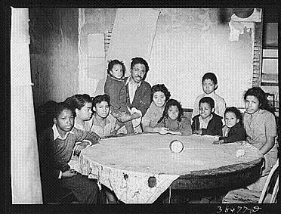
Why Your Archives Matter
Almost everyone has family archives
They tell the story of who we are
Future generations will have a record of where they
came from (answers questions: who, when, where and
sometimes why)
Family archives tell the story of our communities
Family treasures can become national treasures (Amelia
Boynton Robinson Collection)

Slide 3
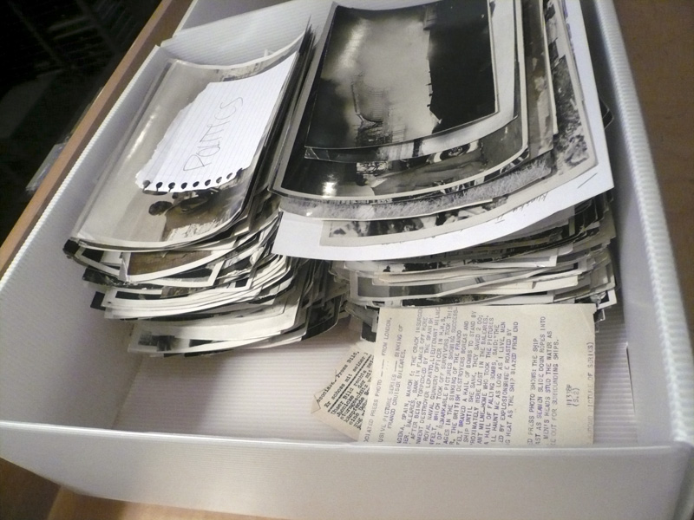
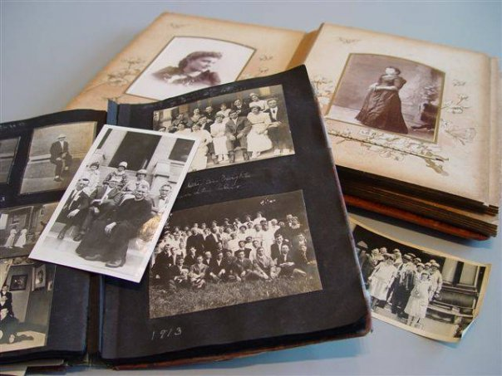
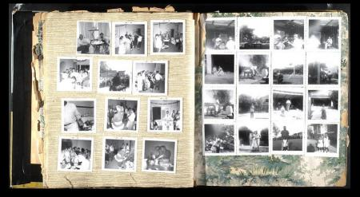
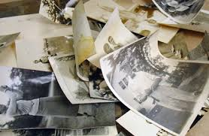

Slide 4
What are Family Archives?
May be sentimental, legal, financial
They serve as proof that an event occurred, or to explain how something happened
A physical collection of books, paper documents, photographs, etc.; or a place where collections are stored
Electronic records: email, web sites, databases, sound and images

Slide 5
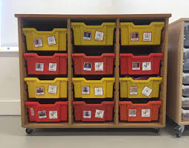
Organizing Family Archives
Identify: writers and receivers should be fully
labeled; separate notes are fine; include any
other relevant information
Organize: Avoid letting the collection get scattered or misidentified

Slide 6
Question
What do you have that represents your family archives that you plan to preserve?
Books, scrapbooks, diaries and pamphlets
Documents (letters, deeds, marriage certificates)
Newspapers and newspaper clippings
Photographs–prints, slides, negatives, film
Audio/Video –film, discs, cassettes, reel to reel

Slide 7
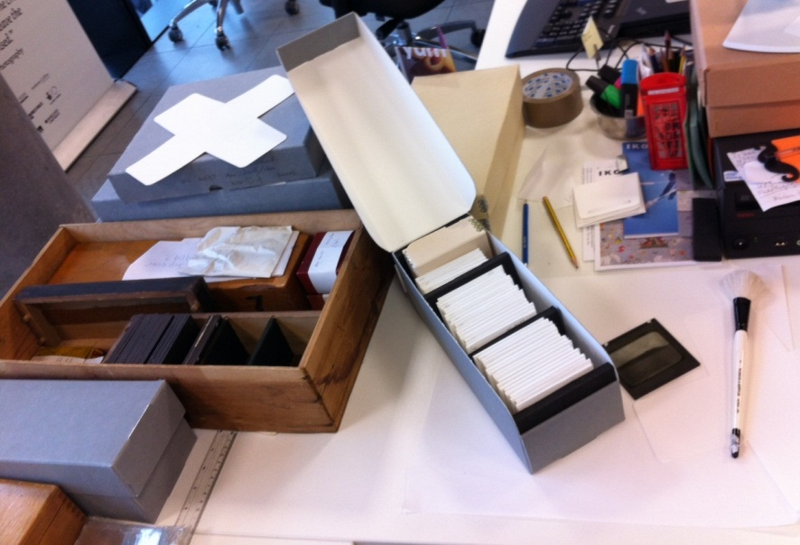
Major Ways to Protect Collections
Control the environment: temperature, humidity, light, dirt and dust
Use the right type of enclosures
Careful, limited handling
Use copies instead of originals
ALSO:
Protect Against Emergencies (multiple copies)

Slide 8
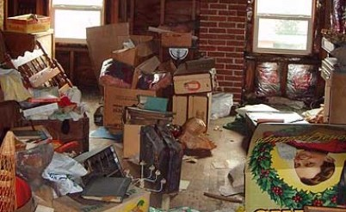
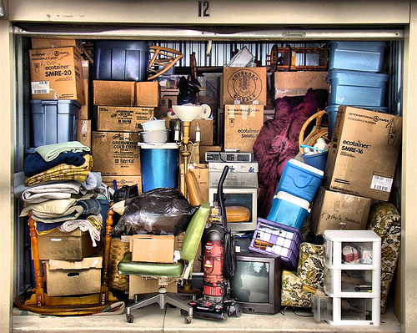
Questions
Where are your physical family archives currently stored?
In an attic
In a basement or garage
In the main part of a house or apartment
Offsite (U-storage vault, safety deposit box)
Other

Slide 9
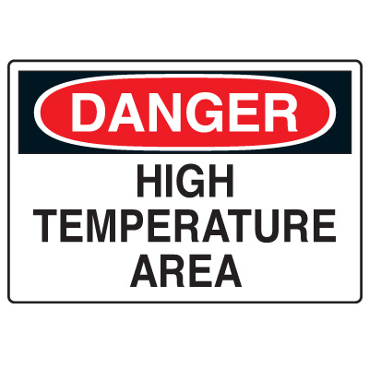
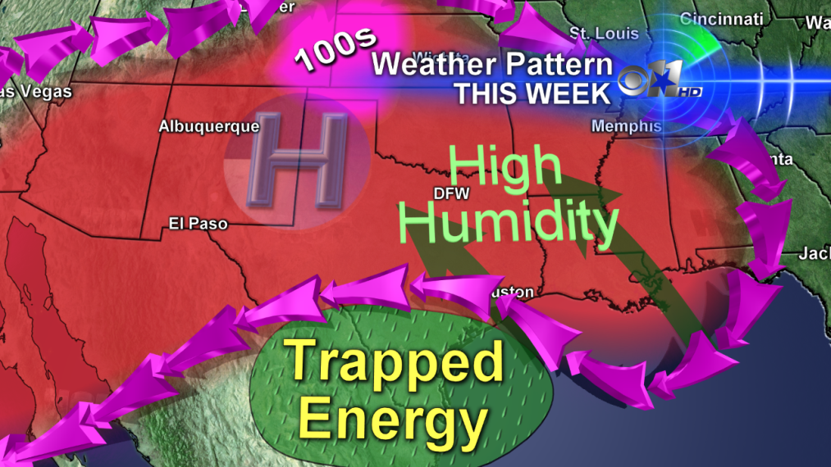
Environmental Risks –T & RH
Temperature: Too hot? For every 10 degrees rise in temperature the rate of deterioration/decay is doubled
Relative Humidity: Too high or too low
Avoid extremes, including rapid changes in T & RH
Ideal: Cool and dry (65-70 degrees Far.; 45 to 50% RH)

Slide 10
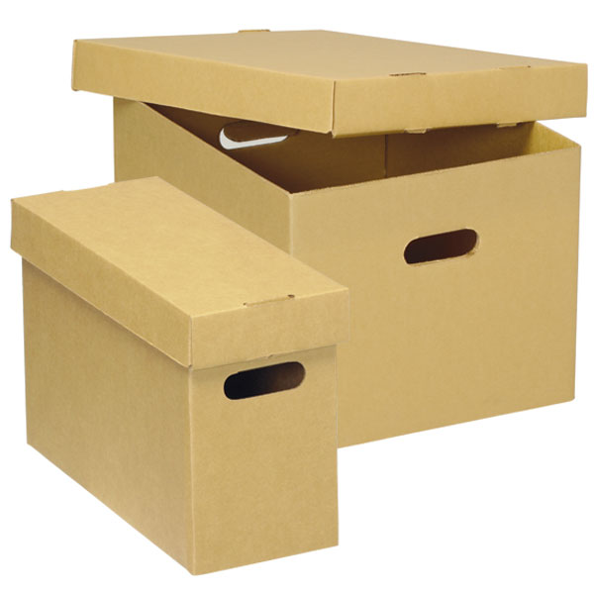
Low-Cost Solutions for Minimizing Damage from T & RH
Avoid basements and attics
Use enclosures to buffer sudden changes in T & RH
Store family archives in the central part of the home in boxes, drawers, closets, under beds where T & RH are more stable
Seal windows, cracks and crevices
Lower the temperature in your home during the winter months

Slide 11
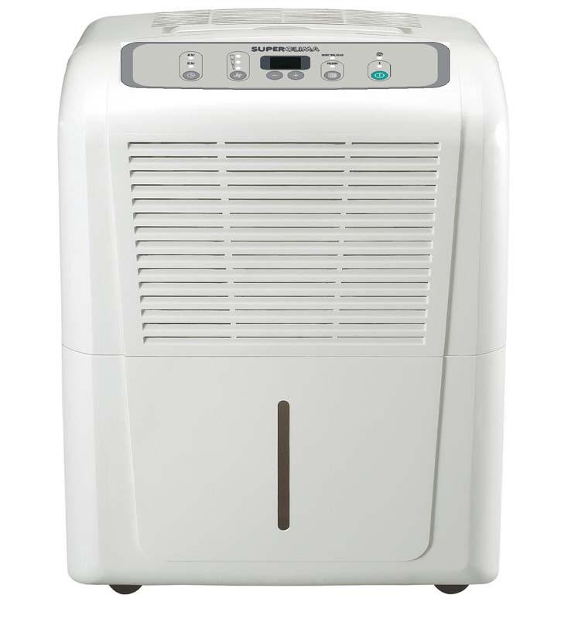
Low-Cost Solutions for Minimizing Damage from T & RH
Use of insulated curtains; blinds; window films to reduce radiant heating
Use a dehumidifier in damp areas
Use AC to control temperature and humidity in the summer months

Slide 12
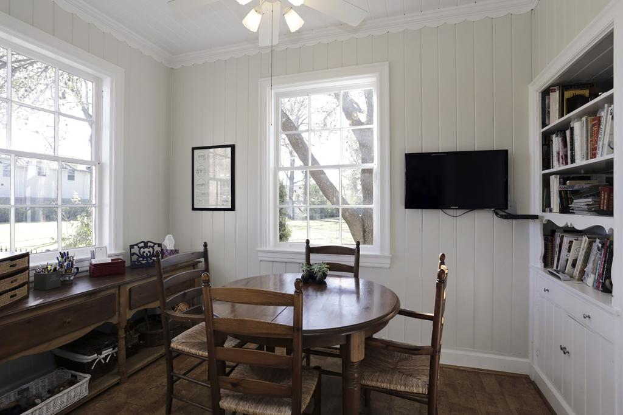
Environmental Risk -Light
All types of light cause damage
Two factors to consider: intensity and duration
Can be a source of heat/overheating
Damage includes fading, discoloration, and embrittlement
Damage is permanent and irreversible

Slide 13
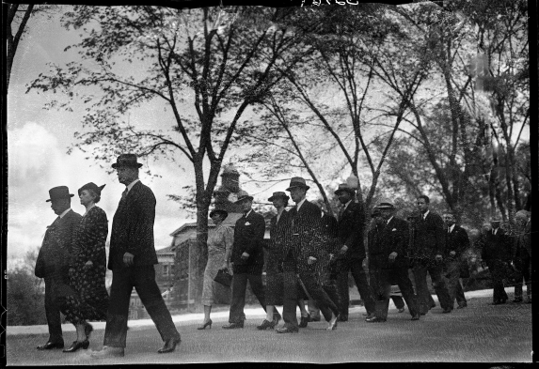
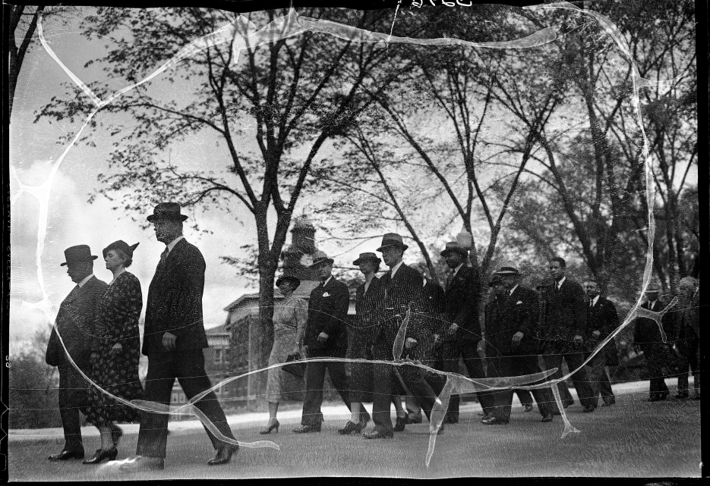
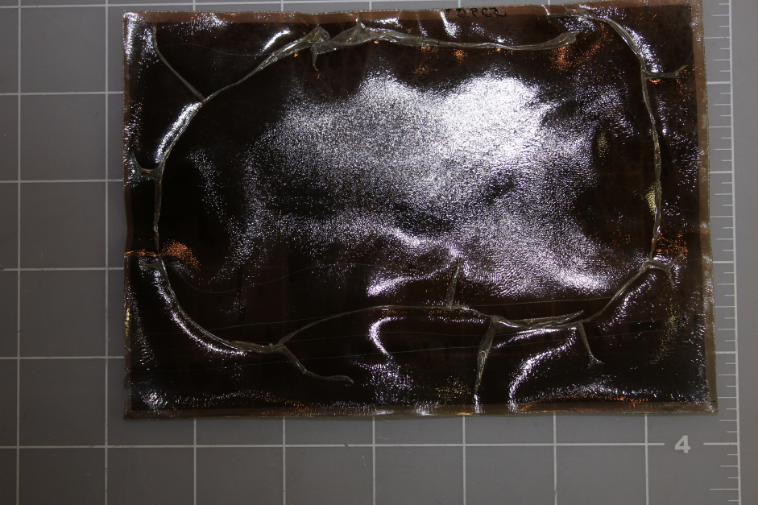
Let’s See What Happens:
Be careful:
a. Image may be unique
b. It may be severely
Damaged!
Must:
a. Digitize
b. Repair
c. Preserve
3. Outcome: Amazing

Slide 14
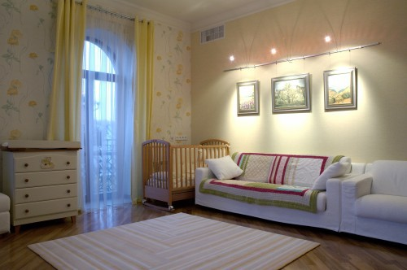
Low-Cost Solutions for Controlling Light Damage
Use curtains and blinds in a systematic way
Keep lights off when no one is around
Framed works should be away from direct sources of natural light
Avoid using fluorescent lighting in spaces where valuable items are displayed

Slide 15
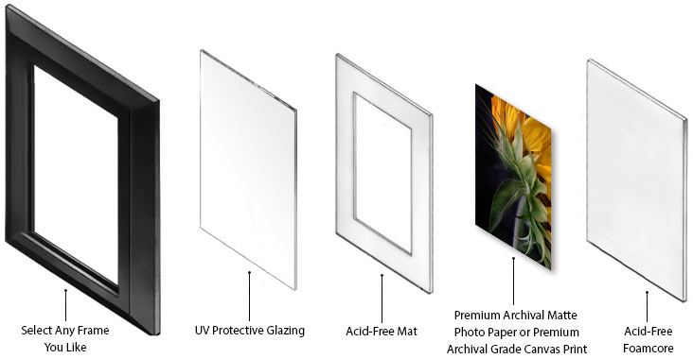
Suggestions
Display your artwork away from direct light to prevent fading.
Oils from your hands can create fingerprints that appear over time, so be careful when handling your work.
Use conservation tape with acid-free adhesive to mount your art to the mat.
Have display images and photographs professionally mounted and framed wiht Acid-Free Foamcore and UV Protective Glazing.

Slide 16
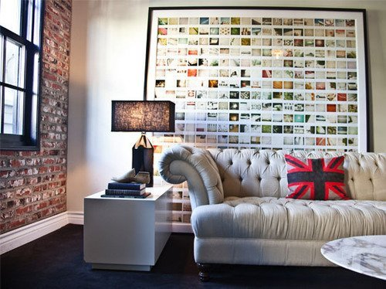
Further Low-Cost Solutions for Controlling Light Damage
Avoid the use of display lighting; use low wattage bulbs with dimmers
Don’t leave things on display “permanently” rotate
Display copies and store originals in the dark

Slide 17
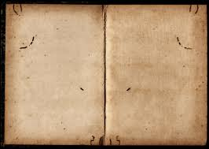
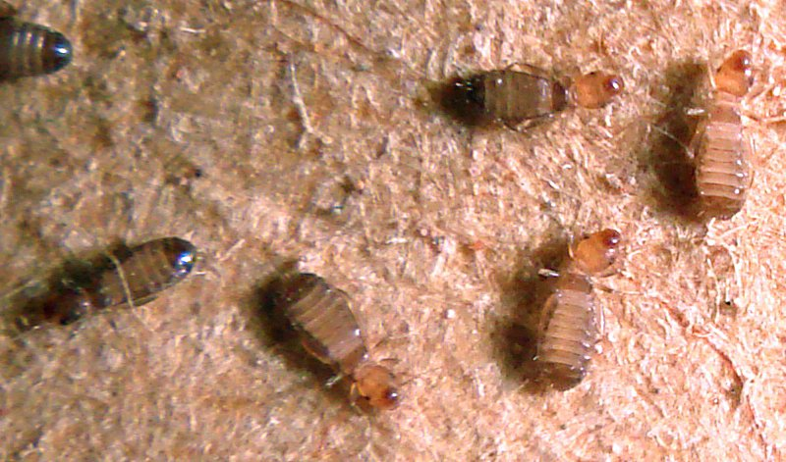
Environmental Risks: Dirt & Dust
Particulate debris can become embedded in paper objects, textiles, any surface that is rough or sticky
It can scratch
Often acidic; so if there’s moisture in the air the debris can solubilize –the result is localized deterioration
Dirt and dust can attract microscopic molds and insects (including book lice)

Slide 18
Low-Cost Solutions to Control Dust & Dirt
Regular housekeeping
Use enclosures
Air filters in your central heating/cooling system
Window screens

Slide 19
Characterize how your physical family archives are currently stored
Organized and properly stored in a few known locations
Sort of organized and stored pretty well
Not very organized, but you know where most of it is
It’s a mess and one day you hope to get it organized
In scrapbooks and albums or framed and on display

Slide 20
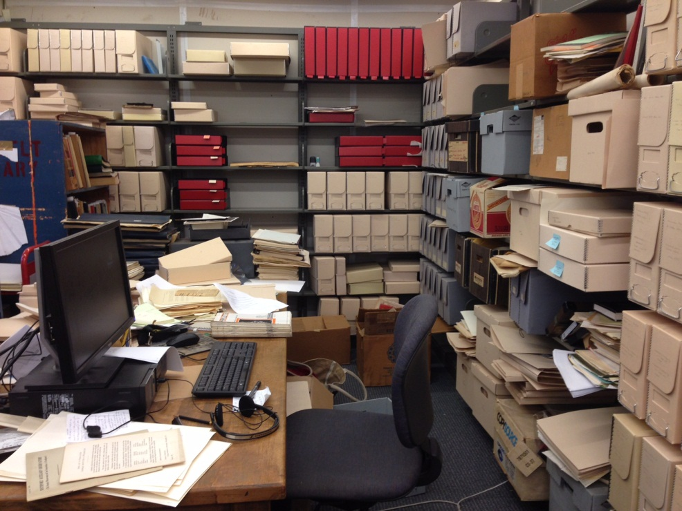
Tips on Use of Physical Collections
Never repair with pressure sensitive tapes or commercial adhesives
Segregate acidic items like newspaper clippings
No clips, pins or rubber bands
View your collection items with clean hands in an area that is clean and uncluttered

Slide 21
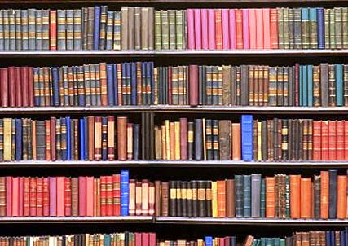
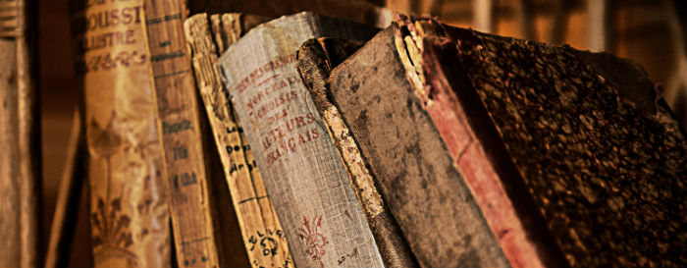
Caring for Books
Shelved upright, fully supported
Oversize books can be shelved spine down or flat
Don’t pull books out from the head cap
Store fragile books in fitted boxes
Don’t fold over corners, use Post-it notes, notate, or leave any extraneous material inside the pages
Don’t leave it open, face down, or stacked with others, face up

Slide 22
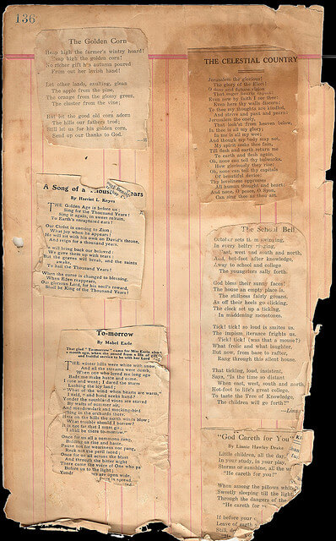
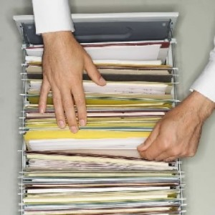
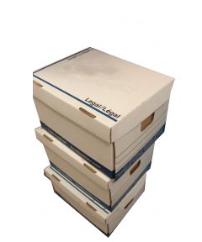
Storing Documents
File cabinets best quality folders; hanging files are best
Boxes –various sizes and designs depending on what you are storing; sturdy, chemically stable; no holes and snug lids
Acid-free, lignin-free and buffered paper, board and tissue
Polyester, polyethylene or polypropylene if using plastic
Use folders instead of envelopes so you avoid causing damage when getting things in and out

Slide 23
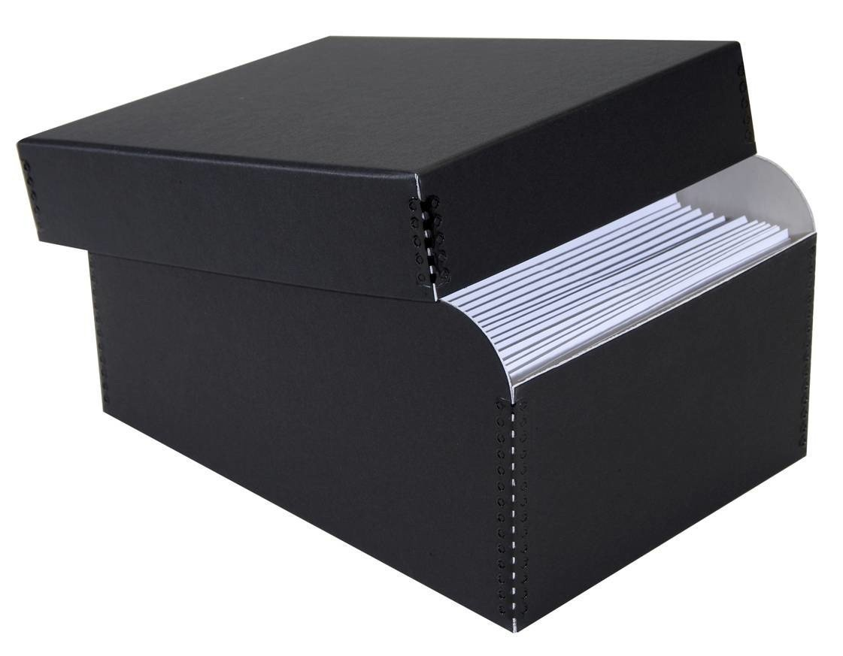
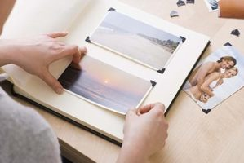
Storing Photographs
Best if enclosures have passed the Photographic Activity Test, P.A.T. (https://www.imagepermanenceinstitute.org/testing/pat)
Avoid plastic sleeves if storing in areas where humidity runs high
When storing photographs in an album use mounting
corners; albums should be constructed with good quality
paper and/or stable plastic pages (no self-adhesive albums or scrapbook pages)

Slide 24
Storing Photographs
Preserve albums intact whenever possible and store them in boxes
Store cased photographs in their original cases
Segregate anything that smells funny (possible sign of deterioration); if you have broken glass plates store each piece wrapped separately
Multiple copies. Store originals and show copies.

Slide 25
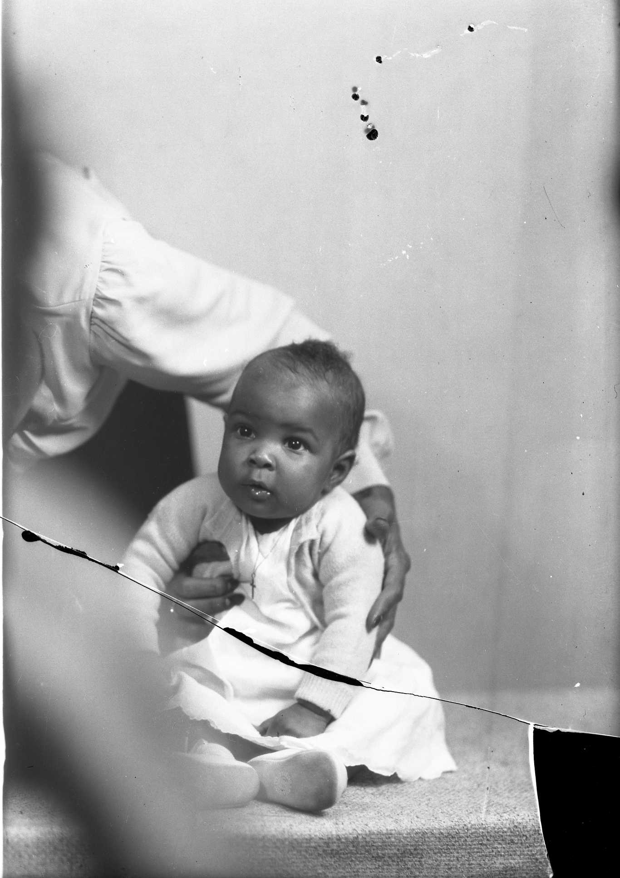
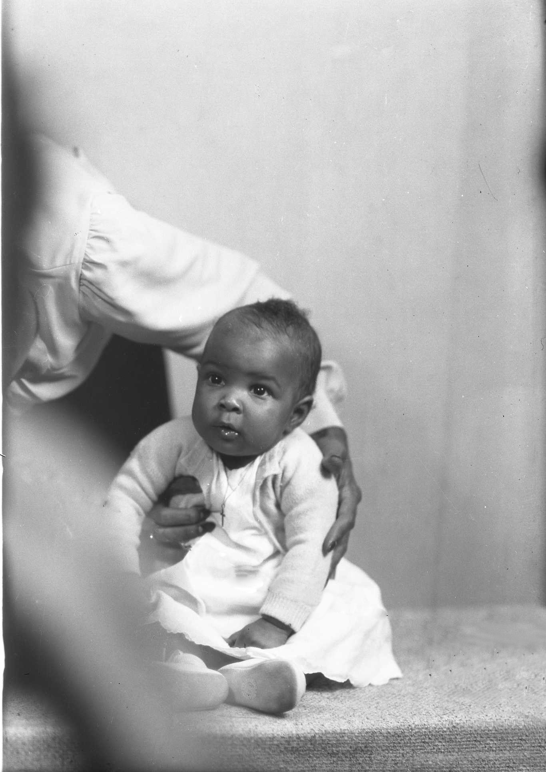
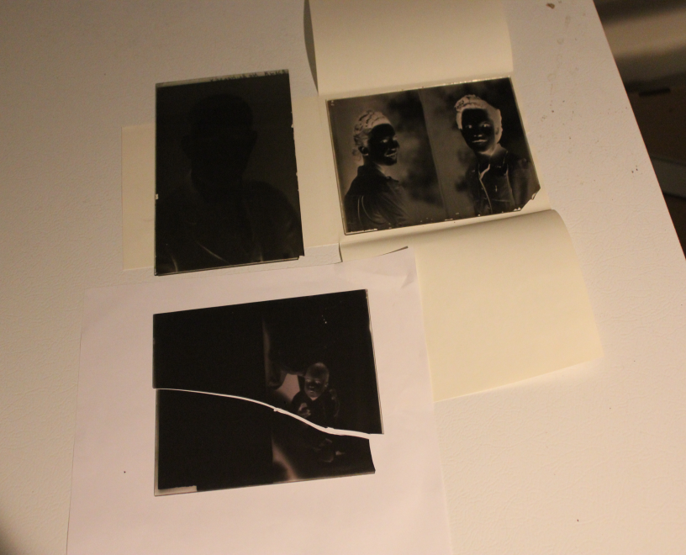
Problems Are Many:
Because we are primarily concerned with
digitization of our photographs at TU
Archives, I will use them as my
Examples.
Damaged photos and negatives:
Objective: Importance of Image
a. Determine format
b. What needs to be done?
c. Using right resources

Slide 26
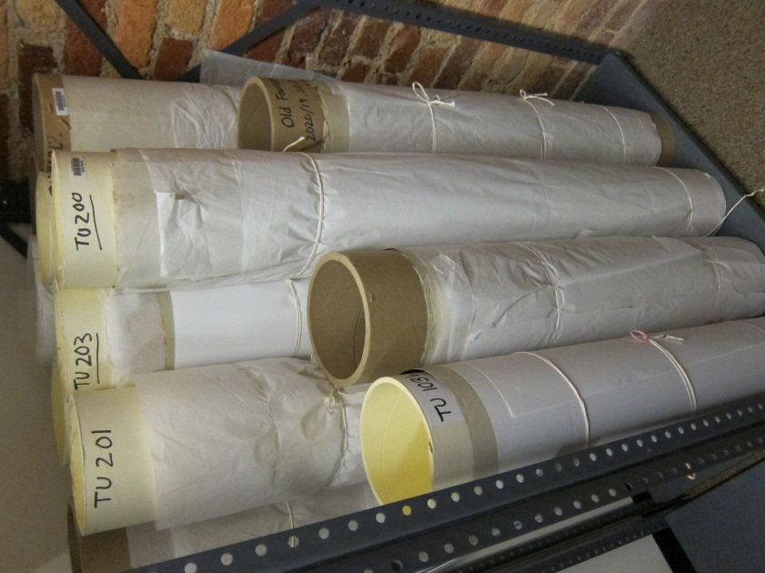
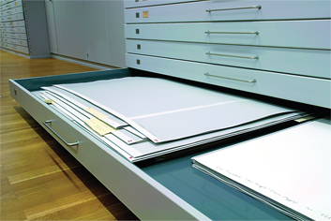
Oversize Collections
Store flat whenever possible, not rolled or folded
Refold newspapers along the original center fold with the edges aligned
Stack newspapers inside fitted boxes in chronological order
If you roll something roll it around a tube, secure it in place by wrapping with tissue and tying with cotton tying tape, then place into a larger diameter tube capped at both ends

Slide 27
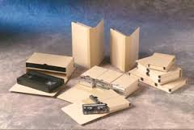
Audio Visual Stuff
Handle grooved and optical discs by the edges or center hole only
Handle open reel and magnetic tape by the edges or outer shell only; do not touch the spools
Handle film only by the edge
Store all formats upright
Keep playback equipment clean and well maintained
If it’s badly deteriorating consult a specialist and copy to new media

Slide 28
Display of Family Archives
Interior rooms are more stable than those with outside walls
Don’t store or display your family archives above or immediately adjacent to heat vents, radiators and fireplaces
Don’t hang framed works of any value on outside walls; use spacers between the frame and the wall
Make a copy and put this out for viewing; store the original

Slide 29
Prepare for Emergencies
Protect your rights, secure your health, document your financial assets
Legal records
Historically important records
Make duplicates and store in a safe place outside your home
“Grab and Go” packs
Preventing damage to originals

Slide 30
If There Is An Emergency: Salvage
Safety first!
Prevent mold –48 hours
Air dry
Clean gently
Focus on what’s important to you if you can’t save everything
Freeze and thaw/air dry later
Conservation services when you need help
If you need help, call us!

Slide 31
Selected Resources
Library of Congress leaflets, Collections Care: http://www.loc.gov/preservation/care/
Heritage Emergency National Task Force: http://www.heritagepreservation.org/programs/taskfer.htm
American Institute for Conservation, Guides for Taking Care of Your Personal Heritage: http://www.conservation-us.org/about-conservation/caring-for-your-treasures#.UyC_bIXLKLw
Quick Preservation Tips for Military Families: http://www.ala.org/alcts/sites/ala.org.alcts/files/content/confevents/preswk/pdfs/QTmilitary13.pdf
Quick Preservation Tips –Take the First Step: http://www.ala.org/alcts/sites/ala.org.alcts/files/content/confevents/preswk/pdfs/QTgeneral13.pdf

