Slide 1
Tuskegee Students Fight the Good Fight: Important Collections Within the TU Archives
Dana R. Chandler
Tuskegee University Archives
50th Anniversary Lecture Series
Alabama State University
Tuesday, April 28, 2015

Slide 2
Long History
Tuskegee University students have a long history of participating in the Civil Rights Movements
Civil Rights Movements?
Actually, The American Civil Rights Movement consisted of several movements which were not constant, but were a series of starts and stops, some successful, some not.
During these periods, many African‐Americans began to take a variety of actions to do away with segregation, legal discrimination, and political disfranchisement.
Some such movements came before the 1960s

Slide 3
Other Movements
Tuskegee also played an important role in earlier phases of the struggle which include such organizations as the National Committee to Abolish the Poll Tax (1940-1948), an organization that sought, through grass-roots efforts, to repeal the national, as well as state poll taxes.
Almost successful, passed the House of Representatives in 1943, but not the Senate.
These materials, within the archives, are representative of the work done by students to alleviate segregation and “Jim Crow Laws”

Slide 4
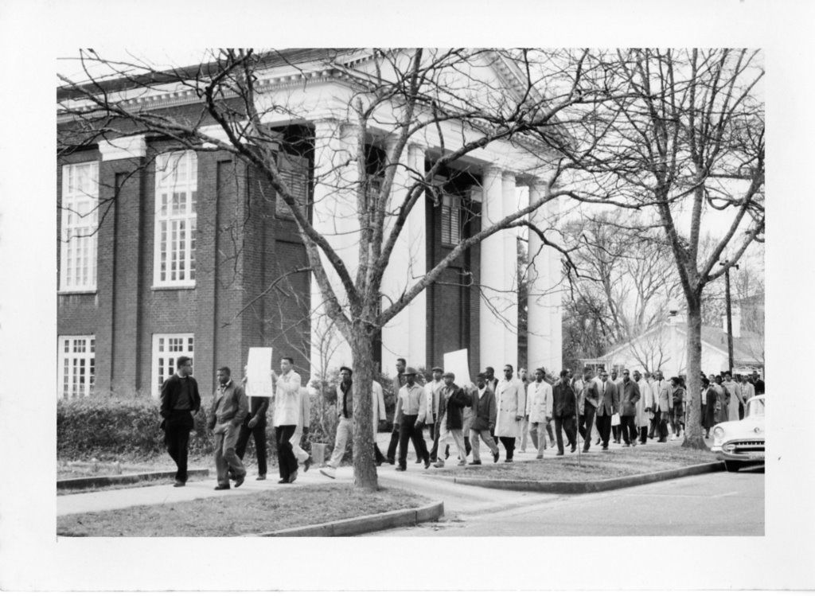

Slide 5
Other Collections
Eric Krystall - worked in the anti-apartheid movement in his native South Africa during the 1950s, and then in the Civil Rights Movement of the 1960s in the United States.
Tuskegee Civic Association (TCA) – Formed in 1941, the Tuskegee Civic Association grew out of a group of men who had been meeting since 1910 as The Men's Meeting and, later, The Tuskegee Men's Club. In 1957 worked to fight against Gerrymandering of the city limits of Tusekgee.
Charles Gomillion – President of the TCA and chief protagonist in the1961 Supreme Court Case, Gomillion vs. Lightfoot. In Gomillion v. Lightfoot, the U.S. Supreme Court ruled that such redistricting had violated the 15th Amendment rights of Tuskegee's African Americans.

Slide 6
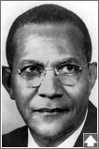
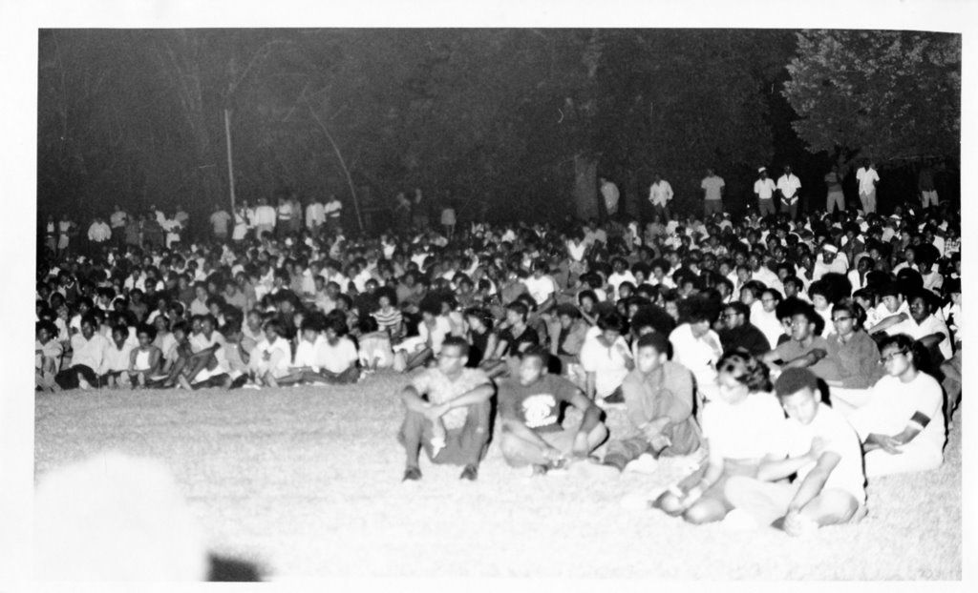
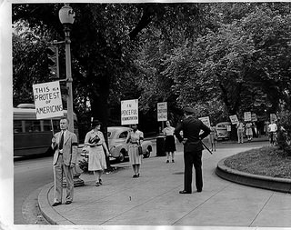
Photo Collections

Slide 7
Famous Tuskegeeans
Gwen Patton – President of the Tuskegee SGA
Amelia Boynton Robinson – Iconic Figure, Selma March
Fred Gray – Civil Rights Attorney
Rosa Parks – Born in Tuskegee
President Luther H. Foster – Under his leadership, faculty and staff were not discouraged to be involved in the Civil Rights related activities.
Used the Dr. Martin Luther King Model of non-violent protest!

Slide 8
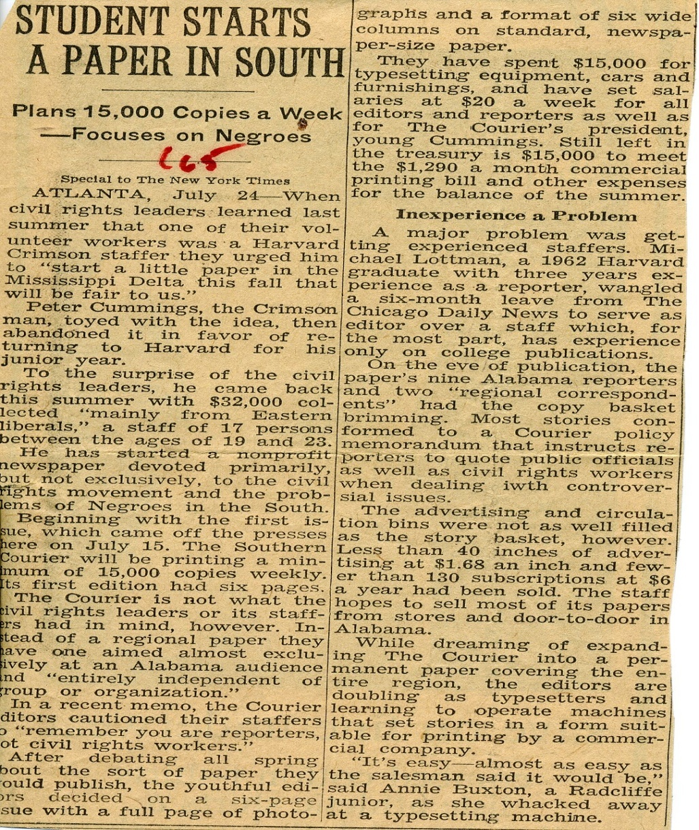
Papers of the Southern Courier
In April, 2006, journalists who had worked
on the Courier gathered in Montgomery,
Alabama, for a reunion.
Where are the papers…?
Within the archives.
What do they reveal?
Based in Montgomery, Alabama
Civil Rights Movement from July 1965 to December 1968
Originally planned as a regional, non-profit, independent paper (founded by staff from the Harvard University Crimson)
Its young staffers (which ranged in age from 19 to 23) narrowed their efforts toward an almost exclusive Alabama audience.

Slide 9
“…forced to go out and warmly and charmingly steal.”
Used $32,000.00 startup funds received primarily from “Eastern liberals”
Eventually received grants from a variety of corporations and endowments, which aided with operating expenses
Austere measures, during the entire time of publication, meant that staff members relied on “help from home” and often doubled as typesetters and printers.
Student from Tuskegee named Meg wrote…

Slide 10
“We are tired... and scared” Tuskegee Student
Many letters pointing out the difficulties and dangers the reporters and delivery people faced
Some had to face “mad dogs”
Some were beaten, sometimes badly
Many times they were ridiculed, cursed and spit upon
Some were threatened with death

Slide 11
Not Everyone Can Respond…
“Each week I am anxiously awaiting…
Please don’t think that people are not proud… because they do not respond.
We want to know about our people…
We want to know what is going on…
With the Courier, we can, for the first time, know…”

Slide 12
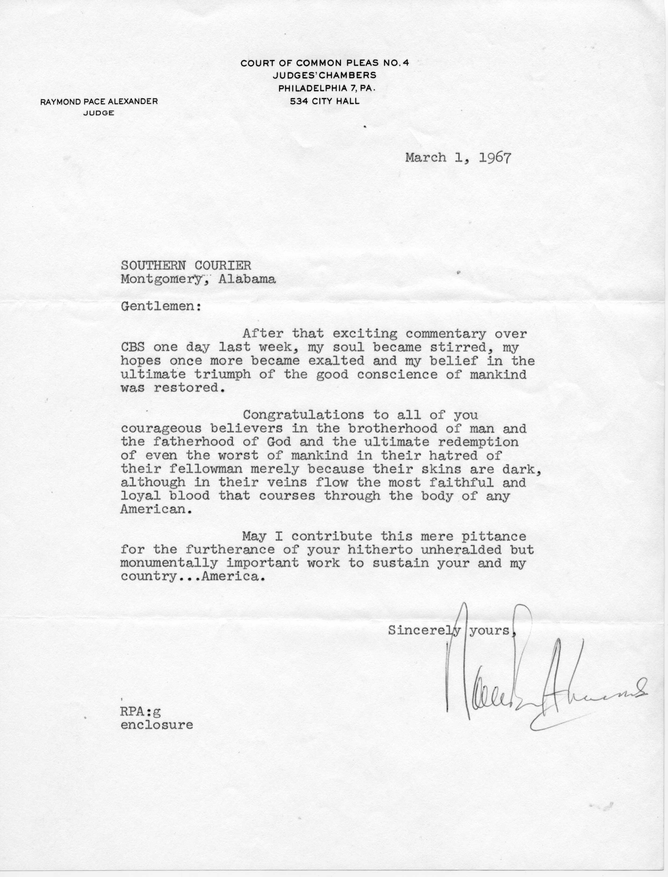
My Soul Became Stirred….
Letter Addressed to the Courier
“…my hopes once more became exalted and my belief in the ultimate triumph of the good conscience of mankind was restored.”

Slide 13
The Courier Affects Alabamians…
“I was stunned…
…minimal effect on Washington
…minimal effect on Alabama Statehouse
One of the best %$#$%# things that ever happened to Alabama and you can be proud that you did something worthwhile…
I wish I could say the same.”

Slide 14
The Southern Courier
After three tumultuous years, The Southern Courier came to an end in December of 1968 due to funding shortfalls.
Many of the staff had continued to work, until the last paper was printed, with little or no financial assistance.
The paper’s influence led to many localized newsletters, thereby assisting in a grass roots campaign for racial equality.
The materials remain in the TU archives

Slide 15
Tuskegee University Archives
We seek, not to follow, but to lead and, like our first President, Booker T. Washington, to provide our students with the best tools to compete in any situation, during any time and in any country.

