Slide 1
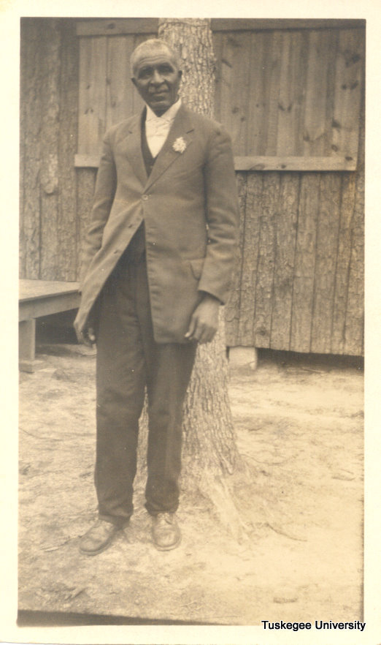
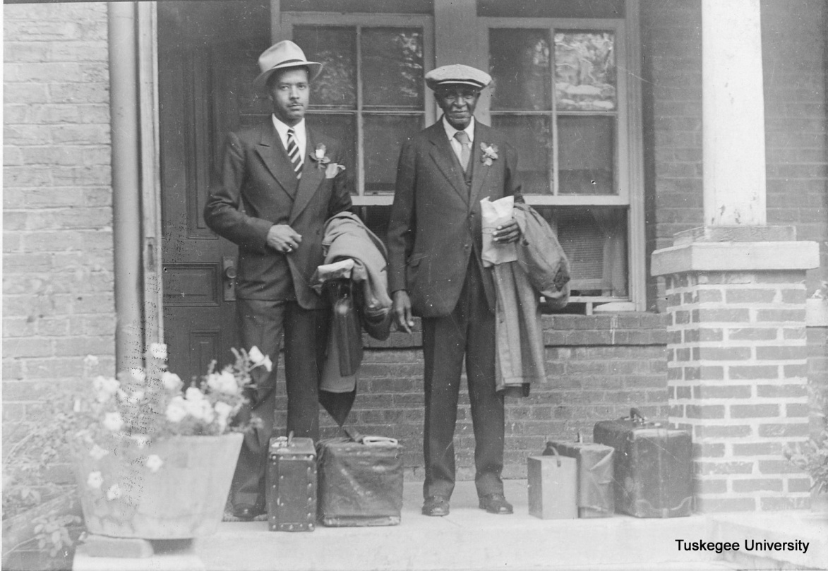
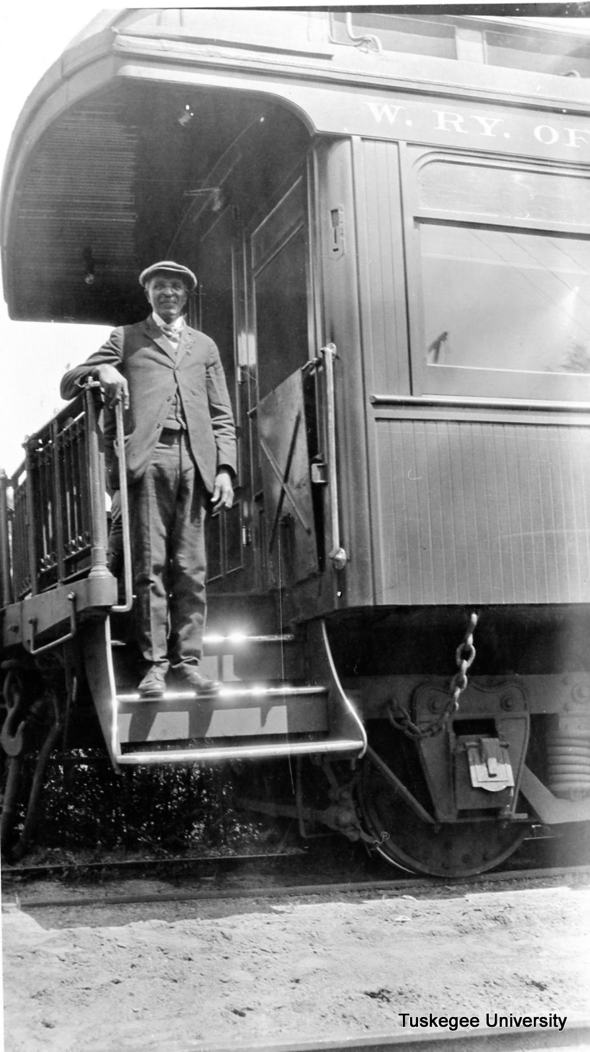
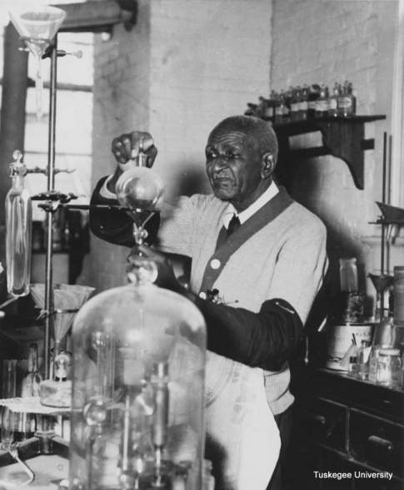
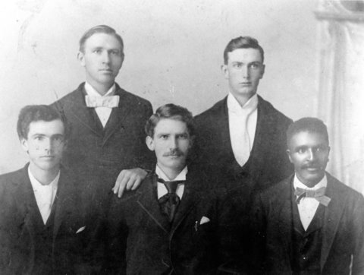
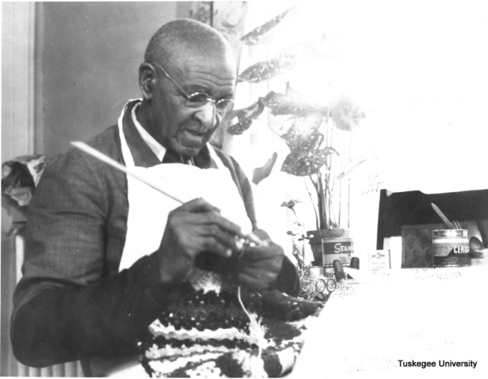
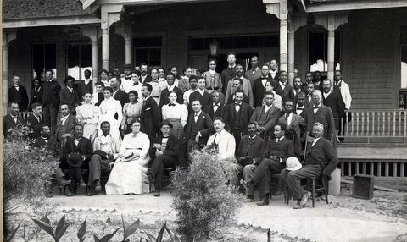

Slide 2
GWC: Exploring the Myths and Clarifying Some Criticisms Presented for Black History Month Program, Florida A&M University, Tallahassee, Florida By: Dana R. Chandler, TU Archivist February 28, 2014
Tuskegee University Archives

Slide 3
Carver the Myth
Beginning in the 1970s, revisionist historians have castigated Carver for, what they claim, his ascension to fame based on an exaggerated or fictional version of his accomplishments.
Likewise, detractors and supporters alike have pointed to a lack of “scientific” formula and experimentation that could verify the claims of his brilliance and methods.

Slide 4
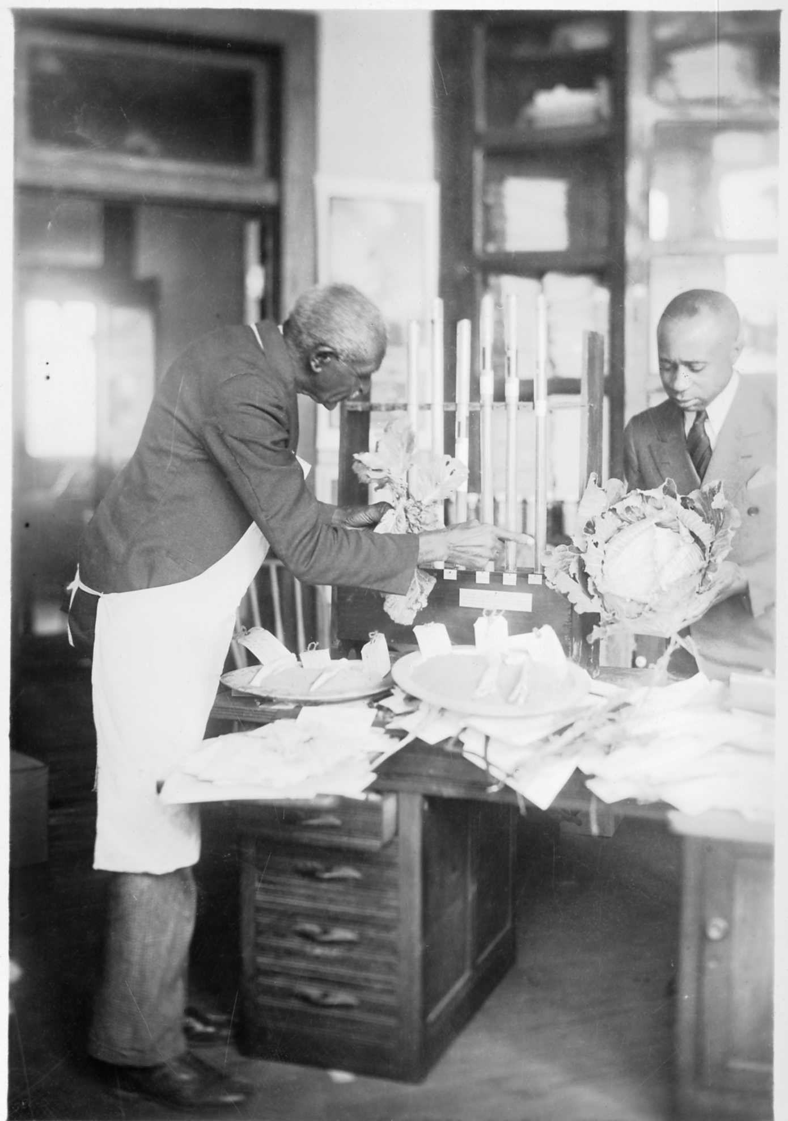
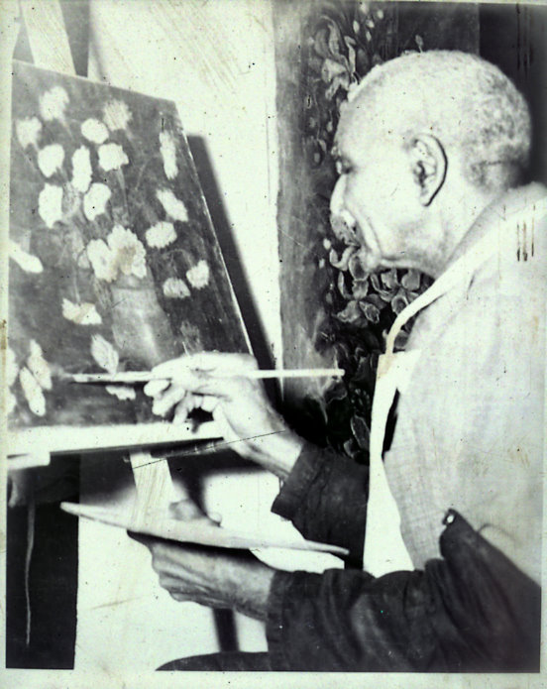
Interpreting History

Slide 5
Revisionist History
Historical revisionism is the reexamination of the accepted "facts" and interpretations of history, with an eye towards updating it with newly discovered, more accurate, and less biased information.
Broadly, it is a skeptical approach, that history as it has been traditionally told may not be entirely accurate, and that perhaps an accurate history is as unobtainable as a dispassionate autobiography.

Slide 6
But!
While reinterpreting past events in light of new facts is the essence of good scholarship, corrupt history may distort these facts as a means of influencing readers' beliefs and actions for politically or socially motivated reasons.
Revisionist history sometimes is also used to promote or slander persons, or promote or discredit an idea. This usually backfires as often as it succeeds.

Slide 7
Bias
The key is recognizing historical bias and interpreting the information through the bias.
My colleagues have done a great job within their respected works.
But there are still questions to answer (granted, for some of questions we will never have an answer)

Slide 8
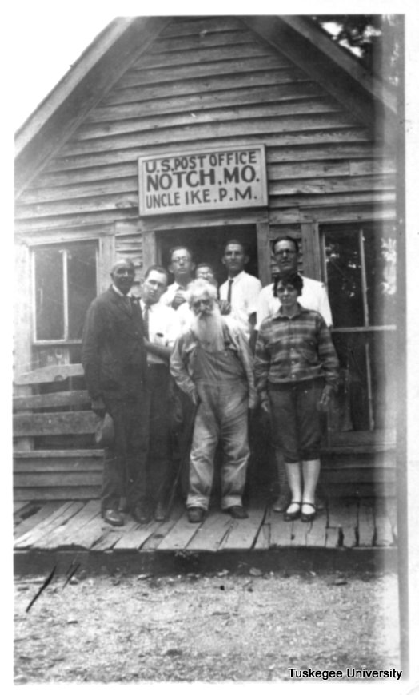
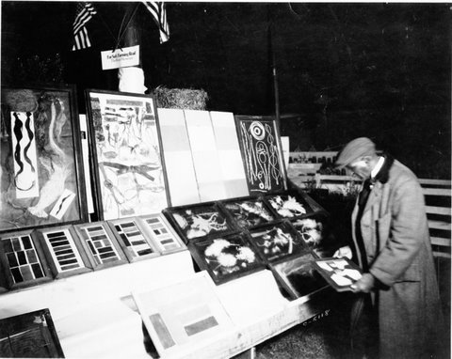
Historical Perspective of Carver

Slide 9
Biographer Linda McMurry:
“The romance of his life story and the eccentricities of his personality led to his metamorphosis into a kind of folk saint both in his lifetime and after. “
“Separating the real George Washington Carver from the symbolic portrayals of his life is difficult. Reality and mythology became blurred even within Carver’s own mind, and his life did have mythic qualities. “

Slide 10
Barry MacKintosh, Historian With the National Park Service
“George Washington Carver…became a legend in his own lifetime, with a popular reputation far transcending the significance of his accomplishments.”
“His agricultural education and extension work at Tuskegee Institute …was praiseworthy but unspectacular in nature and impact. “
“The uses for soils and plants he developed or advocated were not of pioneering importance in science...”
“…his legendary reputation depended less on these supposed achievements than on his psychological and social utility to both whites and blacks.”

Slide 11
As for Carver’s humility and intentions, he did not want to wear the title of Dr.
Carver had three honorary degrees:
Simpson College -1928
Rochester College -1941
Selma University -1942

Slide 12
Elmer Keihl, et.al., University of Missouri
“Dr. Carver appears now to have been an intelligent and gifted individual with great perseverance and varied interests even in scientific fields. Due to the circumstances under which he first went to Tuskegee Institute he was unable to follow any one interest to completion. He did not make any great scientific discoveries nor did he further scientific knowledge to any great extent.”
He did say: “Based on available information, Dr. Carver’s products were not the result of new ideas or procedures.”

Slide 13
Biographer Rackham Holt
The only major Carver biography with a claim to objectivity, Rackham Holt's George Washington Carver, appeared the year of its subject's death. Holt recognized Carver's products as "not revolutionary in themselves" and saw his major contribution as that of a publicist. Yet the romantic tone of her book did little to counter his established image.

Slide 14
Blogger Chris Pearson
George Washington Carver was not a saint whose soulful nobility enabled him to overcome insurmountable obstacles in order to fulfill his altruistic mission of saving the agrarian South. Instead, he was a smart, determined man who had no objection to exaggerating and aggrandizing his real successes to enjoy the perks and honors of fame.
The mystery then becomes how and why the apotheosis of Carver from exceptional human being to the personification of humane science took place – and, perhaps more perplexingly, why that immaculate image of George Washington Carver persists to this day despite easily accessed, well documented evidence to the contrary.

Slide 15
Some compile the biographies of Carver and reach other conclusions.
Granted, there were some that went too far the other way…

Slide 16
Carver the Legend!
In 1946 popular biographer Hermann Hagedorn held “Carver single-handedly responsible for the tariff on peanuts as a result of his showmanship before the congressional committee and largely responsible for freeing the South from dependence on cotton.” His overall assessment of Carver was a breathtaking combination of scientist and saint.
Two other serious works treating Carver appeared during the postwar period. In Titans of the Soil, issued in 1949 by the University of North Carolina Press, Edward Jerome Dies “attributed to Carver's discoveries the establishment of major business enterprises.”
Even though Carver’s laboratory records were unknown, Langston Hughes wrote with unintentional irony in Famous American Negroes, "From Carver's small laboratory at Tuskegee came formulas in agricultural chemistry that enriched the entire Southland, indeed the whole of America and the world."
The last and perhaps most extensive mass circulation of the Carver myth came with the condensation of Lawrence Elliott's George Washington Carver: The Man Who Overcame in the May 1965 Reader's Digest. Elliott's book had Carver, in conjunction with the boll weevil, responsible for making peanuts the principal crop in much of Alabama prior to the First World War, then for developing "well over 300" peanut products manufactured in "scores of factories." “The South's economic salvation was due to Carver alone.”

Slide 17
An honest examination of the information is in order.

Slide 18
If history is a continuing dialogue between the past and present…
Then we must take into consideration both sides of the story.

Slide 19
The arguments…
“Since Carver left no formulas or other records of his processes beyond one patent (sic) for a cosmetic utilizing peanuts, it was impossible for later investigators to evaluate most of the peanut products attributed to him or to document his production of them.”
“Because the great majority of products on Carver's list could be made more easily and cheaply from other substances, they were of little more than curiosity value.”

Slide 20
Many Adhere to this Notion…
“Three patents (one for cosmetics, and two for paints and stains) were issued to George Washington Carver in the years 1925 to 1927; like the other products, these were never, however, commercially successful. Aside from these patents and some recipes for food, he left no formulas or procedures for making his products. He did not keep a laboratory notebook.”

Slide 21
So, with all of the information above, we have this assessment of Carver:
“Since his personal attributes alone were insufficient to support claims of greatness, his laboratory work was revised and extended to a level of wizardry, to be joined by his exploits in saving the Southern economy”

Slide 22
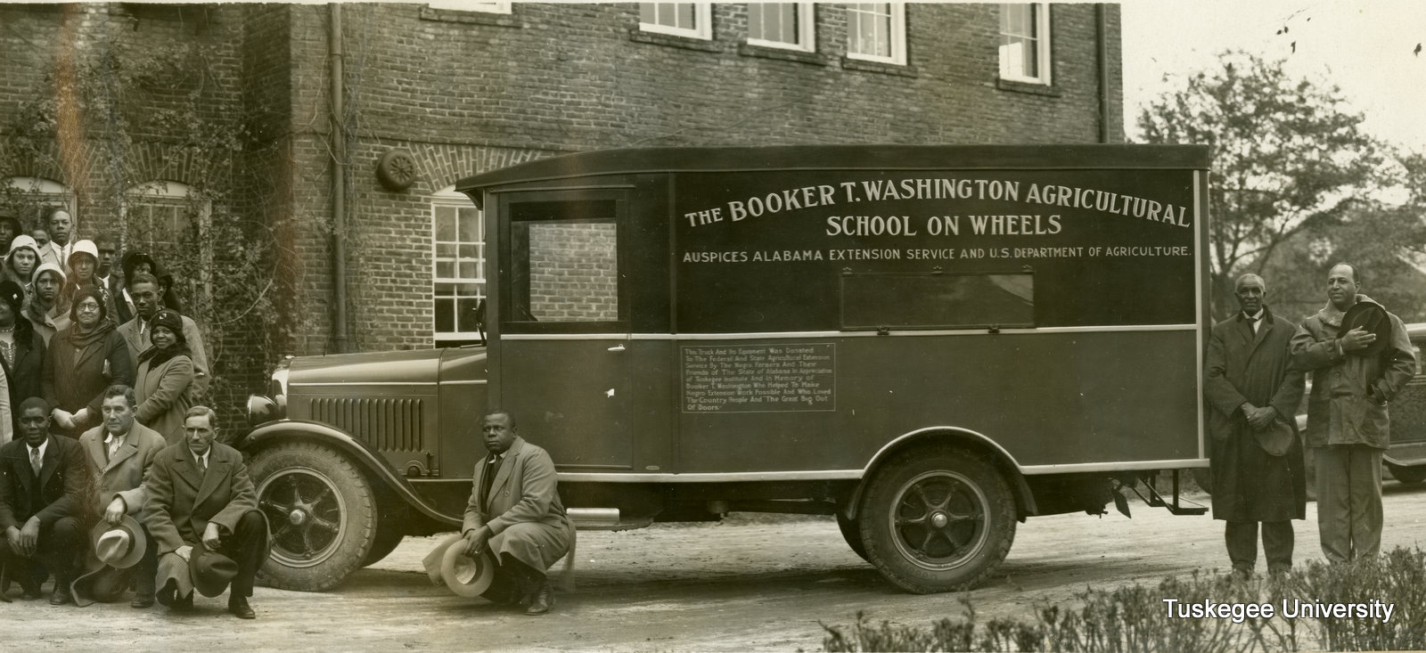
So, how do we respond?

Slide 23
Interpreting information
First of all, just because no information regarding his experiments was found, it does not mean it did not exist.
Sometimes, information is given based on the question asked. This can mean that some things are emphasized, while others are not.
Just because one piece of information seems to contradict another, it does not mean that they are mutually exclusive.

Slide 24
Examples
The Tuskegee University Archives has four different autobiographies (including one oral history interview that was transcribed by W. A. Liston and Etta M. Rudd).
a. One mentions only Carver and his
brother Jim.
b. One mentions that he had a brother Jim
and two sisters (twins?) that died.
c. One mentions that he had a brother Jim
and another sister (Melissa?) that was carried
off with him and his mother.
Which version is correct? Can we discount one for the other?
Maybe all are correct and it just depends on his memory of the time and the questions asked of him.

Slide 25
Big Part of the problem… a lack of Definitive evidence!
Sometimes we need to extrapolate.

Slide 26
Obtaining a Patent
Carver’s three patents had to meet certain requirements
The U.S. Patent Act’s general requirements for a utility patent state:
“Whoever invents or discovers any new and useful process, machine, manufacture, or composition of matter, or any new and useful improvements thereof, may obtain a patent, subject to the conditions and requirements of this title.”
In other words, for an invention to be patentable it must:
be statutory,
be new
be useful
be non-obvious.

Slide 27
Big Part of the problem… a lack of Definitive evidence!
Sometimes the evidence needs to be found!

Slide 28
Lack of evidence does not mean that there was not any!
During Elmer Ellis’ visit to Tuskegee (1961), he and his companions sought out information about Carver’s experiments
Contacted B.D. Mayberry, James Henderson, Clarence Mason and Jessie Guzman. All basically said that they had very little information
What they did not know, that we now know:
Elaine Thomas, then Director of the Carver Museum, was not available to be interviewed, therefore they could not see the materials that she had.
Elmer Keihl, et.al. “The Scientific Contributions of George Washington Carver” (Washington: National Park Service, 1961), 28. This document was never released to the general public, although many copies exist throughout the nation.

Slide 29
What Elaine Had: The Findings
Information that dispels claims that he was not a good scientist
Found seven notebooks (one notebook has been damaged by fire, found in building to be renovated) containing Carver’s experiments, drawings and observations.

Slide 30
The Notebooks

Slide 31
Inside the notebooks:
Beautiful Drawings
Formulas and Discoveries

Slide 32
What the notebooks reveal…
Notebooks are filled with Carver’s experiments revealing his environmental sensitivity.
He spent many hours working with the Amaryllis, trying to “better the varieties.” (Some of his hybrids may be popular today).
Many pages are dedicated to water purity and usage
Sought how to reuse plant matter in a variety of ways beyond cooking, such as for paint and better feed.
Some experiments aided him in preparing his bulletins.

Slide 33
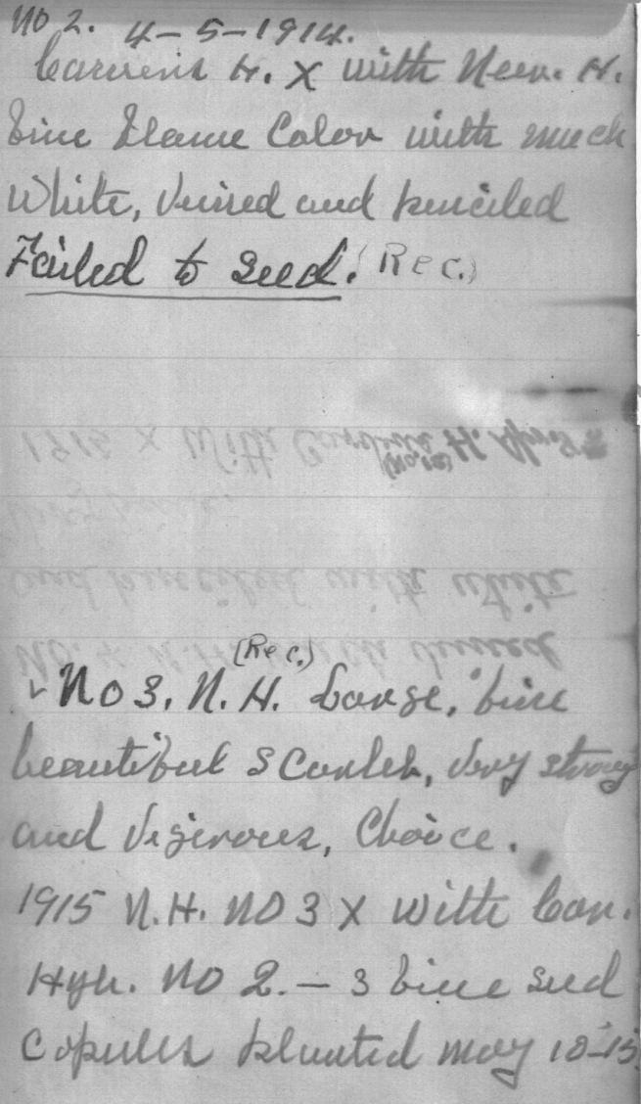
Notebook Found in Building to be Renovated

Slide 34
So, why have they been hidden?
“One reason I never patent my products is that if I did it would take so much time I would get nothing else done. But, mainly I don’t want my discoveries to benefit specific favored persons.”

Slide 35
What caught our eye…
In Bulletin No. 35, published in 1925, entitled “How to Grow the Cow Pea, and Forty Ways of Preparing it as a Table Delicacy,” Carver made an interesting statement :
He begins the article by stating that the cow pea “stands out prominently…”
Agreed, the phrase “green-manuring,” no doubt means the cow pea could be used as a cover crop grown primarily to replenish the soil with useful nutrients
But, in this bulletin, he lists 11 reasons for growing the cow pea that go beyond its primary use as a food source or ground cover.
He was looking for a way to use the cow pea to help man, beast and earth in a natural and safe way.

Slide 36
Carver’s use and reuse method
In Bulletin No. 41, published in 1936, entitled “Can Live Stock Be Raised Profitably in Alabama?,” Carver wrote…
Interestingly, he starts out with the cow pea as an essential food source for livestock whose manure fertilizes the same!
Carver’s participation in reusing, recycling and utilizing “earth-friendly” measures was more than helping people to succeed economically, it was part of his world-view!

Slide 37
He was concerned with what we did with “God’s Creation”
“I believe the Great Creator has put oil and ores on this earth to give us a breathing spell. As we exhaust them, we must be prepared to fall back on our farms… For we can learn to synthesize materials for every human need from the things that we grow.” ^{[7]}
Because of his awareness of the finite quantity of natural resources, he sought to reuse those materials to continue to aid mankind.

Slide 38
Going Green and Crop Rotation
“Crop rotation” has become an important phrase in the green movement, especially regarding organic farming ^{[9]}
Forage and grain legumes, especially clover, must be used in organic crop rotations as a soil fertility increasing component ^{[10]}
Carver was well aware of this at least a century ago

Slide 39
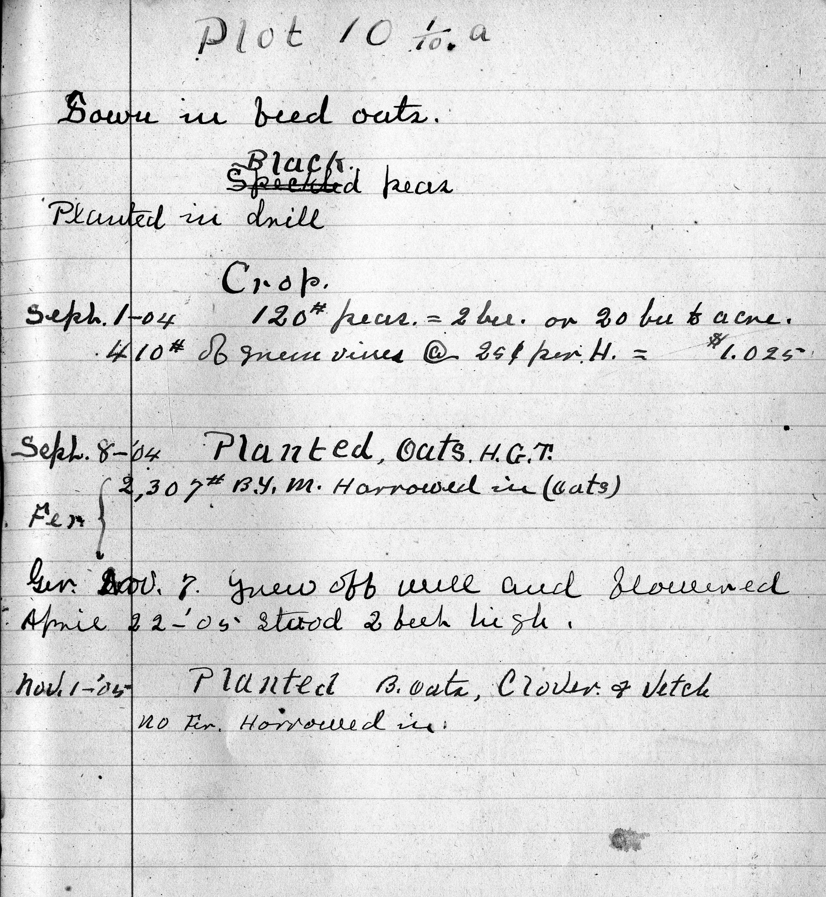
Plot Rotation

Slide 40
Plot Rotation Plan

Slide 41
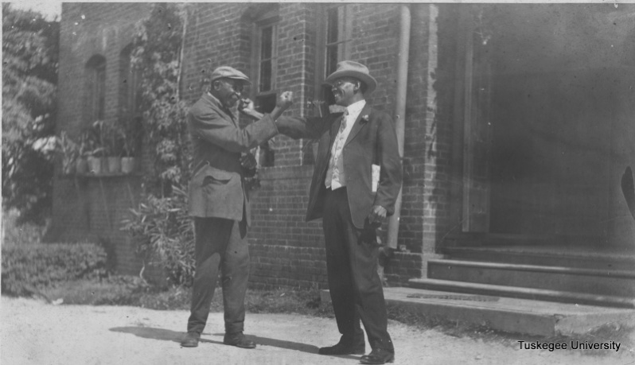
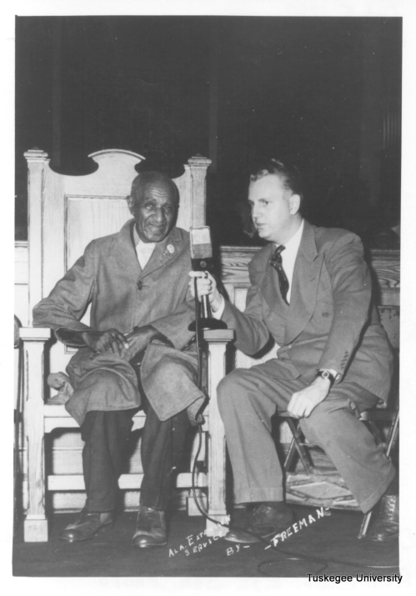
Carver worked to develop paints and stains from natural products.

Slide 42
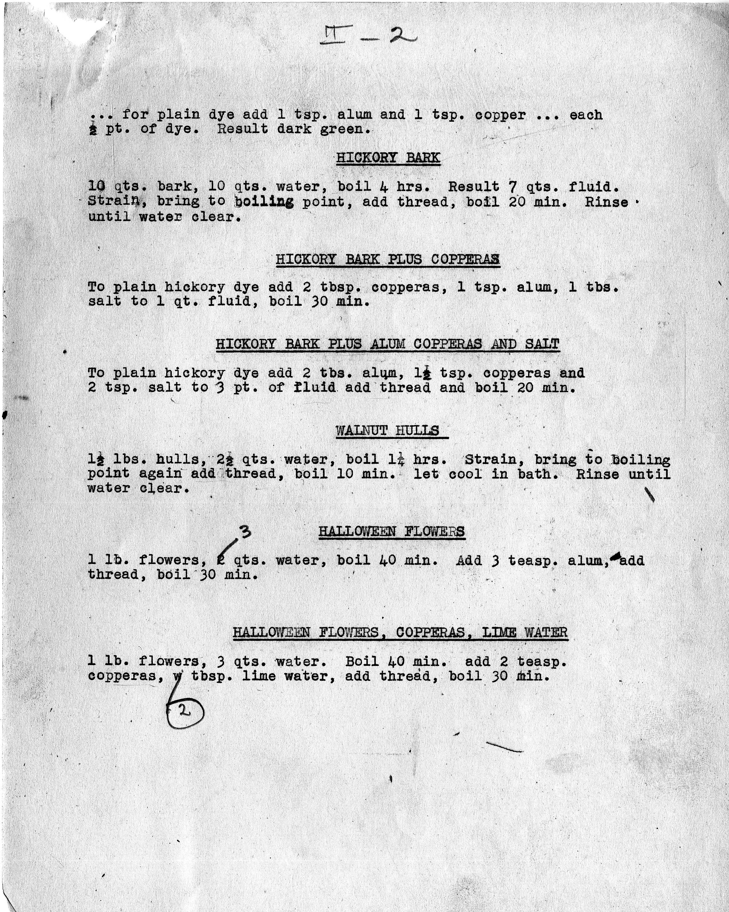
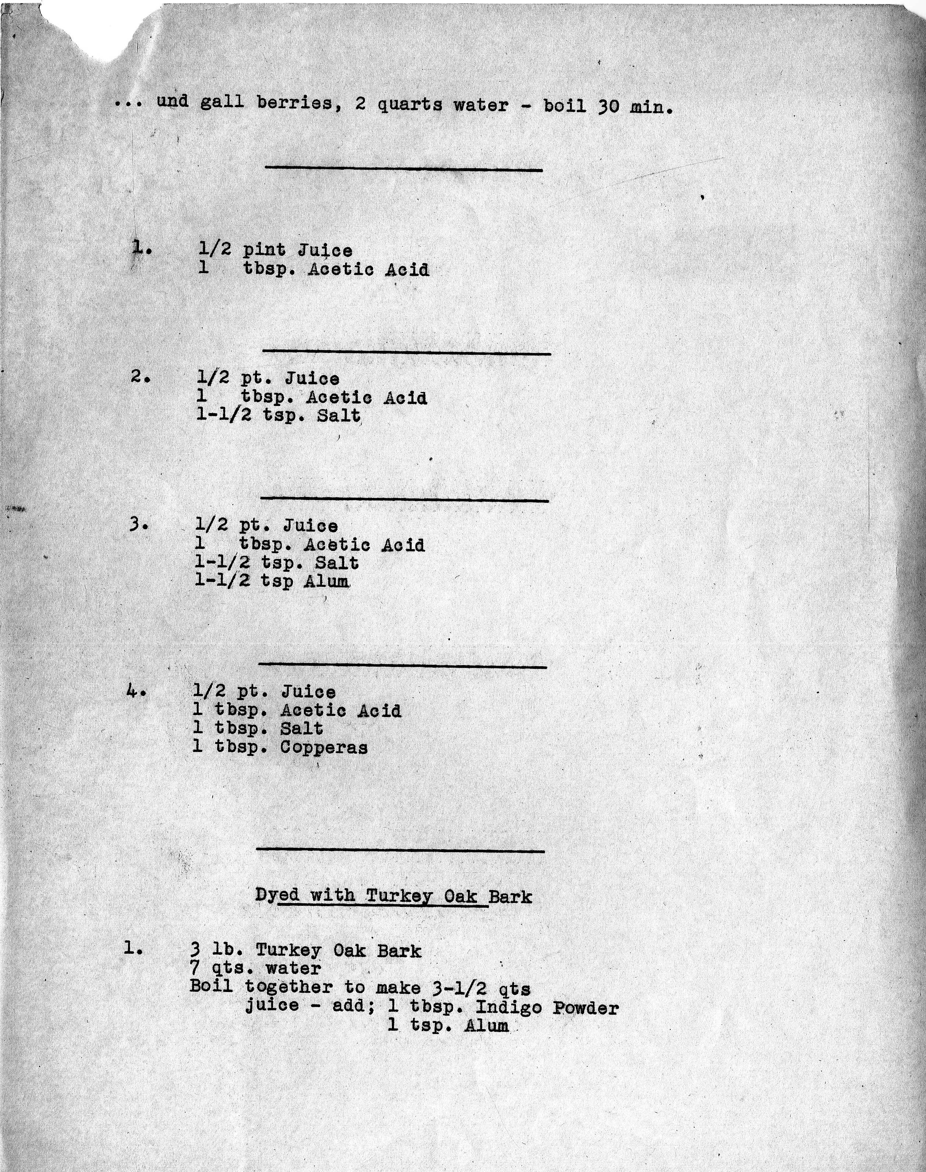
Formulas-paints and stains

Slide 43
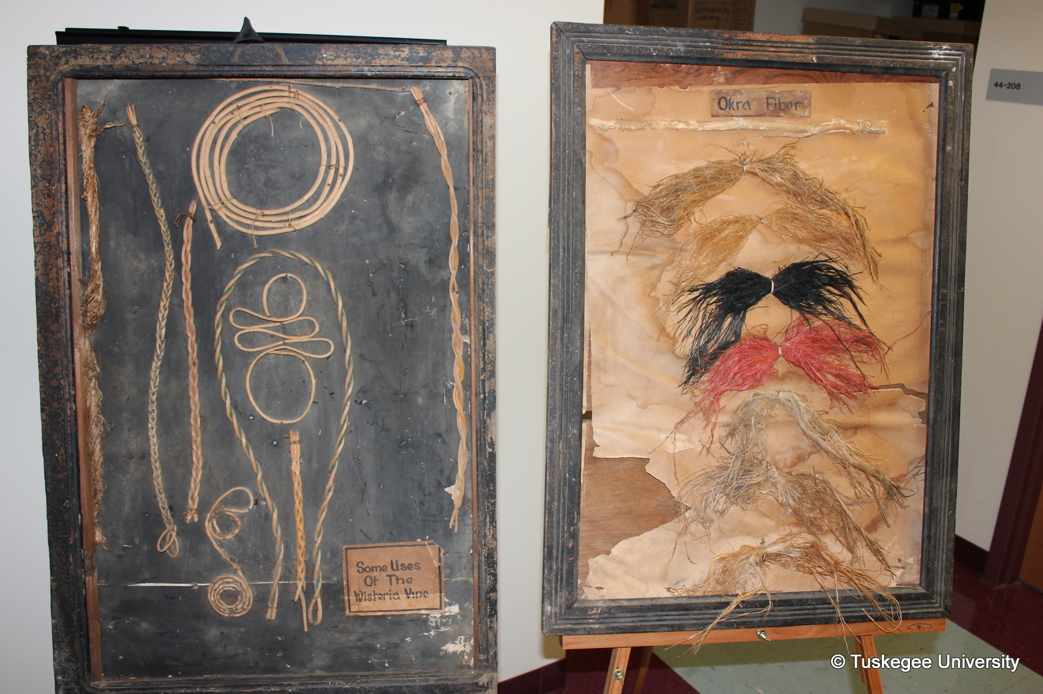
Example of His Paints and Stains

Slide 44
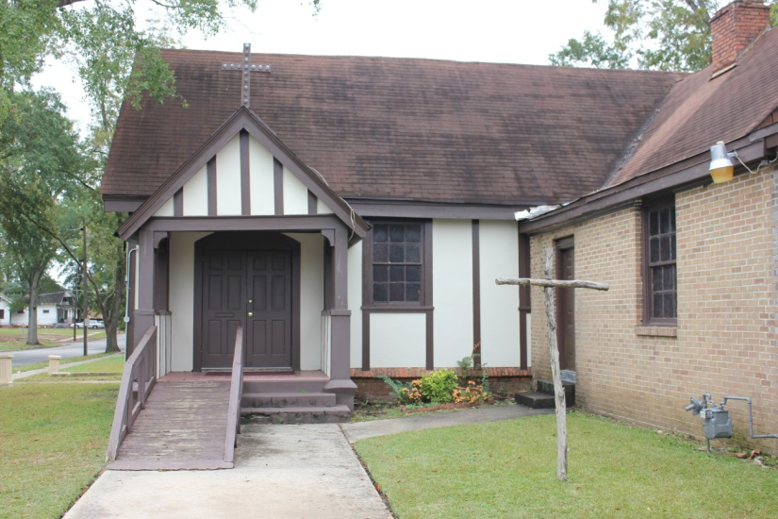
Interestingly…
Carver’s stains were used locally, such as at the former white Episcopal Church in Tuskegee
And, at the Richmond Hill Plantation owned by Henry Ford in Richmond Hill, Georgia
Richmond Hill Plantation
Former white Episcopal Church

Slide 45
His experimentation went beyond investigation to recycling.

Slide 46
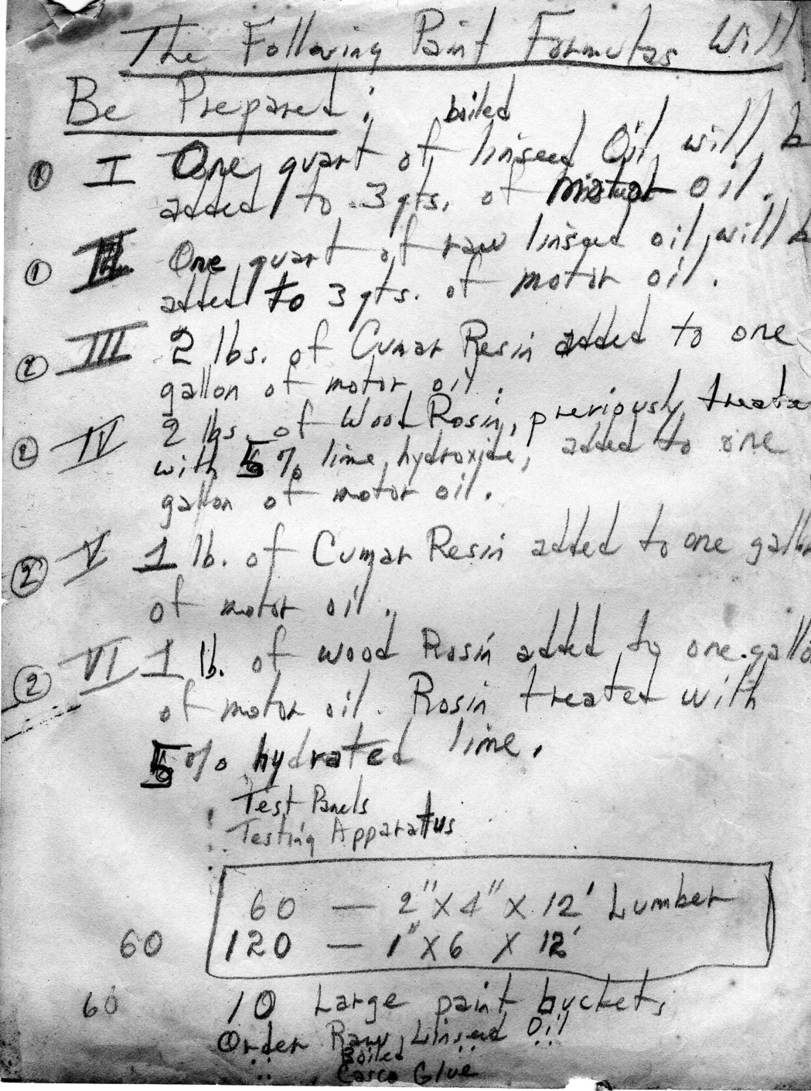
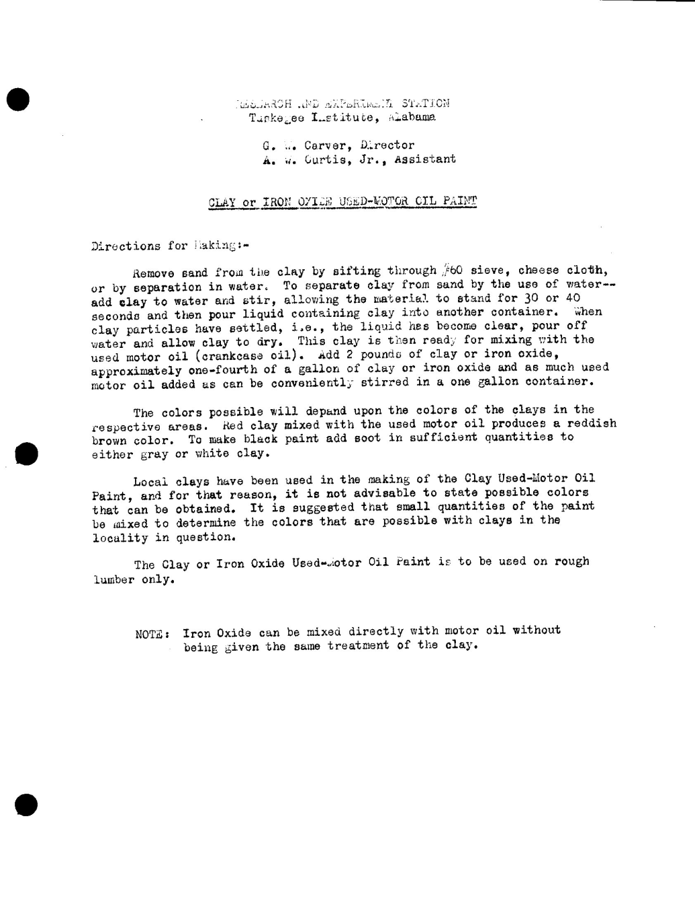
Used Motor Oil and Paint

Slide 47
Carver wanted young people to be informed about nature

Slide 48
The Carver Textbook: “Botany Made Easy”
Carver prepared for publication a 223 page manuscript to “be used in Common Schools, High Schools, and Academies

Slide 49
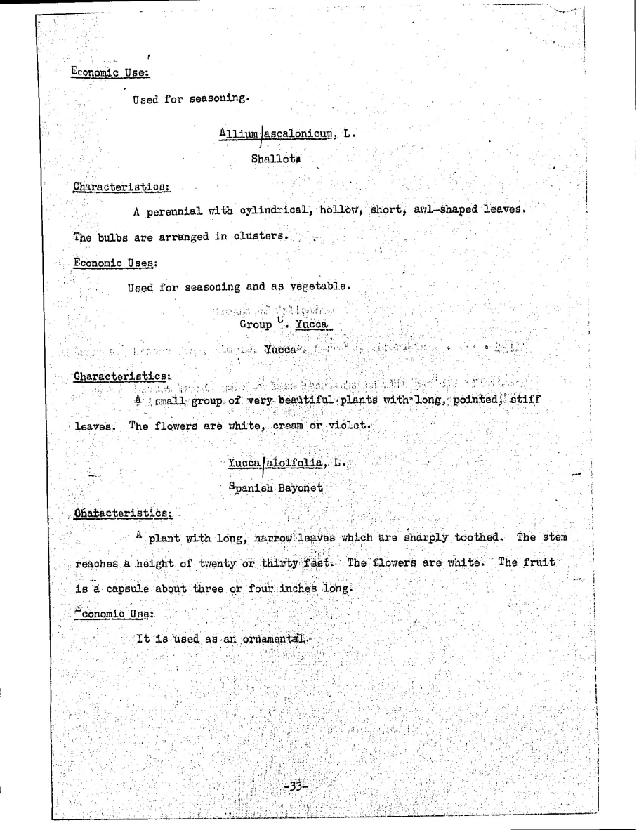
Textbook covered many plants seen throughout the South and nation.

Slide 50
A Scientist?
Webster’s Dictionary defines a scientist as “a person learned in science and especially natural science : a scientific investigator”
Question: Does the preceding information indicate that Carver was a scientist?

Slide 51
Carver saw himself as a “trailblazer,” leaving the details of many of his discoveries to others.

Slide 52
1916-Carver elected A Fellow of the Royal Society for the Encouragement of Arts, Manufacturers and Commerce, London, England
The Society's core members are the Fellows: Fellows are eligible to use the post-nominals FRSA. Fellows are elected to membership of the fellowship and must have demonstrated achievement or potential related to the arts, manufactures and commerce.

Slide 53
This is first of many honors!
Would the RSA have chosen someone who could not meet their standards?

Slide 54
Finally…
Many claims have been made concerning Carver’s achievements, but…
Have the many people that used his Bulletins been consulted regarding whether their situation was better after reading them?
How many did he influence with his teaching?

Slide 55
The dialogue continues…
Where it will lead depends on the evidence and its interpretation.

Slide 56
GWC: Exploring the Myths and Clarifying Some Criticisms
Tuskegee University Archives

