Slide 1
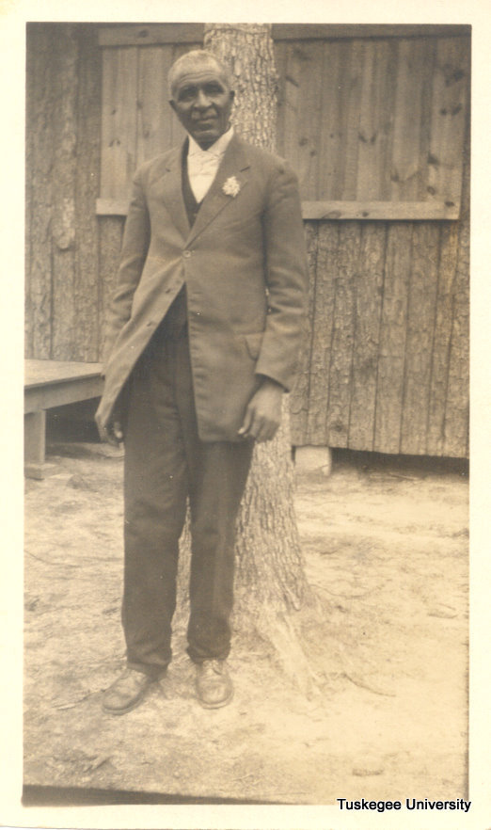
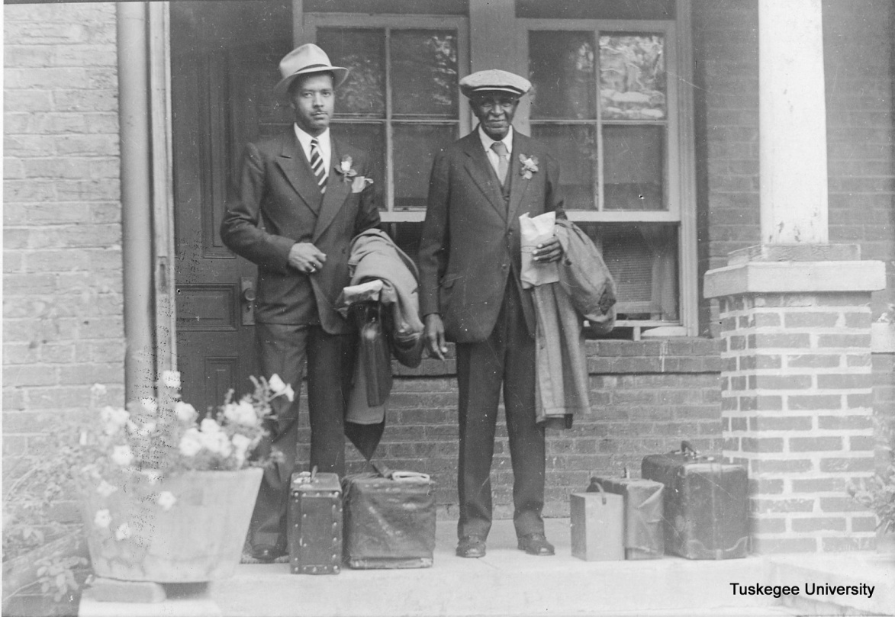
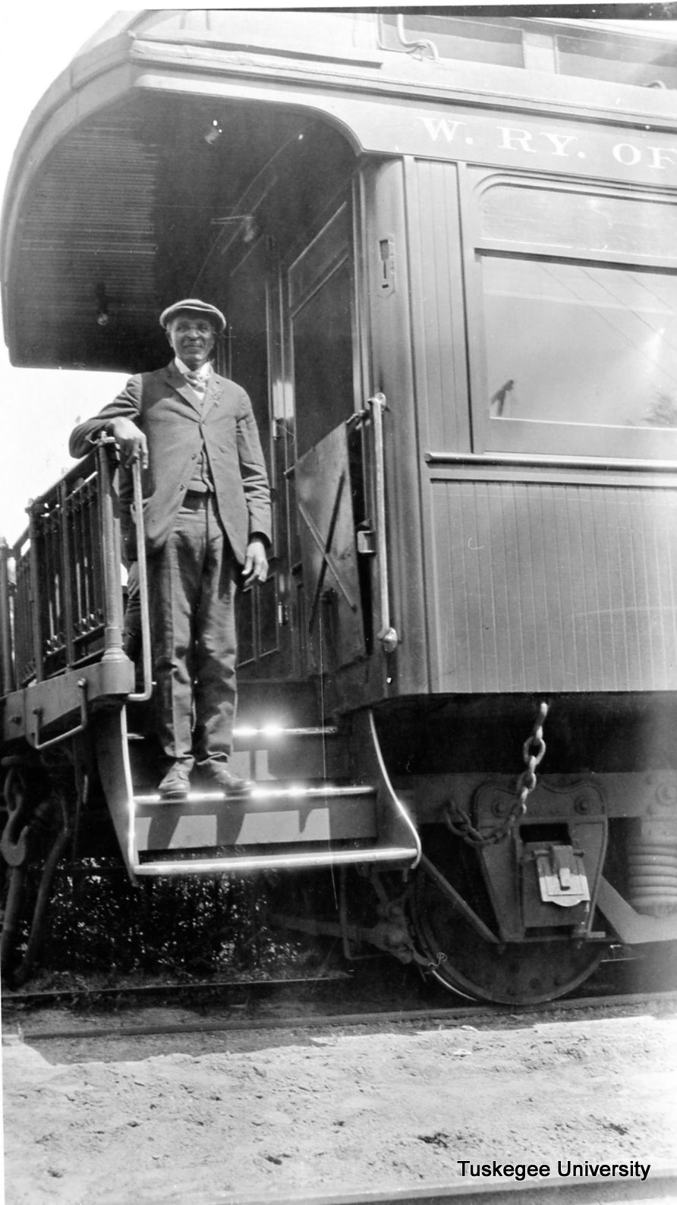
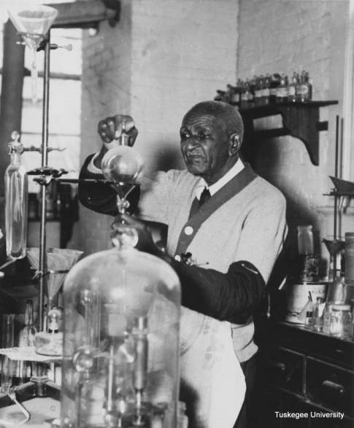
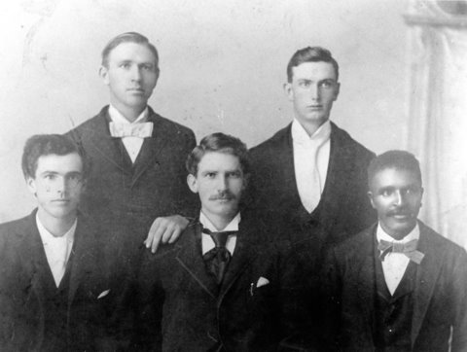
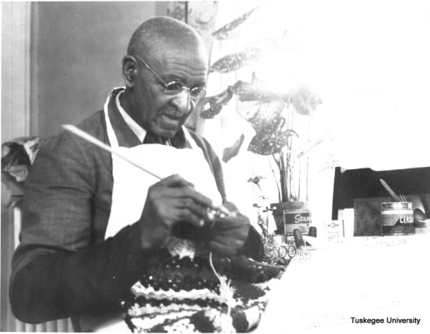
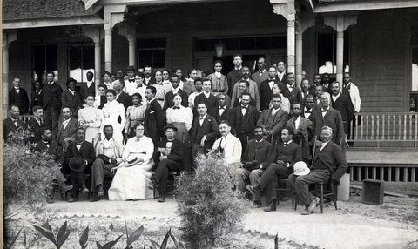

Slide 2
Extension and Tuskegee By: Dana R. Chandler, TU Archivist July 21, 2014
Tuskegee University Archives

Slide 3
Early History
Any consideration of the contributions of black Americans to agricultural extension and research during this period, however, must begin with Justin Smith Morrill and the Land-Grant College Act, commonly known as the Morrill Act, signed by President Abraham Lincoln on July 2, 1862.
This act, although supposedly extending agricultural extension and research to farmers throughout the country, made no provisions for the use of land-grant funds for blacks. The majority of blacks were still in slavery at the time and the act did not divide funds on racial lines
Therefore, except for four states (Alabama, Mississippi, South Carolina, and Virginia) which allocated portions of their funds for use at black colleges in 1871, and the Hatch Act of 1887,
It was not until the second Morrill Act of 1890, and the Smith-Lever Act of May 8, 1914, that blacks were officially incorporated into the system of cooperative extension and research.

Slide 4
Results of the 1862 Morrill Act
Allowed for states to receive federal grants to establish training institutions for agriculture and industry
The majority of blacks were still in slavery at the time and the act did not divide funds on racial lines
Only one Black institution, Alcorn State University, Lorman, Mississippi was designated as a land-grant university
Two other black institutions that received funds prior to 1890, Hampton University in Virginia, which would later give up its land-grant status to Virginia State, and Claflin University in South Carolina, which would later become South Carolina State

Slide 5
Extension and Blacks
2nd Morrill Act of 1890 was passed to create a "broader education for the American people in the arts of peace, and especially in agriculture and mechanics arts.“
Important caveat- To overcome the problem of non-cooperation from Southerners, Congress added a "separate but equal" provision for the establishment of colleges for blacks
Seventeen Southern and Border states took advantage of the funding and established the institutions commonly referred to today as 1890 Land-Grants.

Slide 6
Interestingly…
“As early as 1889 farmers‘ institutes and conferences were held in different states to provide black farmers with information related to the improvement of farm and home life. College experiment station personnel, physicians, and other specialists provided demonstrations and lectures to black farmers and homemakers in order to improve their health and happiness.” James W. Smith in "The Contributions of Black Americans to Agricultural Extension and Research.”

Slide 7
Extension and Blacks
Tuskegee University did not start out as a land-grant university
1890s its curriculum was similar to the land-grant schools
In 1887, when the Hatch Act was passed, state legislation established an Experiment Station for agricultural research
In 1899, the U. S. Congress granted Tuskegee Institute 25,000 acres of land and annual appropriations
Under the watchful eye of Booker T. Washington, Tuskegee Institute (now Tuskegee University) was instrumental in the development of Extension within the 1890's.

Slide 8
Extension and Tuskegee
There are many notable examples of courage and determination of people striving to educate black people between periods of the 1870's through the 1890's.
Two names stand out, Booker T. Washington and George Washington Carver
Set the foundation of Extension at the Black land-grants, but also their research and ideas in regards to outreach are very much a part of the Extension System's foundation
Booker T. Washington
George Washington Carver

Slide 9
Extension and Tuskegee
Washington held Sunday evening talks in which he introduced his students to the Department of Agriculture and also emphasized the importance of developing rural life for Blacks in the South.
Throughout his administration, Washington visited black families in their homes in order to gauge their needs

Slide 10
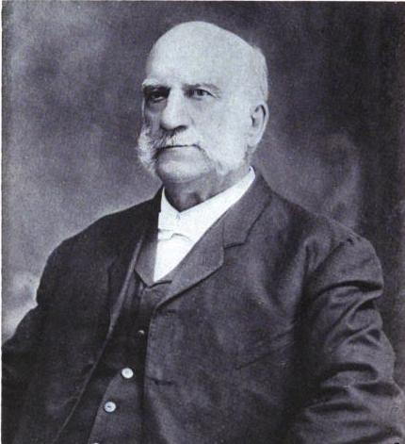
Extension and Tuskegee
In 1896, Washington persuaded George Washington Carver to come to Tuskegee as the director of the school farm and instructor of practical farming.
Borrowing from an idea by Dr. Seaman A. Knapp, Washington instructed Carver to pack tools in a surrey and visit rural communities across the county and put on demonstrations calling it a “Moveable School of Agriculture”

Slide 11
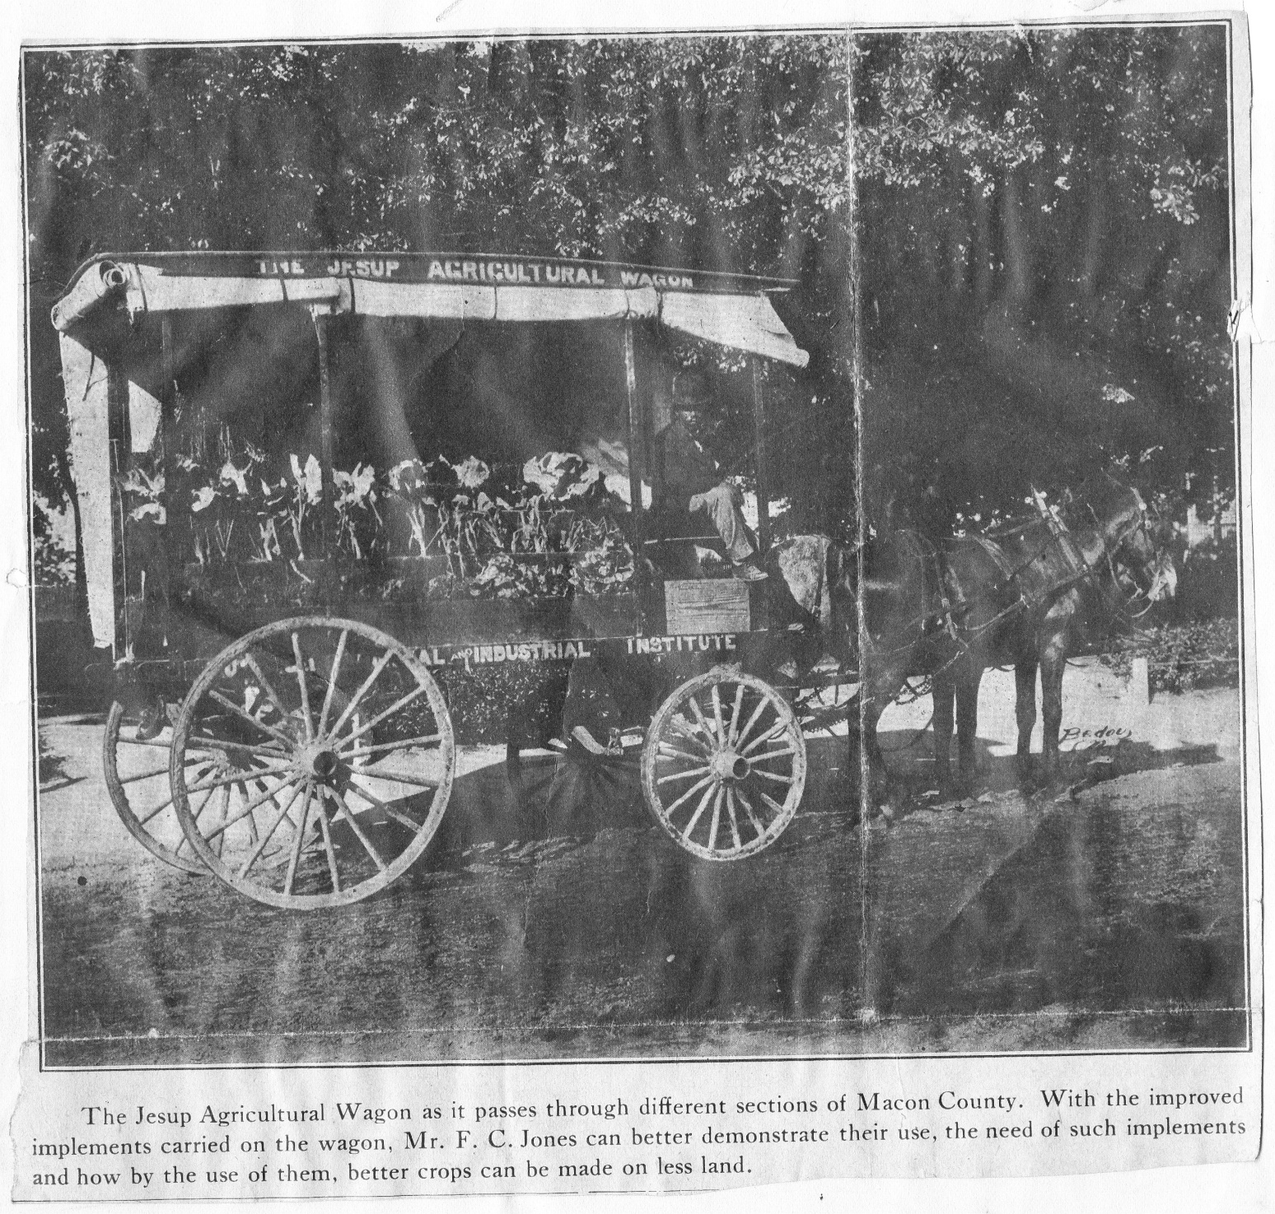

Slide 12
Extension and Tuskegee
In addition, their contributions were made through agents' conferences, farm and homemakers' short courses, farmers' workshops, 4-H short courses, and through extension courses for agents in the field.

Slide 13
Extension and Tuskegee
In February 1892, the first annual Negro Farmers Conference was held, drawing over 500 farmers to Tuskegee Institute from all over the state. This conference is said to be the spark that ignited agricultural Extension work among Blacks.

Slide 14
Extension and Tuskegee
In 1896 Washington persuaded the Alabama State Legislature to pass a law creating the Tuskegee Agricultural Experiment Station which Carver directed
By 1900, Extension work was being conducted by over 1,000 Tuskegee students in 28 states, Cuba, Jamaica, Africa, Puerto Rico, and Barbados.

Slide 15
Continued Outreach
The Tuskegee experiment station published pamphlets on
"How to Grow the Peanut and 105 ways of Preparing It for Human Consumption",
"How to Raise Pigs with Little Money",
"When, What, and How to Can and Preserve Fruits and Vegetables in the Home",
"A New Prolific Variety of Cotton".

Slide 16
Black Extension Agents
Not only had Washington presented Seaman A. Knapp, known as the father of extension, the idea of the moveable school, and he also urged him to appoint black extension agents to serve black farmers.

Slide 17
Thomas M. Campbell
Thomas Monroe Campbell (1883 – 1956) was hired in 1906 by Tuskegee University, later he became the first African American extension agent in the nation.
He became supervising agent in 1910 and held the post until he retired in 1953.

Slide 18
Some Controversy…
IN 1903, Dr. Knapp, then special agent in the United States Department of Agriculture, was invited to Terrell, Texas, to discuss with businessmen the serious condition of agriculture and business caused by the spread of the cotton boll weevil.
On February 29, 1903, with the cooperation of the businessmen of Terrell, Dr. Knapp established the first privately owned demonstration farm. It was managed by Walter C. Porter, son of the owner and supervised by Dr. Knapp.
In 1906, the businessmen of Terrell, Texas, appealed to Dr. Knapp for a man to give his entire time to their county. They offered to pay a part of his salary. As a result, the first agent to work exclusively in one county was appointed November 12, 1906. They claim: this first county agriculture agent was W. C. Stallin.

Slide 19
Stallin was a county agent, paid from some private funds, Campbell was a Federal Extension Agent, paid from federal government.

Slide 20
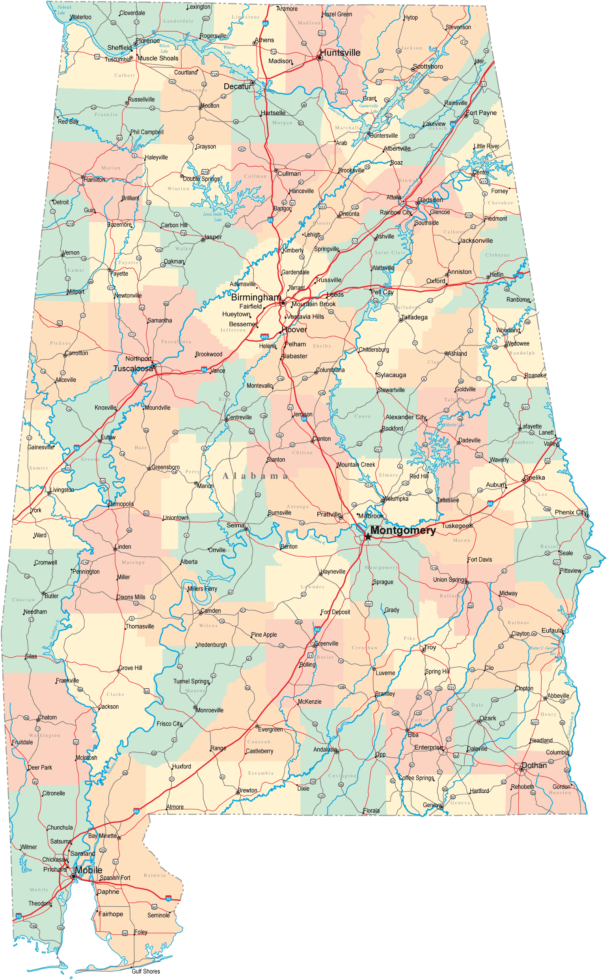
Thomas M. Campbell
After graduation from Tuskegee in 1906, both Washington and Carver recommended Campbell for the job of extension agent.
Since he worked through the U.S. Department of Agriculture, he was a federal employee assigned to Tuskegee.
White agents worked out of the administrative headquarters at Alabama Polytechnic Institute at Auburn (subsequently Auburn University), while the black agents were headquartered at Tuskegee.
Although Campbell began his work in Macon County, the location of Tuskegee, he took the Movable Agricultural School throughout the state.

Slide 21
Thomas Monroe Campbell and the Movable School
Using the “Movable School,” Campbell and his agents conducted classes for isolated farm families who were unable to attend the courses on campus.
His work revolutionized black farming in the South. He also led the farmers to improve and enhance their homes and to provide better health care for their families.
He addressed the needs of the woman in the home and on the farm and stressed education for children.

Slide 22
Thomas M. Campbell
In 1909 he was promoted to district agent and supervised and instructed other agents.
Agents who followed him operated the Movable School until World War II.
The practice of carrying education to rural people appealed to leaders in other countries, and sometimes visitors from these countries came to Tuskegee to see the Movable Agricultural School firsthand and to discuss the work of the extension program.
Use of such a school also spread to Europe, East Asia, India, and Africa.

Slide 23
Thomas M. Campbell
Although greatly influenced by Booker T. Washington and George Washington Carver, Campbell went beyond their teaching to expand the scope of the U.S. Department of Agriculture in agricultural extension service for black farmers.
His work made Tuskegee the center of agricultural extension form for blacks in the Deep South.

Slide 24
Carver and Extension
In 1896, Booker T. Washington persuaded George Washington Carver to come to Tuskegee as an instructor of practical farming.
Soon after being hired, Carver became the director of what became known as the “Movable School," a surrey in which lecturers would travel over the county on week-ends to educate Negro farmers on new agricultural approaches
Also, Carver utilized the annual Negro Farmer’s Conference to build relationships with others throughout the nation in which he would hold educational meetings in their home areas

Slide 25
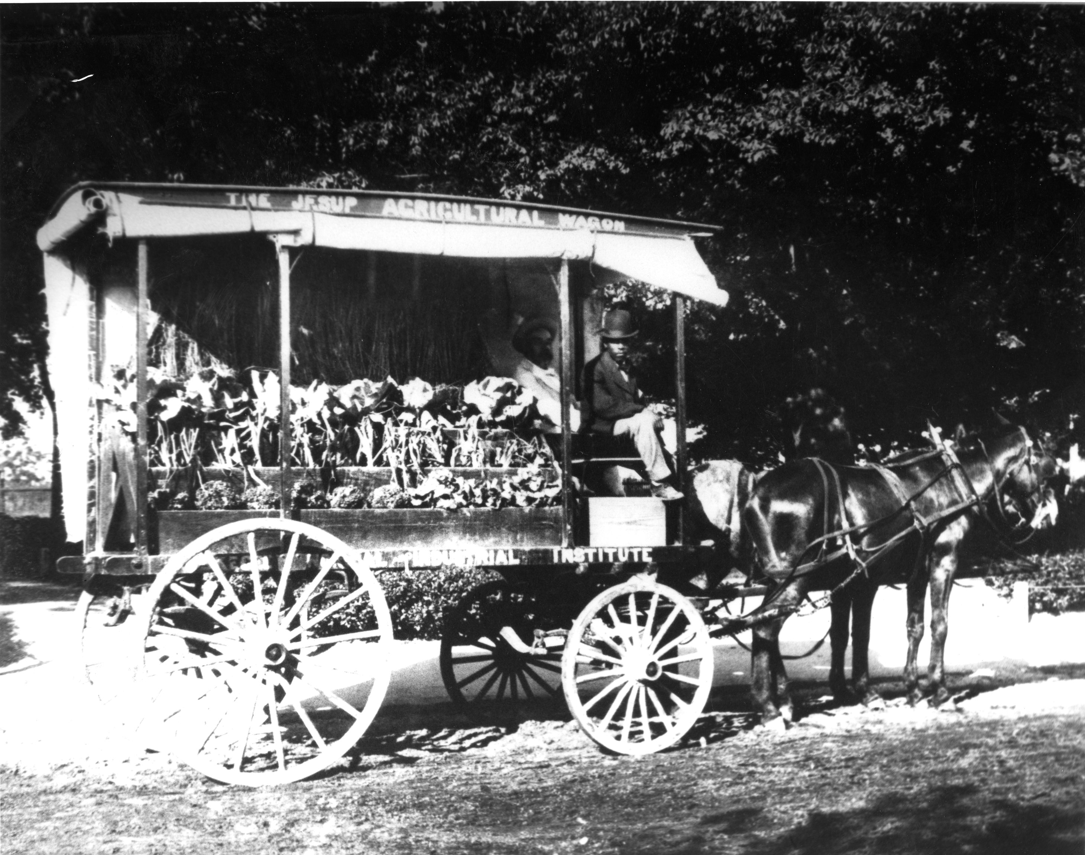
The Jesup Wagon
Carver headed a committee to plan for a demonstration wagon and to determine what equipment it should carry to farmers’ doors.
solicited philanthropist Morris K. Jesup of New York, who donated funds for the wagon.
The Jesup Agricultural Wagon, as it was officially named, was equipped and put in operation on May 24, 1906, under the guidance of the agricultural faculty.
Washington was committed to addressing the needs of women who worked in fields and in homes; thus, the operator of the wagon was instructed to meet these needs.
Equipment of the wagon varied
according to the season.
Showed how to plant the garden,
how to fertilize it, and
demonstrations given on how to
plow the field.

Slide 26
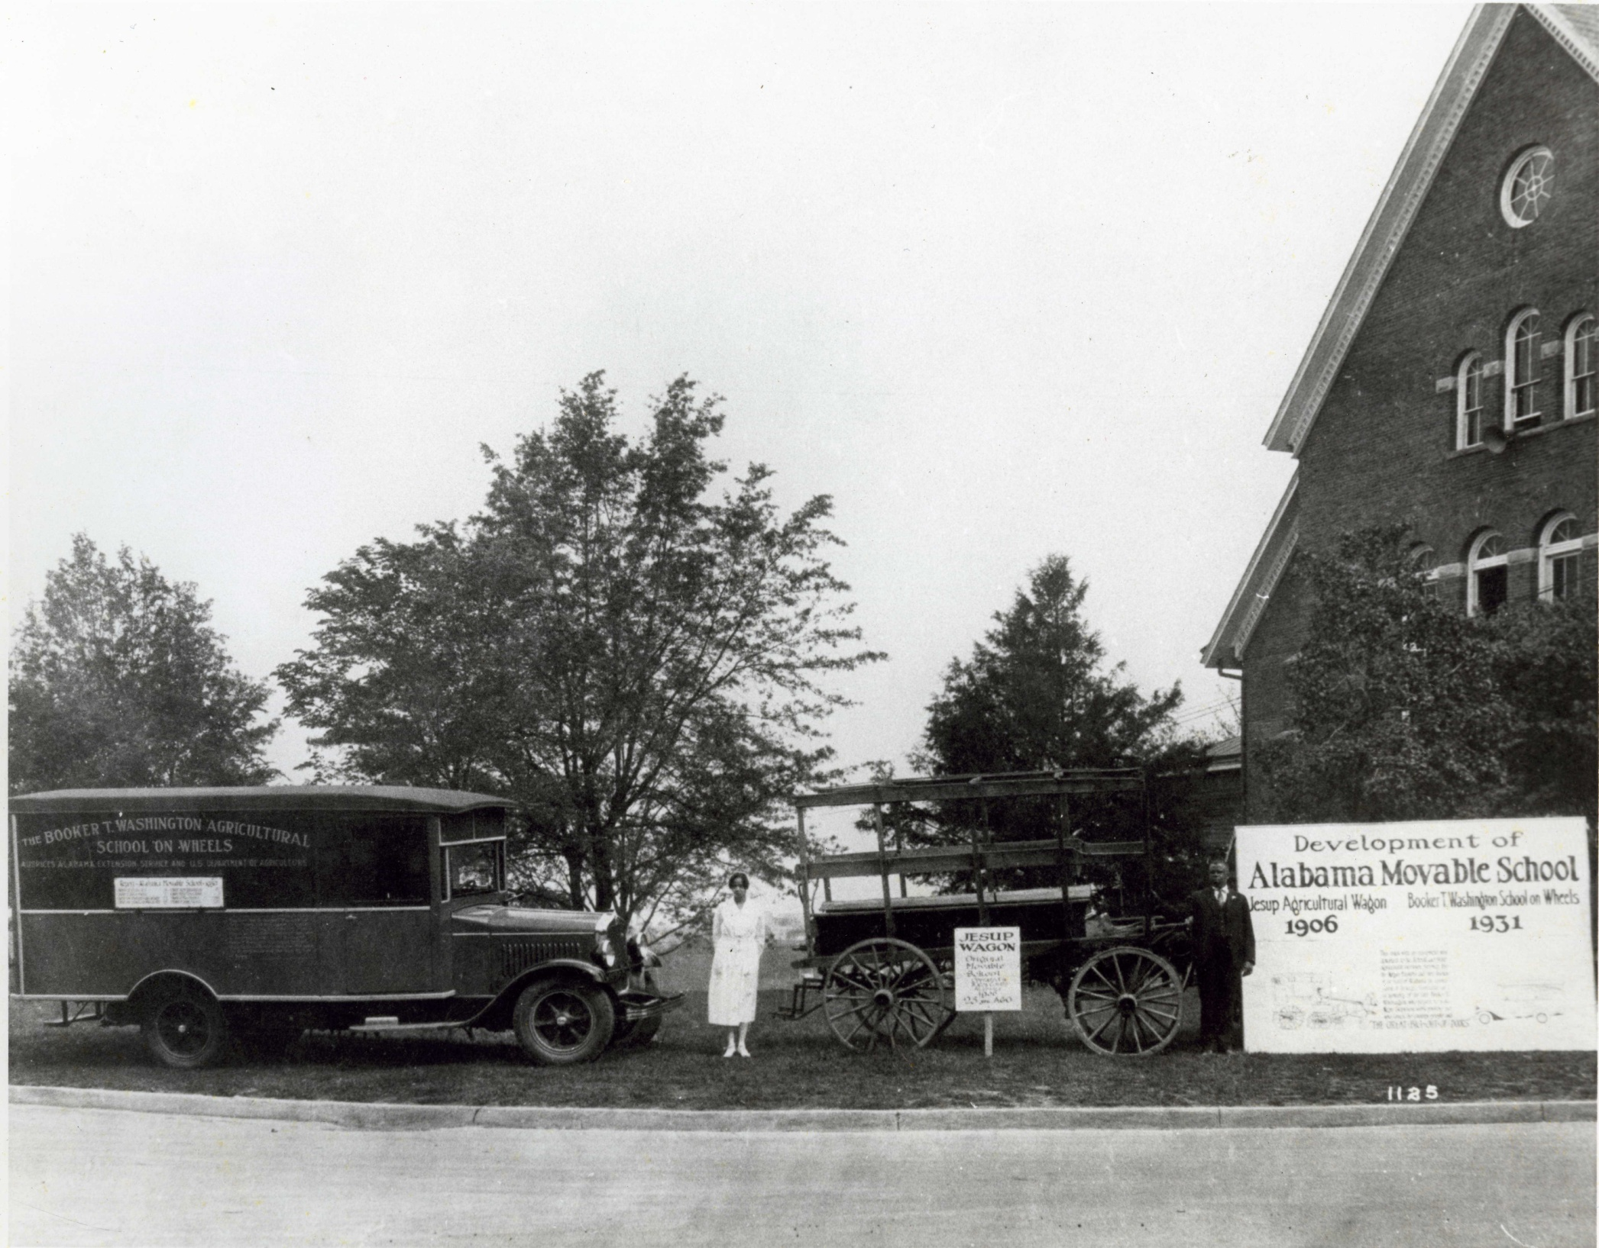
The Movable School
The Jesup Wagon morphed into a newer version of the “Movable School”
By 1930, it carried a nurse, home demonstration agent, an agricultural agent and an architect
Stressed self-sufficiency
and self-improvement

Slide 27
Tuskegee University and Land-Grant Status
Tuskegee University is a largely privately funded institution in Alabama
Functions as de facto land grant university
Though only Alabama A&M and Auburn University participate in the now-combined Alabama Cooperative Extension System (ACES), Tuskegee listed as “cooperating partner”
Explicitly granted the same status as the 1890 land-grant institutions in a number of Federal laws
Receives Smith-Laver funds since 1972 to operate its own Cooperative Extension program.

Slide 28
Carver and Extension
A model to follow

Slide 29
GWC Biography
Born in 1864 near Diamond Grove, Missouri
Attended Minneapolis High School in Kansas
First black student at Simpson College, Indianola, Iowa
Bachelor of Science degree at Iowa State University in 1894 and Master of Science in 1896
First black faculty member at Iowa College
Taught classes in soil conservation and chemurgy
Came to Tuskegee University in 1896
Served as the school's Director of Agriculture
Died in 1943

Slide 30
Who Was Carver?
A skilled visionary who incorporated his world view into everything he did:
Religion
Politics
Food
Farming
Nutrition, Diet and Health
Called “The Black Leonardo,” a Renaissance man,^{[2]}
A man for all ages

Slide 31
How would Carver Respond to this age?
Boston Globe article, dated August 17, 2010, June Wulff noted:
“Carver would have been dismayed by the agricultural and environmental mess we’ve gotten ourselves into.” ^{[3]}
Based on the negative effects of modern farming techniques, people now are going back to simpler methods like those of Carver.

Slide 32
Carver…
Did not invent peanut butter
Did not come up with 300 uses for peanut
Did not save the economy of the South
Did not save farming in the South
Would not have liked the reputation that he now has!

Slide 33
A Legend in His Own Mind?: As for Carver’s humility and intentions, he did not want to wear the title of Dr.
Carver had three honorary degrees:
Simpson College -1928
Rochester College -1941
Selma University -1942

Slide 34
Today’s World Wide Cultural Movement in Agriculture
Introduce high yield crops using improved agricultural techniques in an attempt to increase food production in underdeveloped nations.
Techniques adopted and promoted by the Ford and Rockefeller Foundations and the USDA.
Countries are witnessing serious consequences of intensive farming using chemicals and pesticides. Studies have shown a direct relationship between indiscriminate use of chemicals and pesticides and an increased incidence of cancer in several regions around the world.^{[4]}
Furthermore, fertilizers, pesticides, etc. are not readily available to underprivileged nations and poor farmers.
Now looking to use same techniques developed by poor farmers in the South and further perfected by men such as George Washington Carver.

Slide 35
GWC the Green Scientist
Some have concluded that “He did not make any great scientific discoveries nor did he further scientific knowledge to any great extent .” ^{[5]}
However, recent findings within the Tuskegee University Archives dispel such claims
Found six notebooks containing Carver’s experiments, drawings and observations.

Slide 36
The Notebooks

Slide 37
Inside the notebooks:
Beautiful Drawings
Formulas and Discoveries

Slide 38
So, why have they been hidden?
“One reason I never patent my products is that if I did it would take so much time I would get nothing else done. But, mainly I don’t want my discoveries to benefit specific favored persons.” ^{[6]}

Slide 39
What the notebooks reveal…
Notebooks are filled with Carver’s experiments revealing his environmental sensitivity.
Many pages are dedicated to water purity and usage and the reuse of plant matter in a variety of ways beyond cooking.
Some experiments aided him in preparing his bulletins.

Slide 40
What caught our eye…
In Bulletin No. 35, published in 1925, entitled “How to Grow the Cow Pea, and Forty Ways of Preparing it as a Table Delicacy,” Carver made an interesting statement :
He begins the article by stating that the cow pea “stands out prominently…”
Agreed, the phrase “green-manuring,” no doubt means the cow pea could be used as a cover crop grown primarily to replenish the soil with useful nutrients
But, in this bulletin, he lists 11 reasons for growing the cow pea that go beyond its primary use as a food source or ground cover.
He was looking for a way to use the cow pea to help man, beast and earth in a natural and safe way.

Slide 41
Carver’s use and reuse method
In Bulletin No. 41, published in 1936, entitled “Can Live Stock Be Raised Profitably in Alabama?,” Carver wrote…
Interestingly, he starts out with the cow pea as an essential food source for livestock whose manure fertilizes the same!
Carver’s participation in reusing, recycling and utilizing “earth-friendly” measures was more than helping people to succeed economically, it was part of his world-view!

Slide 42
He was concerned with what we did with “God’s Creation”
“I believe the Great Creator has put oil and ores on this earth to give us a breathing spell. As we exhaust them, we must be prepared to fall back on our farms… For we can learn to synthesize materials for every human need from the things that we grow.” ^{[7]}
Because of his awareness of the finite quantity of natural resources, he sought to reuse those materials to continue to aid mankind.

Slide 43
Used Motor Oil and the Government
Carver proposed a method for utilizing bulk, used motor oil as a base for commercial paint.
Specifically, government and military vehicles during WWII
His peers felt “the formulae are missing, so we have no clue as to his proposition…” (regarding lack of evidence of formulas) ^{[8]}
Yet, here we see Carver’s testing methods for a variety of paints for different materials.

Slide 44
Carver used every opportunity to aid the farmers…
His concerns for the poor farmers around him drove Carver to seek alternative methods of making money within the dynamics of their economic situation.

Slide 45
Going Green and Crop Rotation
“Crop rotation” has become an important phrase in the green movement, especially regarding organic farming ^{[9]}
Forage and grain legumes, especially clover, must be used in organic crop rotations as a soil fertility increasing component ^{[10]}
Carver was well aware of this at least a century ago
Today, Tuskegee using these very same ideas!

Slide 46
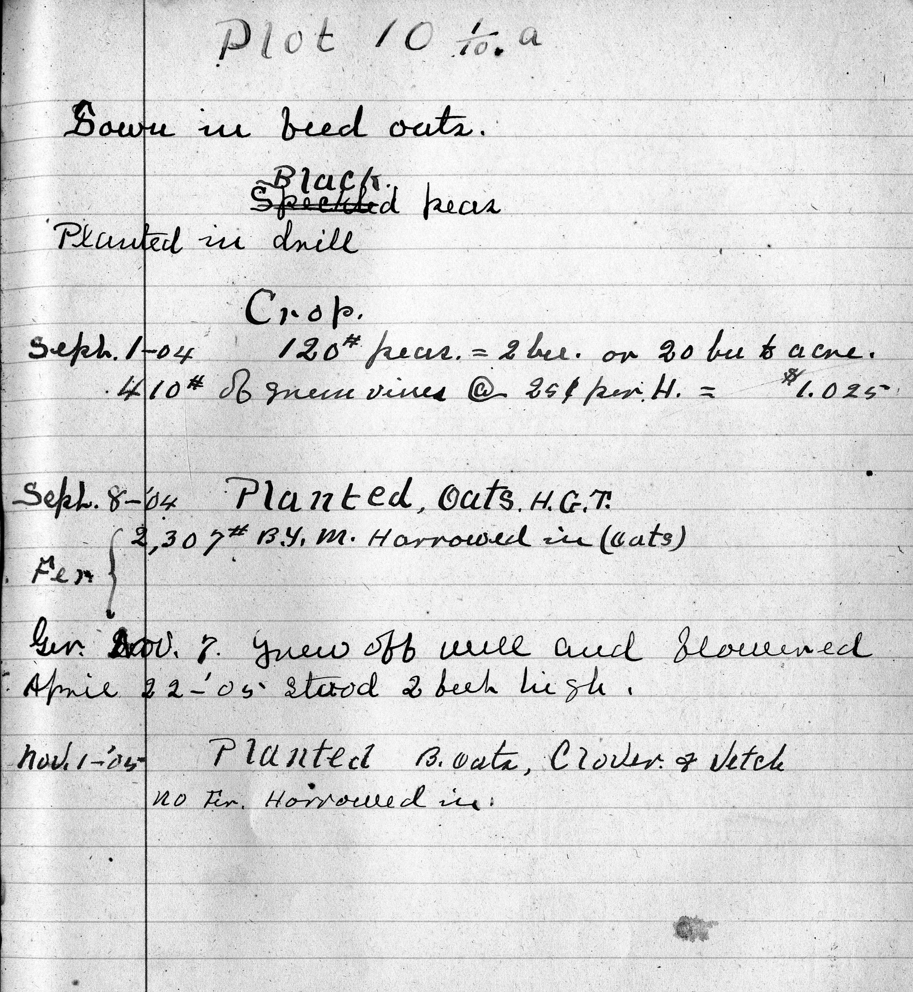
Plot Rotation

Slide 47
Plot Rotation Plan

Slide 48
Carver’s Philosophy
“Start where you are with what you have. Make something of it; never be satisfied!” ^{[12]}
Simple, yet effective, advice

Slide 49
Carver the Pioneer
His other innovative work included developments with synthetic rubber, metal polish, adhesives, bleach, axle grease, buttermilk, fuel briquettes, paper, shaving cream, shoe polish, dyes, stains, and plastics, as well as hundreds of uses for sweet potatoes, soybeans and legumes.

Slide 50
Tuskegee and Extension
Washington and Carver understood that the insights generated at Tuskegee and other agricultural research facilities throughout the nation could not be fully utilized unless they were successfully imparted to farmers
Yeager, Joe, & Gene Stevenson, Inside Ag Hill: The People and Events that Shaped Auburn's Agricultural History from 1872 through 1999, Sheridan Books, Chelsea, Michigan (1999)

