Slide 1
Tuskegee’s Photographic Legacy
Dana R. Chandler, Archivist/Associate Professor
Tuskegee University Archives

Slide 2
P.H. Polk

Slide 3
Prentice Herman Polk
Born November 25, 1898 in Bessemer, Alabama
Died December 29, 1984 in Tallassee, Elmore County, Alabama
Was the official photographer for Tuskegee University from 1939 until his death.

Slide 4
Early Years
In 1916 Polk added his father's middle name to his own and enrolled in evening classes at what was then the Tuskegee Normal and Industrial Institute.
His ambition was to to study art, but he soon learned that founder Booker T. Washington had made no provision for non-"practical" instruction at the institute.
Polk rejected a suggestion to take courses in house painting, and, in his second year became the third student to enroll in the institute's newly-created photography program, led by Cornelius Battey.
He was also a leader in the school band.
Polk left Tuskegee in 1920 to work in a shipyard in Mobile County, but continued to study photography by taking correspondence courses which encouraged him to study how light is used to build up form in painted masterpieces.

Slide 5
Formative Years
After completing the courses he moved to Chicago, Illinois to join his mother and sisters there.
He worked as a painter for the Pullman Palace Car Company during the day and for the telephone company in the evenings, but still found time to apprentice himself to white portrait photographer Fred A. Jensen.
Polk married Margaret Blanche Thompson of Brunswick, Georgia in January 1926.
Over the course of the next year he began going door to door seeking to find his own portrait clients.
Not having much success and dreading the onset of another midwestern winter he moved with his wife and newborn son, Prentice, back to Tuskegee where opened his own "Polk's Studio.”
Joined the faculty in 1927, he assisted Leonard Hyman, who had succeeded Battey as head of the photography division.

Slide 6
Latter Years
In 1933 Polk was promoted to succeed Hyman as head instructor.
He resigned in 1938 to open a studio in Atlanta, Georgia.
He won three awards at the Southeastern Photographer's Convention held there that year.
He returned to Tuskegee in 1939 to accept the position of official campus photographer.
During his tenure on the faculty, Polk mentored countless aspiring photographers, including Charles Lang, Chris McNair, Frank Godden, Albert Carter, and Chester Higgins, Jr.

Slide 7
Particulars
Over the course of his career he made portraits of nearly all the faculty members and administrators and their families as well as the innumerable visitors to the campus, both humble and esteemed.
He went out of his way to capture photographs of laborers and field hands for his "Old Characters" series even as he posed wealthy ladies in furs and jewels for glamorous portraits in his studio.
He photographed Tuskegee scientist George Washington Carver over 500 times and also photographed the Tuskegee Airmen that trained near the institute for flying missions in World War II.

Slide 8
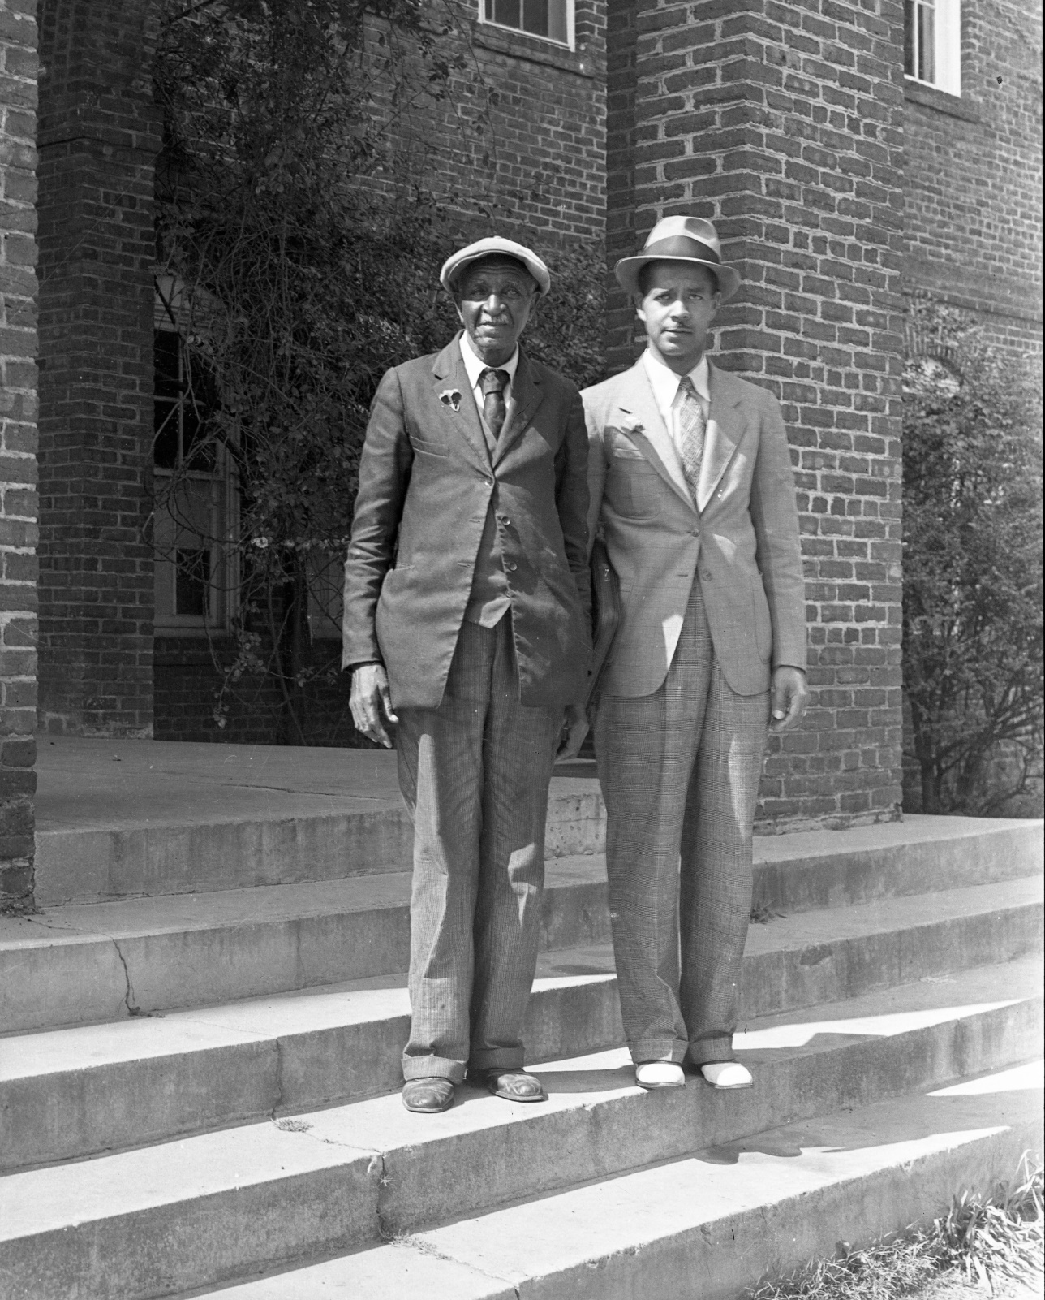

Slide 10
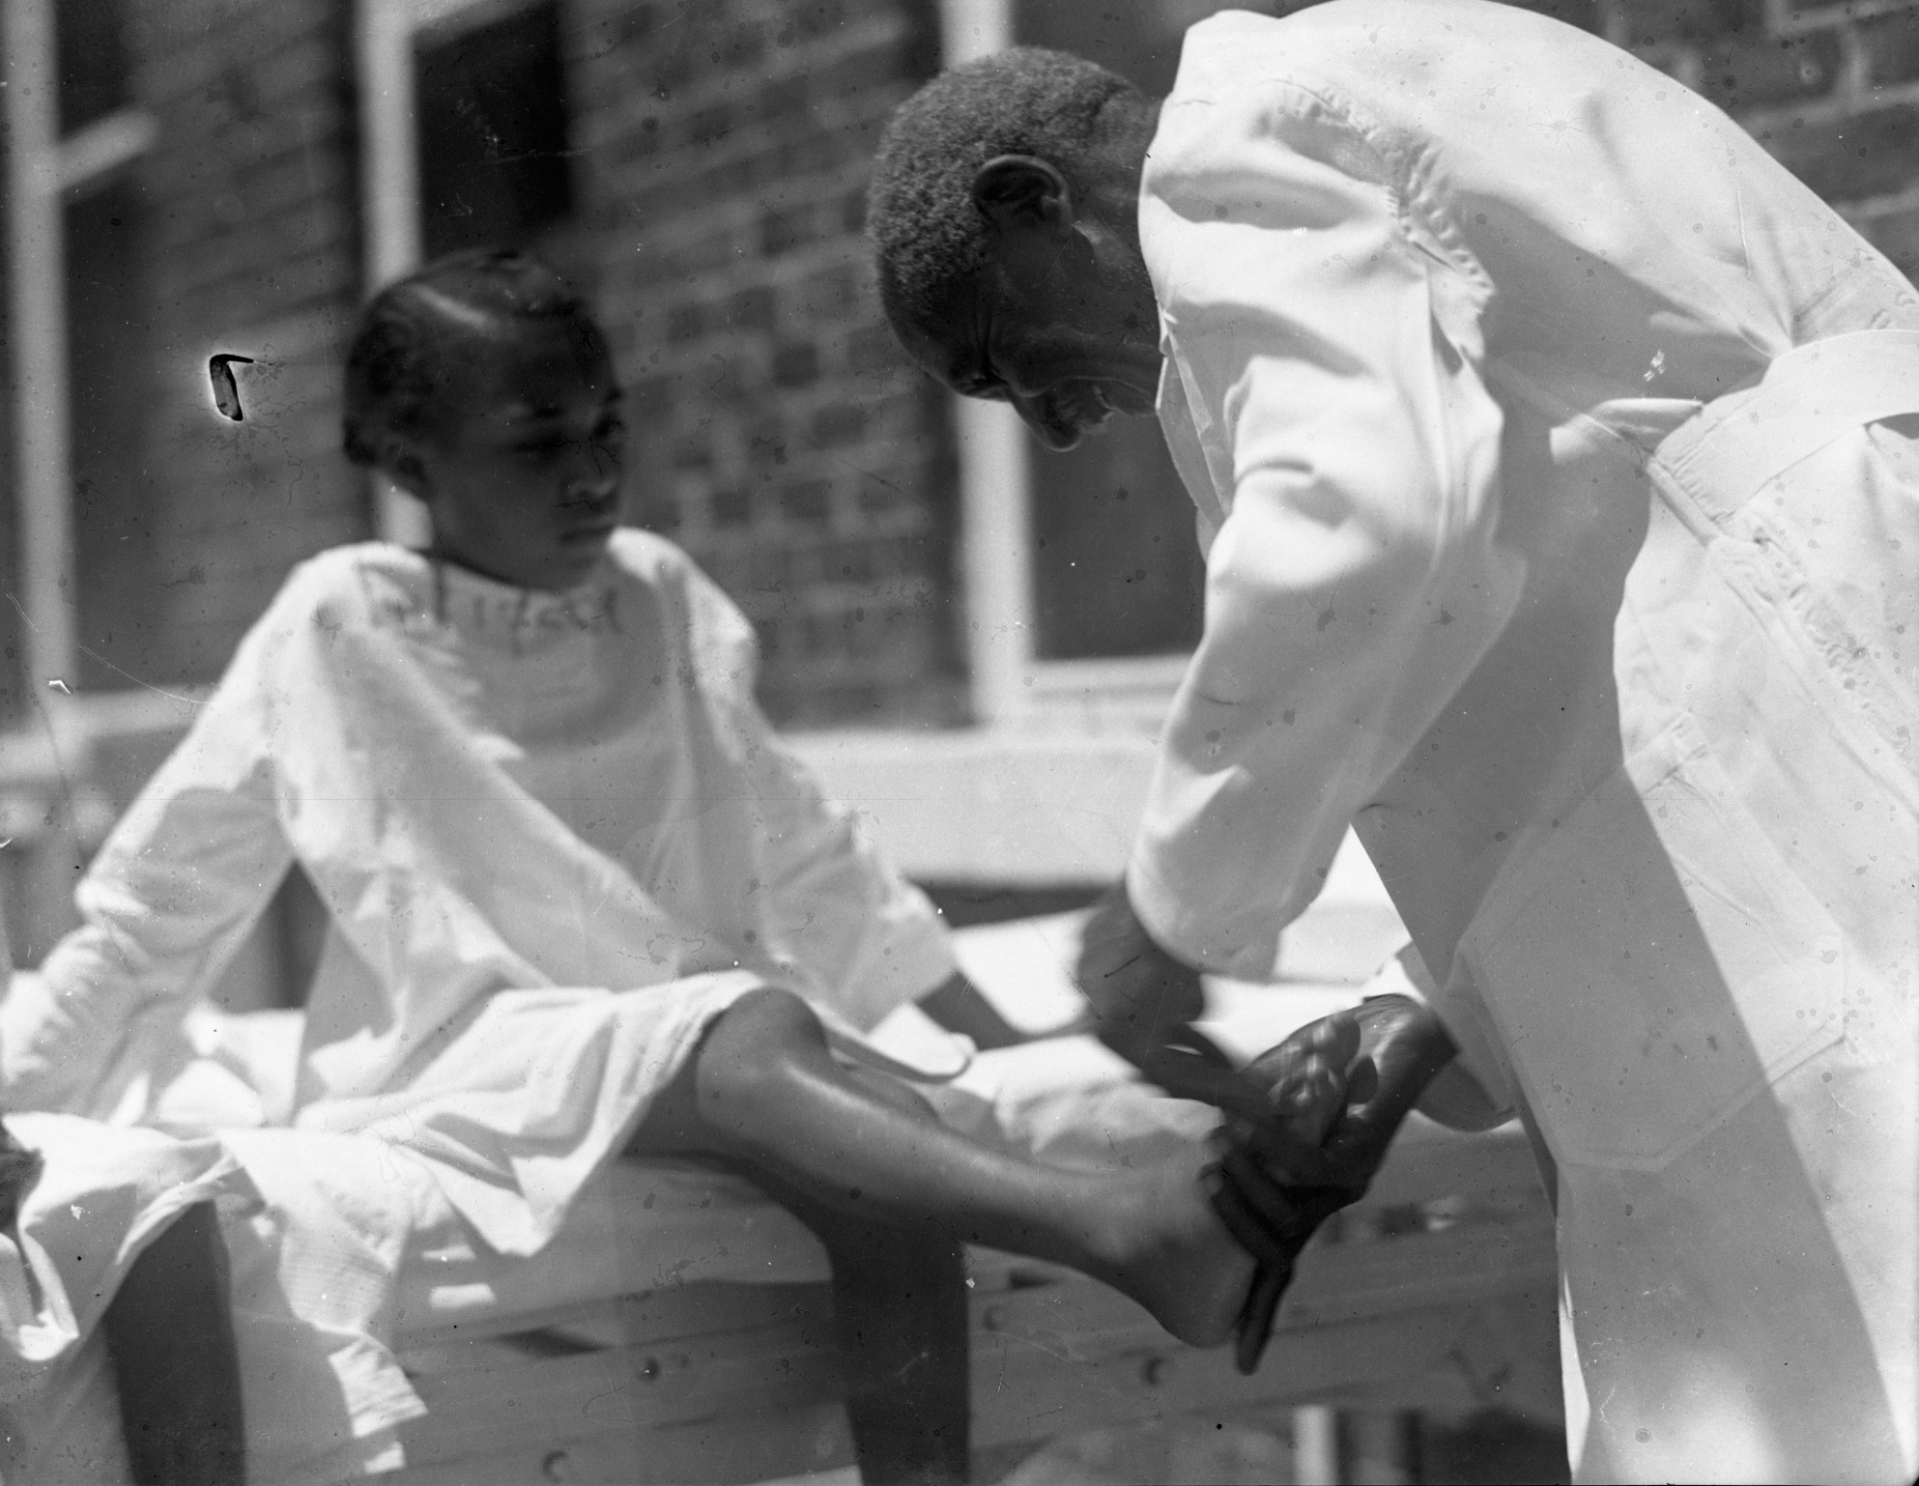

Slide 12
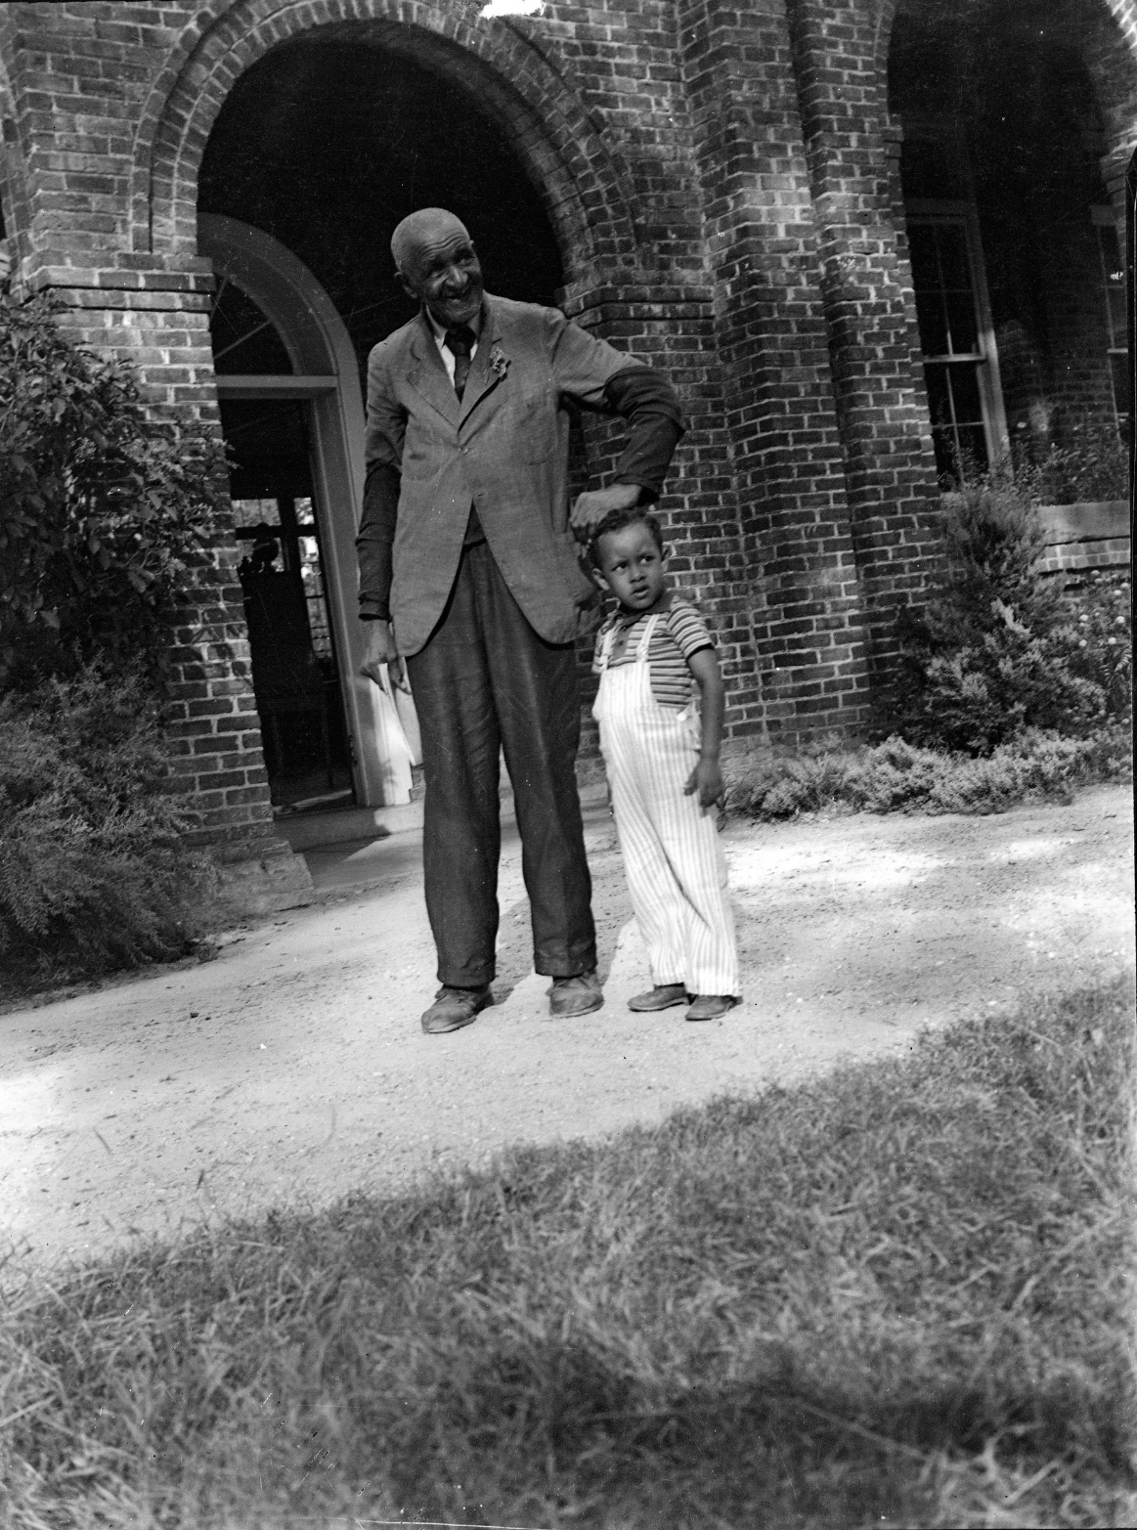

Slide 15
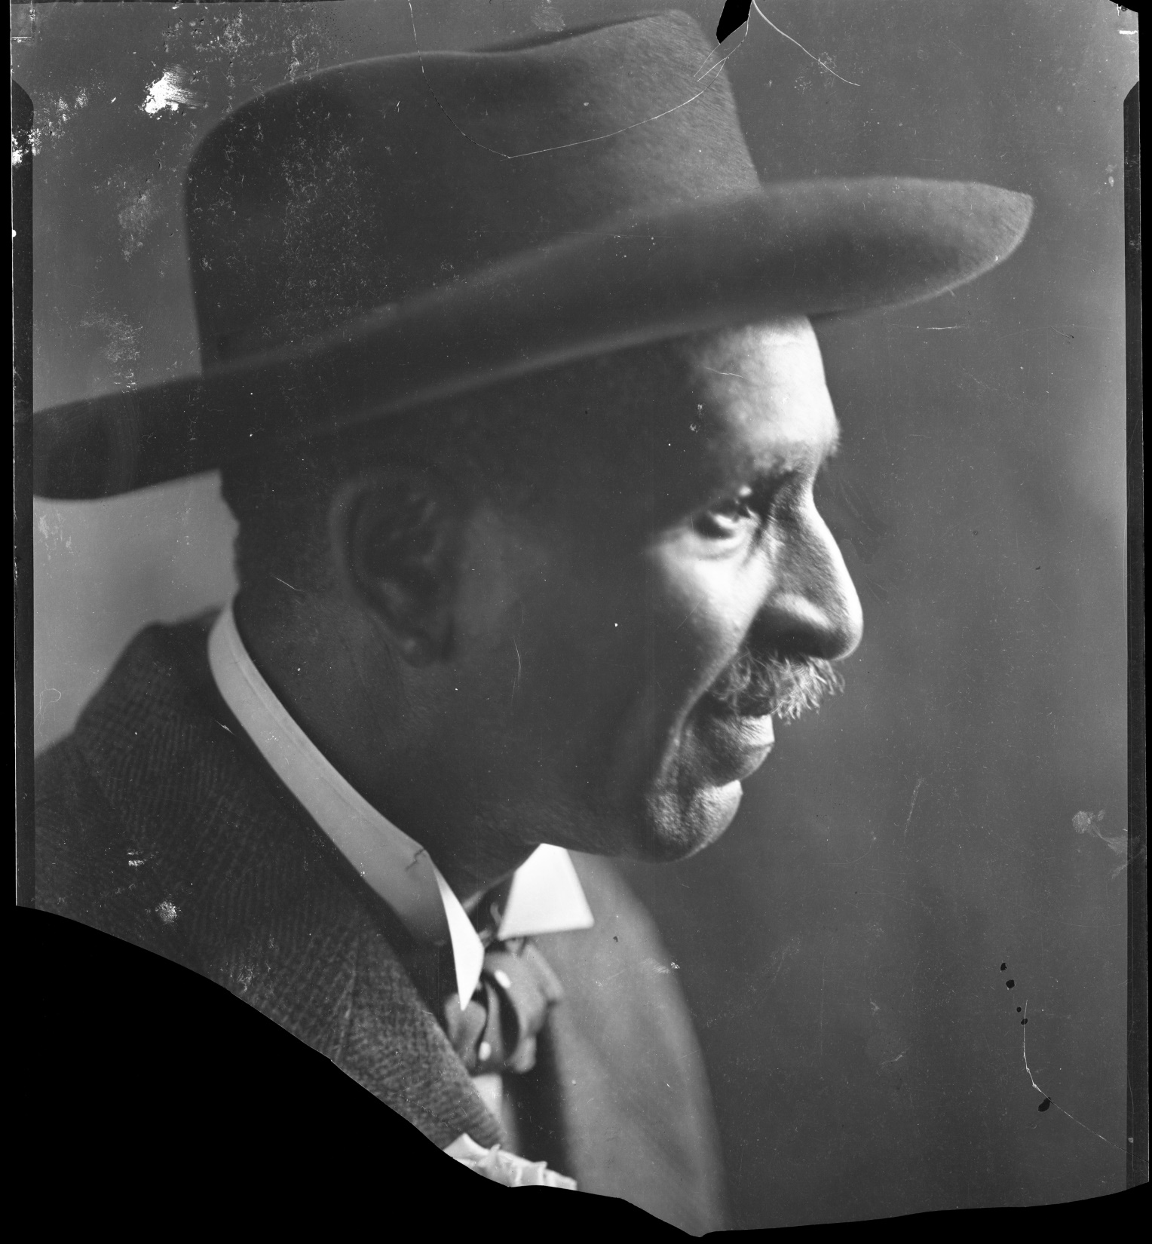

Slide 16
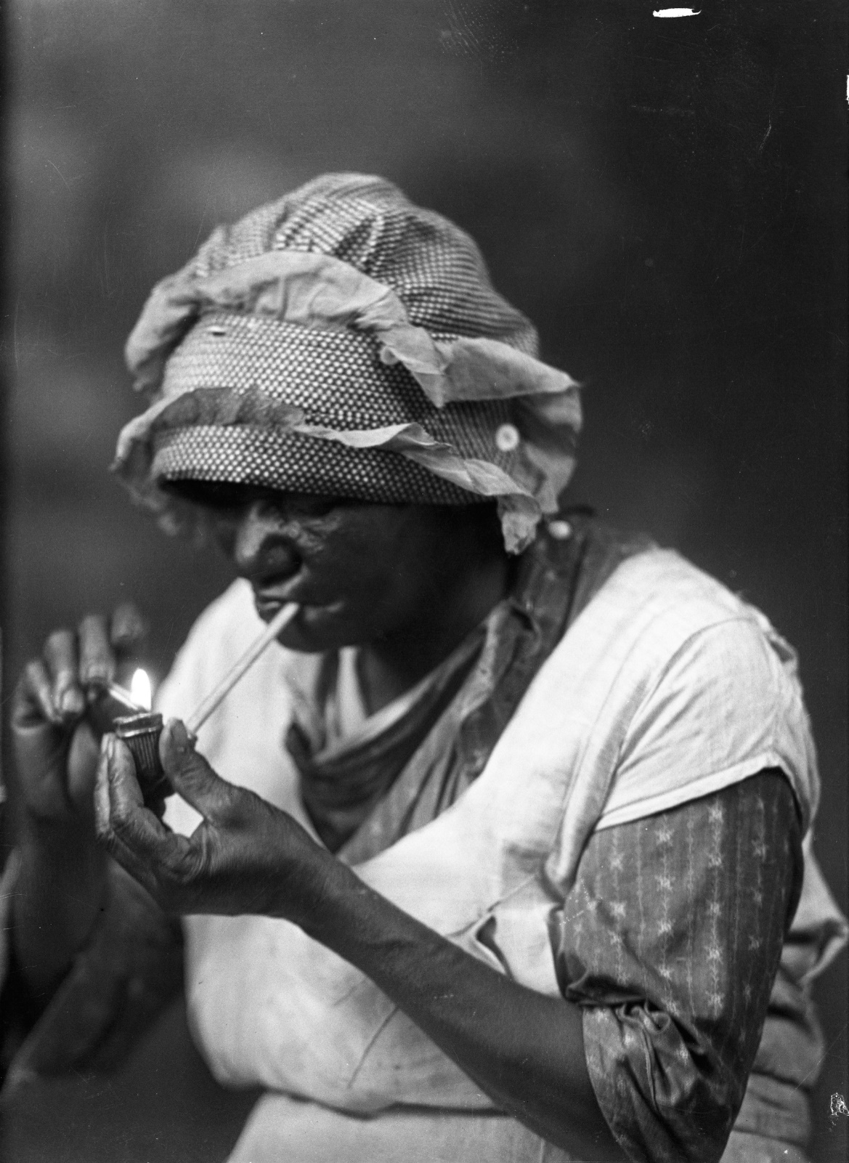

Slide 17
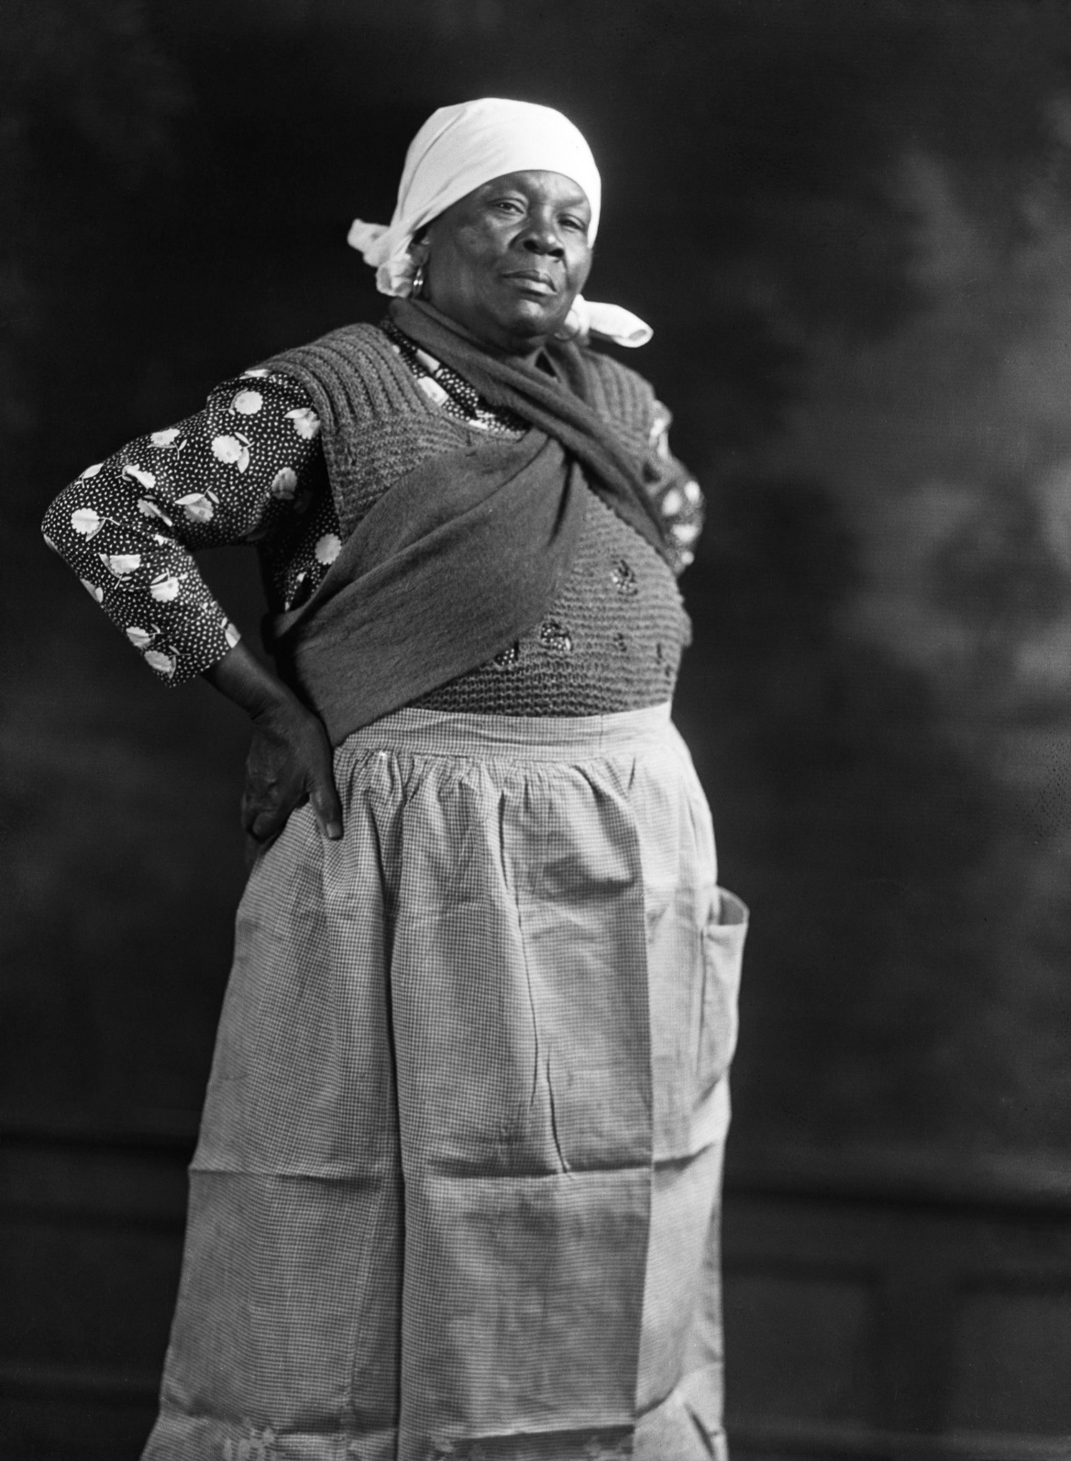
His 1932 image, entitled "The Boss", shows an authoritative female farm worker whom he discovered setting up a produce stand near campus. She stands proudly in her everyday clothes, defying the viewer to dismiss her headscarf and apron as comical or picturesque.

Slide 18
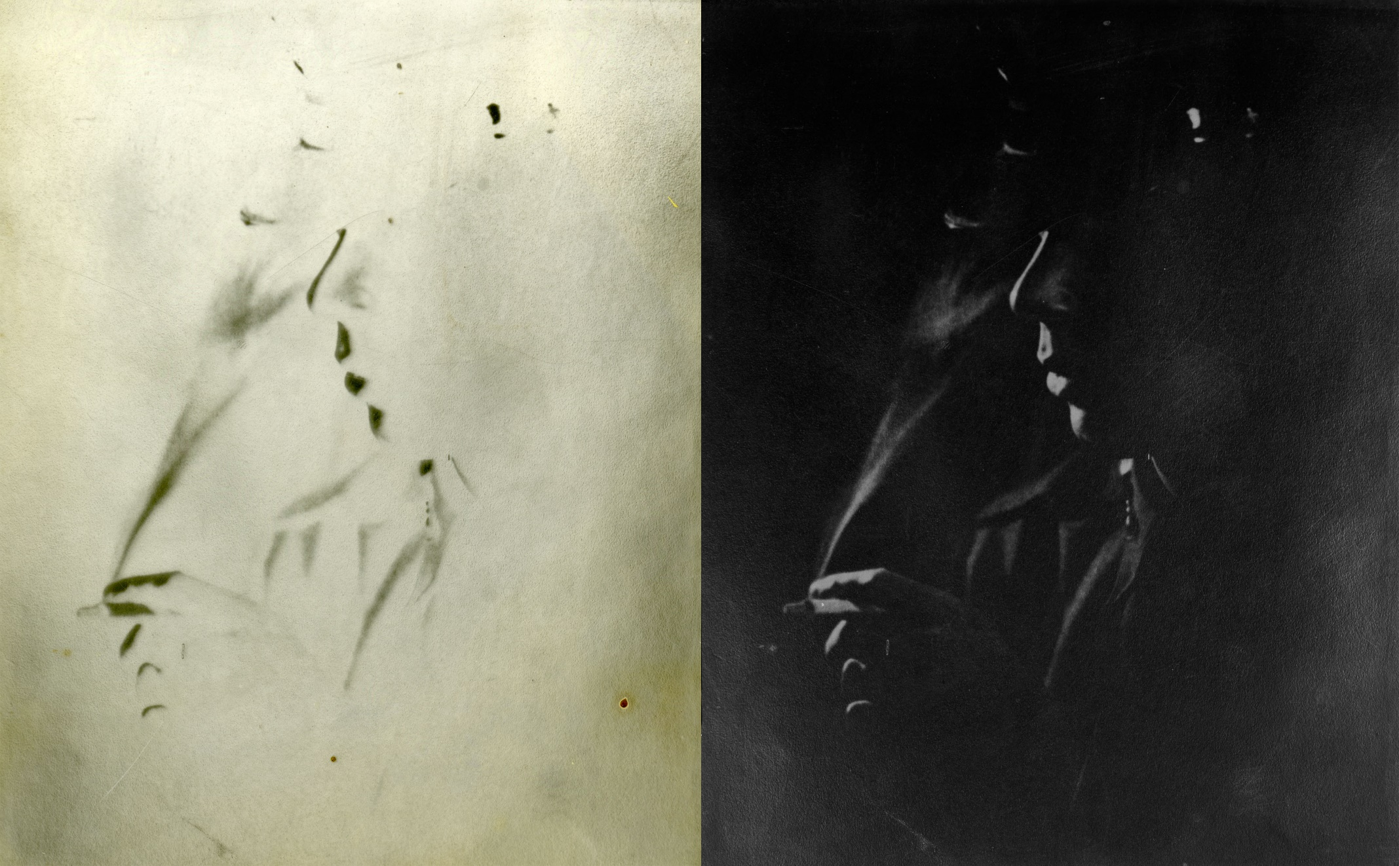

Slide 19
C.M. Battey

Slide 20
Cornelius Marion Battey
Born in 1873 in Augusta, Georgia, but was raised in the North
Died in Tuskegee in 1927
Not much is known about his early life
What we do know…

Slide 21
Early Years
His first job in photography was in a studio in Cleveland, Ohio
He moved to New York and worked for six years in the Bradley Photographic Studio on Fifth Avenue, where he held the position of superintendent
He went on to work at Underwood & Underwood, one of the city's successful early 20th century photo studios, where he headed up the retouching department

Slide 22
Formative Years
Battey eventually opened a business on Mott Street in New York with a white partner under the name Battey and Warren Studio.
He shot idealized photographic portraits of black people, some famous and some not.
One of his earliest known photographs is of Frederick Douglass, shot in 1893 just two years before Douglass's death.
His style was pictorialist, characterized by use of soft focus and retouching of the negatives and prints to smooth out any irregularities.
Battey became a friend of W. E. B. Du Bois
Battey's portraits of America's black leaders began regularly appearing on the cover of The Crisis.
He also shot covers for The Messenger magazine and the journal Opportunity.
As his fame grew, he also photographed white leaders such as President Calvin Coolidge and United States Supreme Court Chief Justice William Howard Taft.

Slide 23
Latter Years
Starting around 1900, Battey began extensively documenting the life of Booker T. Washington, continuing until Washington's death in 1915.
Along with Arthur P. Bedou, he was one of the two photographers Washington most relied on, especially during northern trips. Battey's formal, quiet studio portraits complemented Bedou's more journalistic, snapshot style.
In 1916, Battey replaced Bedou as the official photographer of Tuskegee Institute.
The administration favored him in part because it wanted to set up a photography department and Battey had connections with Eastman Kodak whose founder, George Eastman, had been a longtime supporter of the school.
Eastman donated funds to found the new department, which Battey then headed up until his death a decade later.

Slide 24
Particulars
Battey taught courses in photography and at the same time documented the campus and its students and faculty, creating a unique record of black college life in the early twentieth century. Among those he mentored was photographer P. H. Polk.
In 1921, when the New York Public Library's 135th St. branch in Harlem held its first exhibition of work by black artists, "The Negro Artists," Battey was one of two photographers to have work in the show (the other being Lucy Calloway).

Slide 25
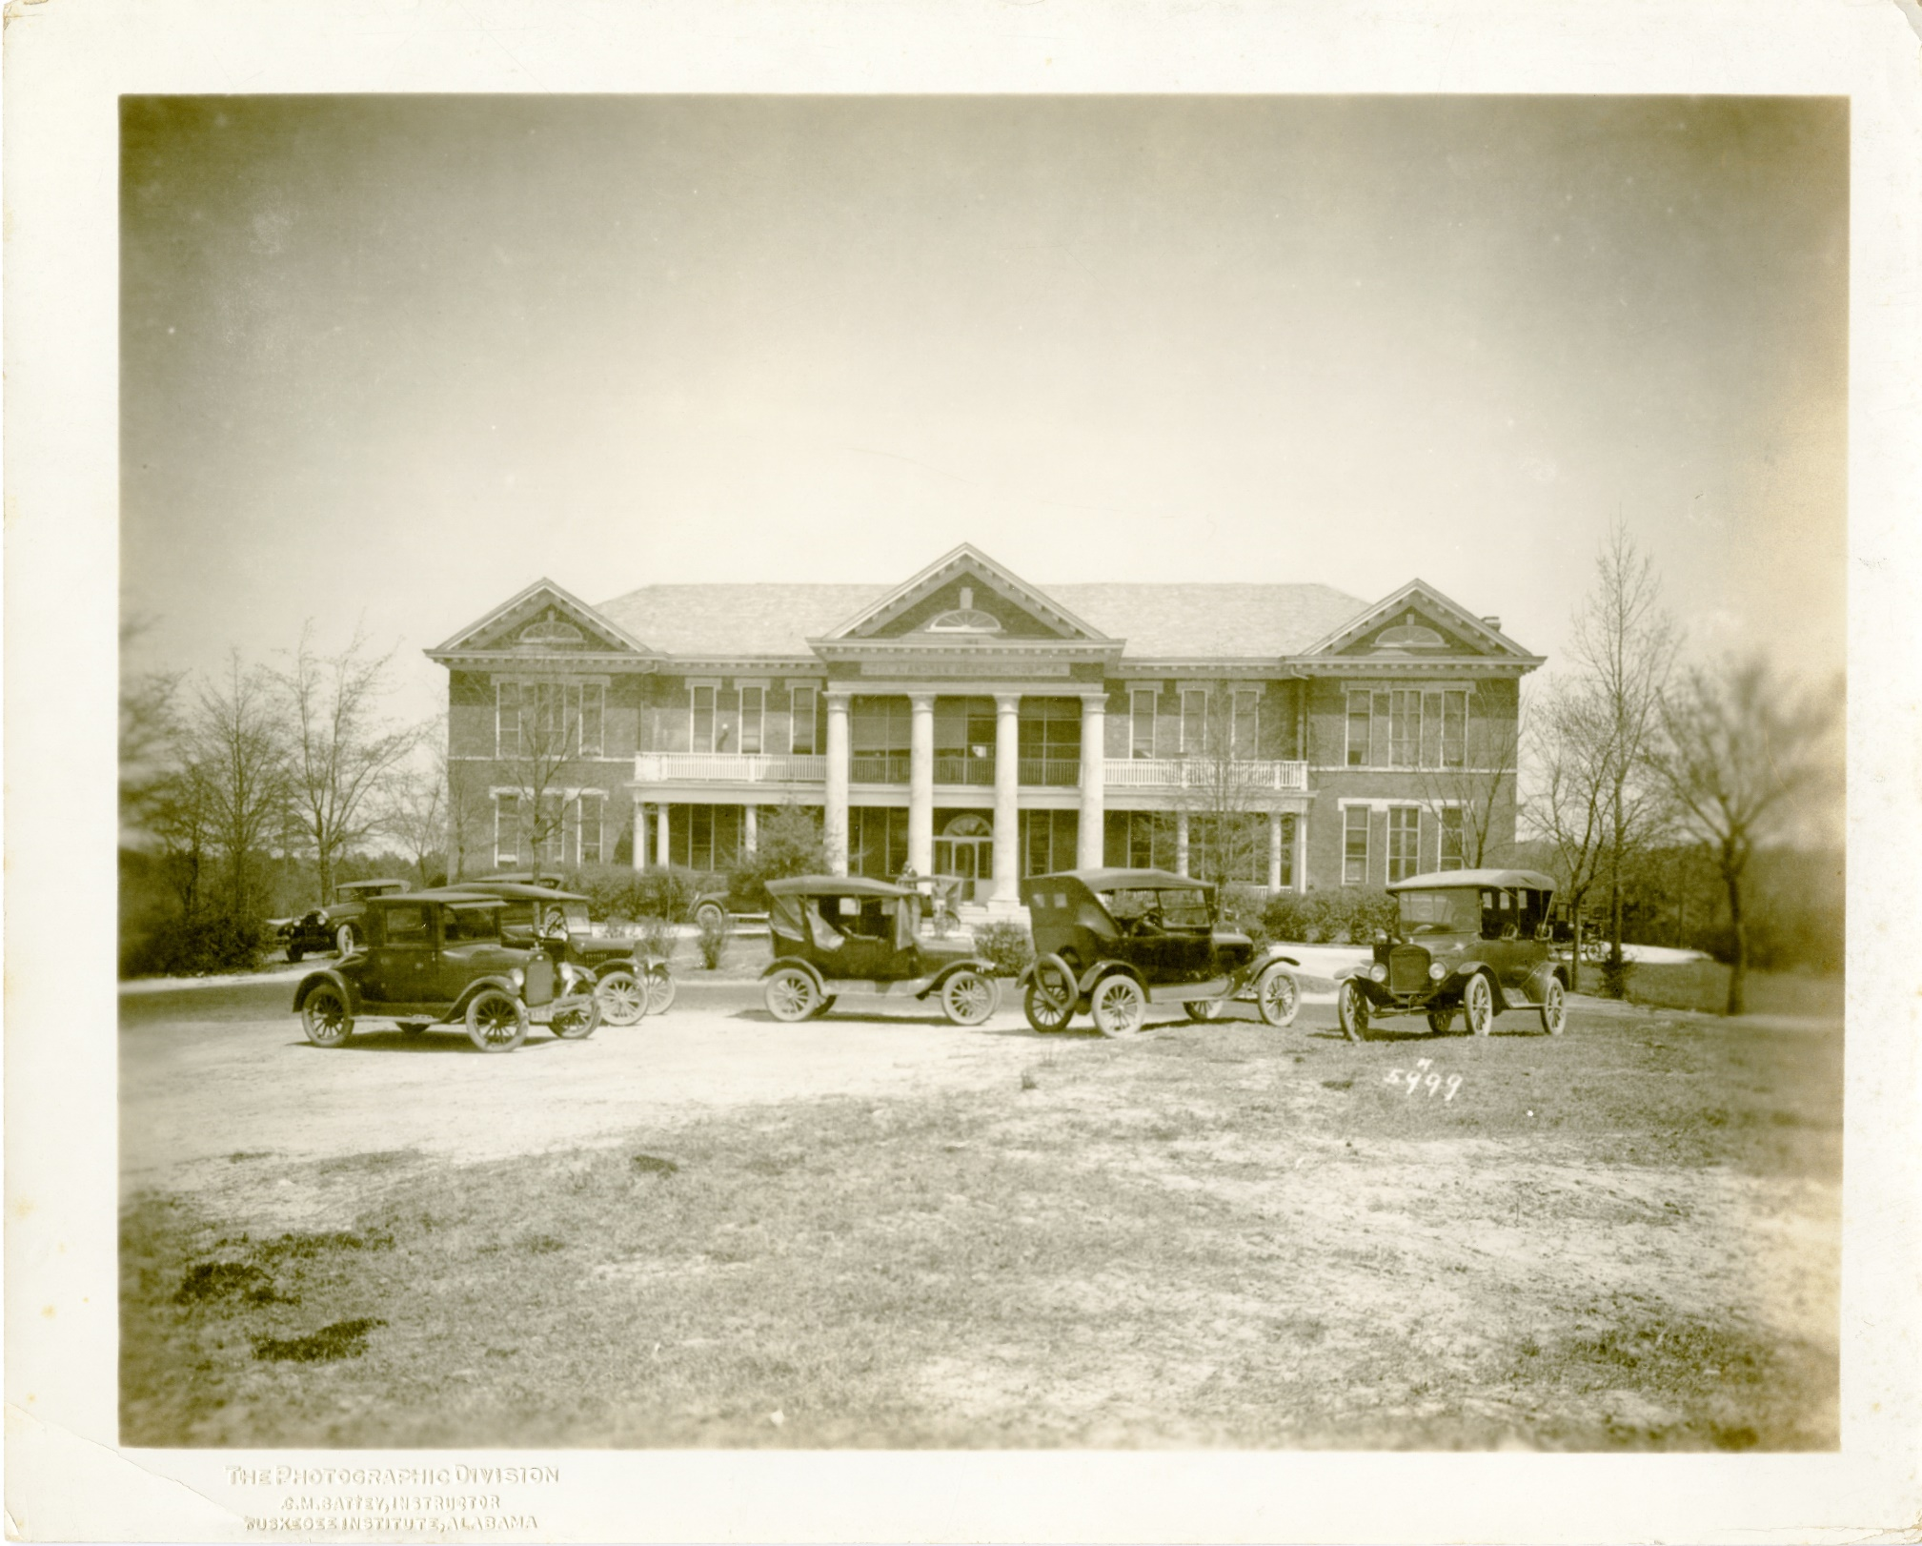

Slide 27
C.Battey Coll. box 1B047 - Cart with "We Want Better Health" Sign

Slide 28
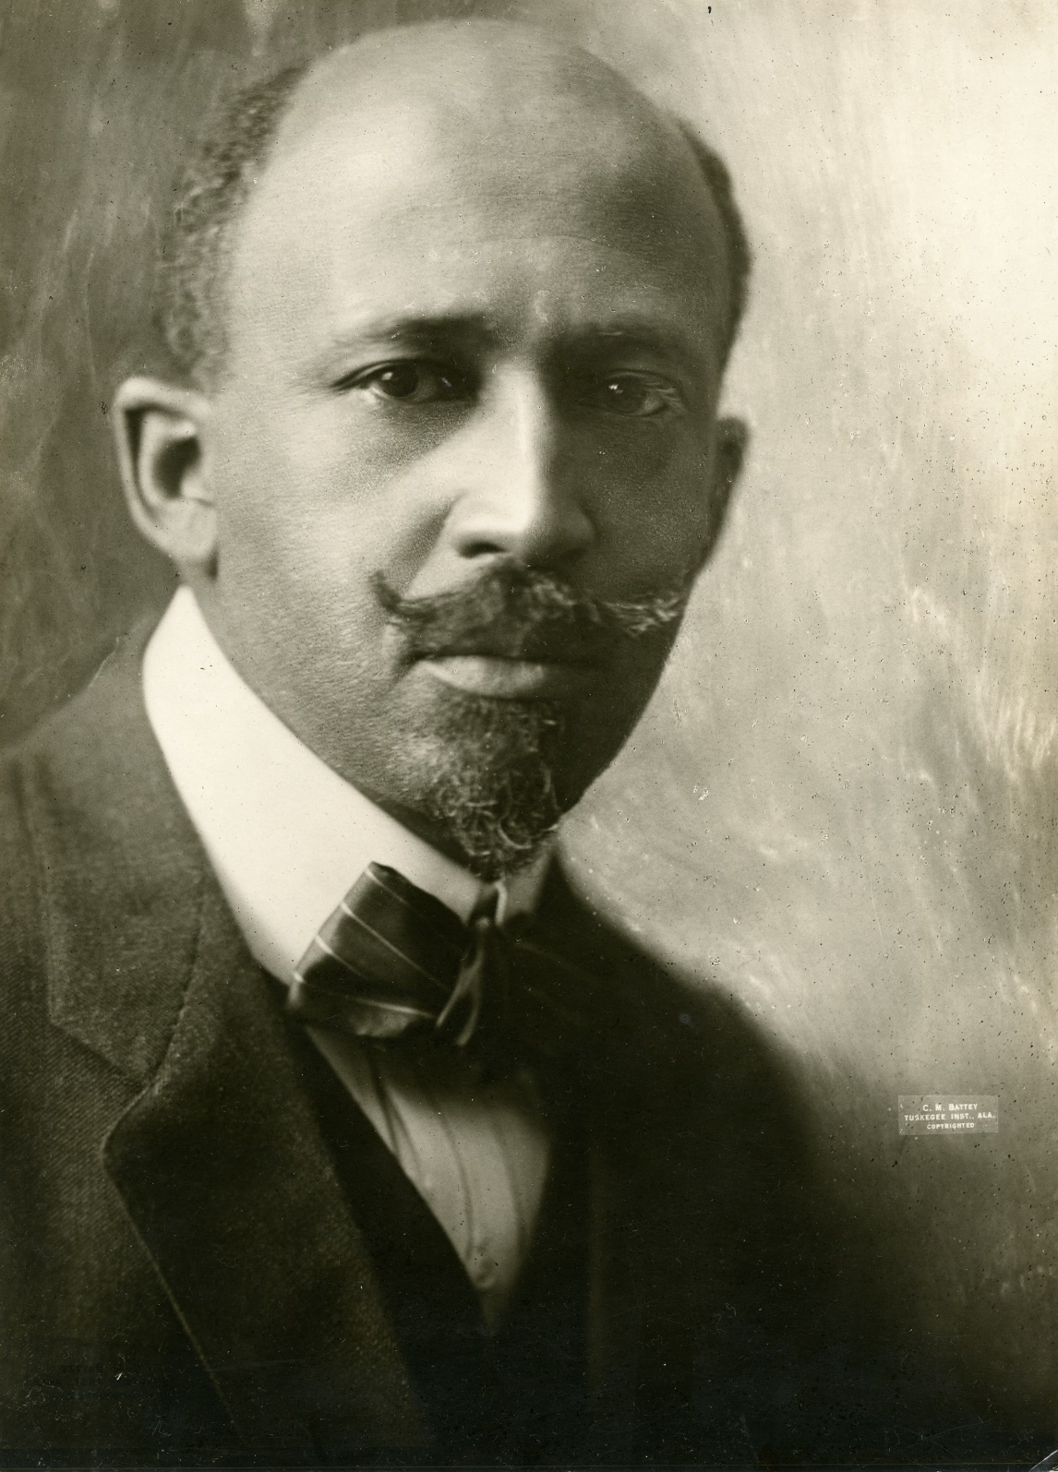

Slide 30
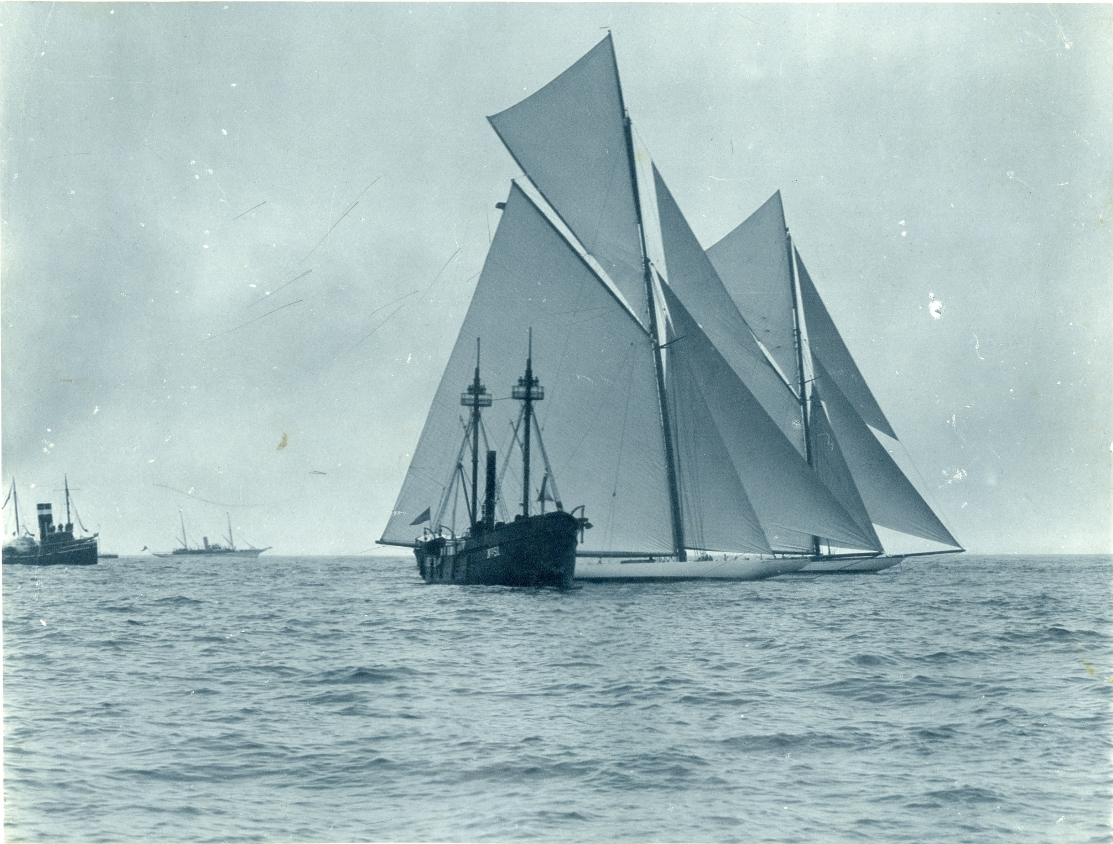

Slide 31
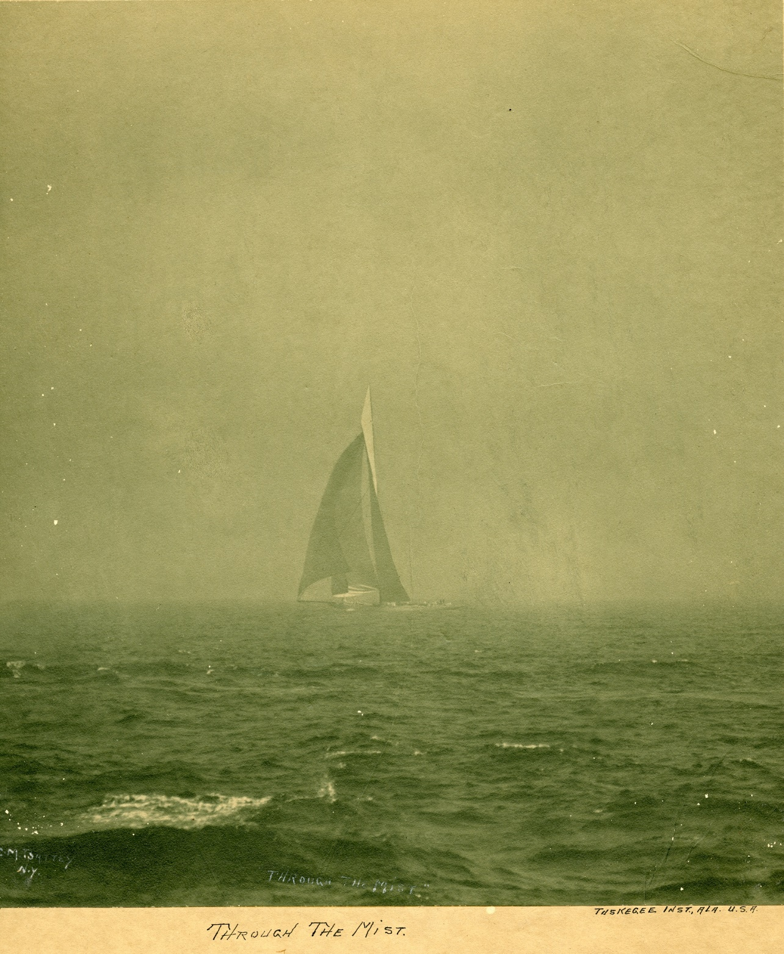

Slide 33
A.P. Bedou

Slide 34
Arthur P. Bedou
Born in New Orleans, LA, on July 6, 1882
Died June 2, 1966

Slide 35
Early Years
His family was poor and he received very little education
As a photographer he was largely self-taught.
Bedou worked for a time as a clerk, but by 1899 he was taking photographs
His career started in earnest when a photograph he took of a solar eclipse in 1900 received wide notice.

Slide 36
Formative Years
In 1903 Bedou documented a conference at the Tuskegee Institute in the hope of gaining visibility for his work.
Booker T. Washington saw some of his photographs and invited Bedou to accompany him as his personal photographer, preferring Bedou over other candidates like C. M. Battey in part for his ability to produce dynamic images of unfolding events.
Most of Bedou’s photographs of Washington were taken between 1908 and 1915, the year of Washington’s death.

Slide 37
Latter Years
To supplement his uncertain income from his travels with Washington, he had some of the photographs he took made into postcards, Christmas cards, and calendars.
His position brought him further commissions to photograph notables both black and white, including George Washington Carver, Theodore Roosevelt, Andrew Carnegie, and Julius Rosenwald.
Through the connection to Washington, Bedou was invited to become official photographer of the Tuskegee Institute.
Shortly after Washington’s death, however, he was replaced as the school’s official photographer by Battey, who at the time was favored by campus officials for various reasons.
Bedou was also in demand by other black colleges and schools such as Fisk University to document life on their campuses, and by professional organizations such as the National Negro Business Leagu, the National Medical Association, and the National Baptist Convention.

Slide 38
Particulars
In the 1920s, Bedou opened his own photography studio in New Orleans, where he photographed everything from black families and their children to the laying of the cornerstone at Corpus Christi Church to the visits of jazz bands and celebrity speakers
His photographs often appeared in both the Lousiana Weekly (a newspaper with a primarily black circulation) and the general-circulation newspaper Louisiana Times-Picayune
His photographs won several awards over the years, including the gold medal at the 1907 Jamestown Tercentennial Exposition.

Slide 39
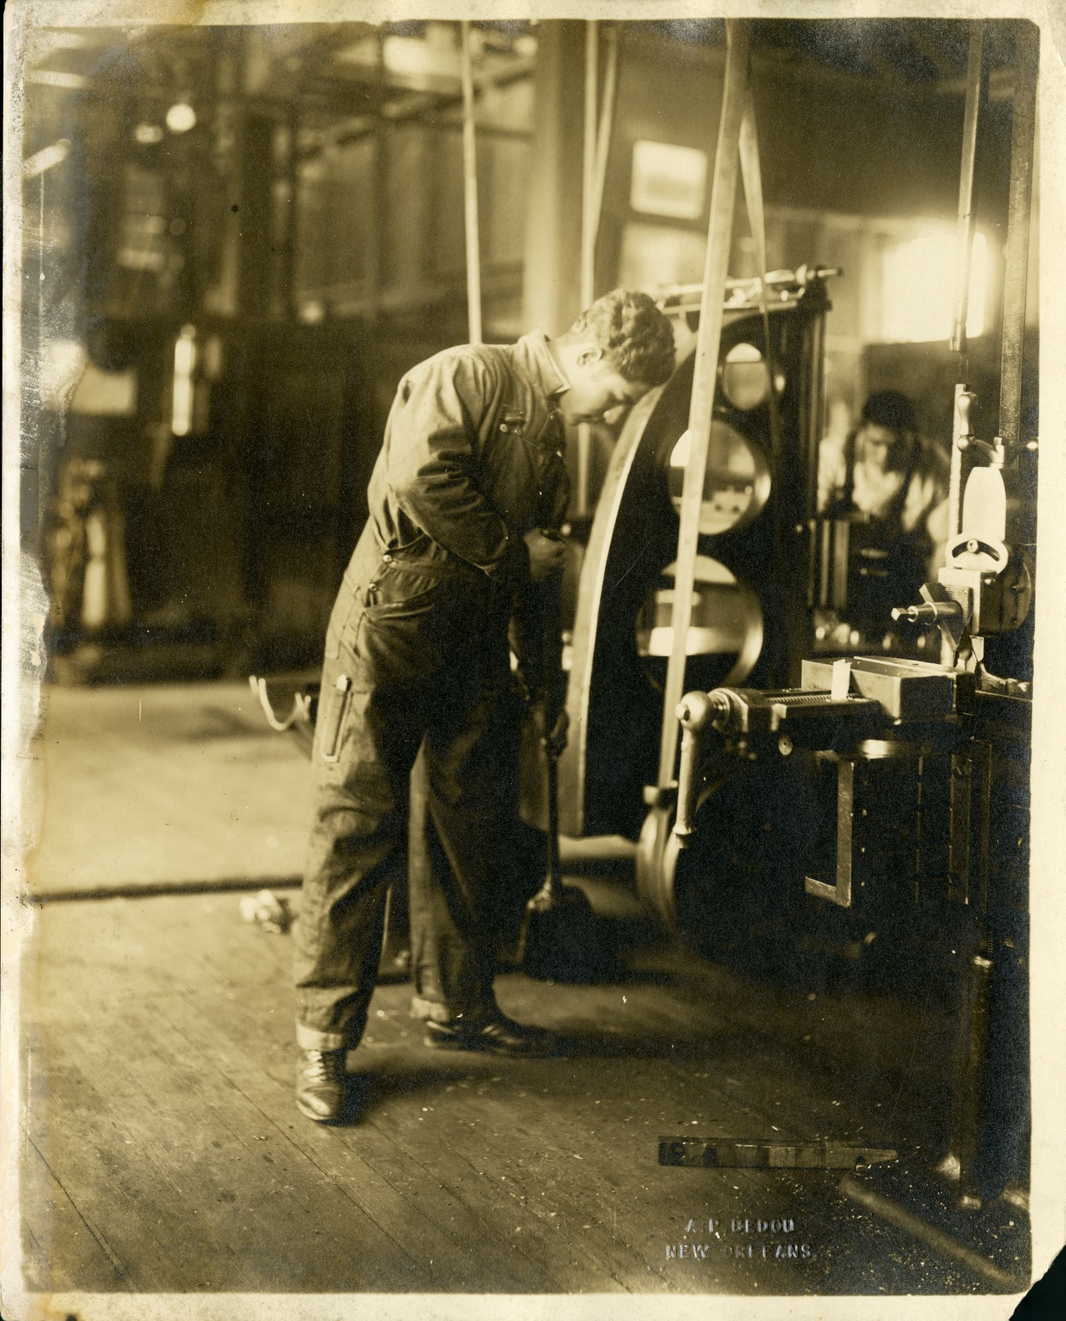

Slide 41
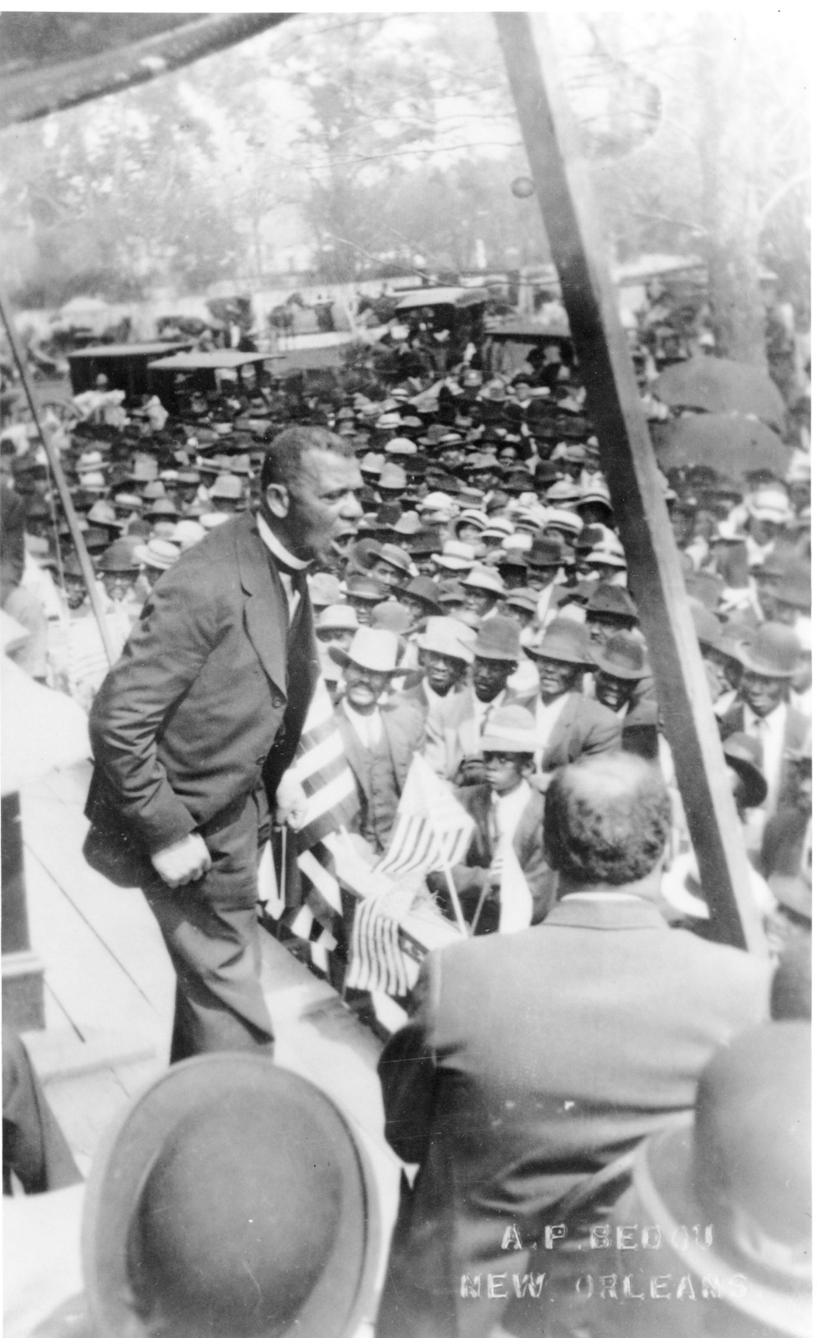

Slide 43
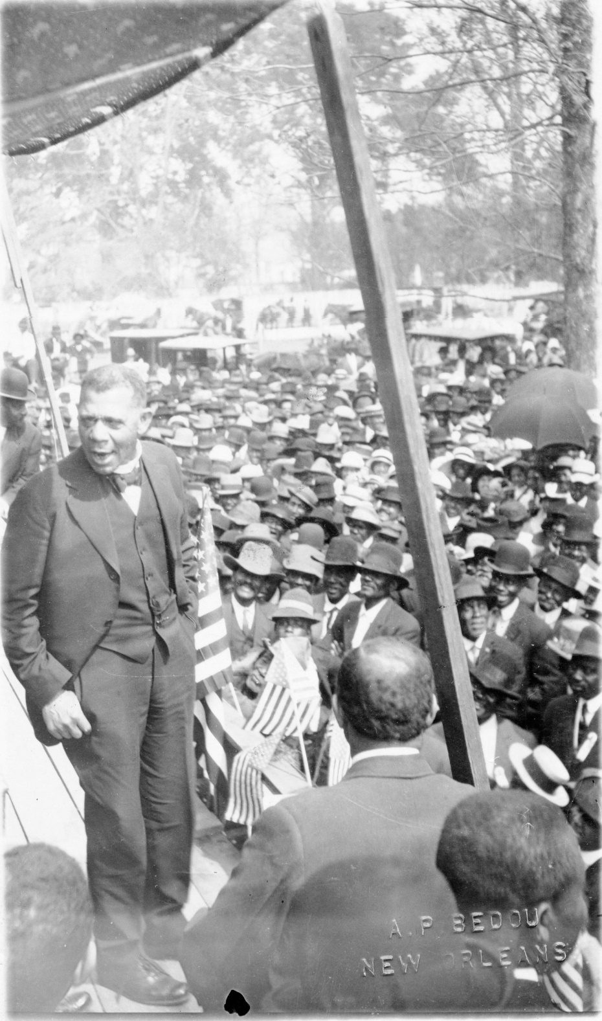

Slide 44
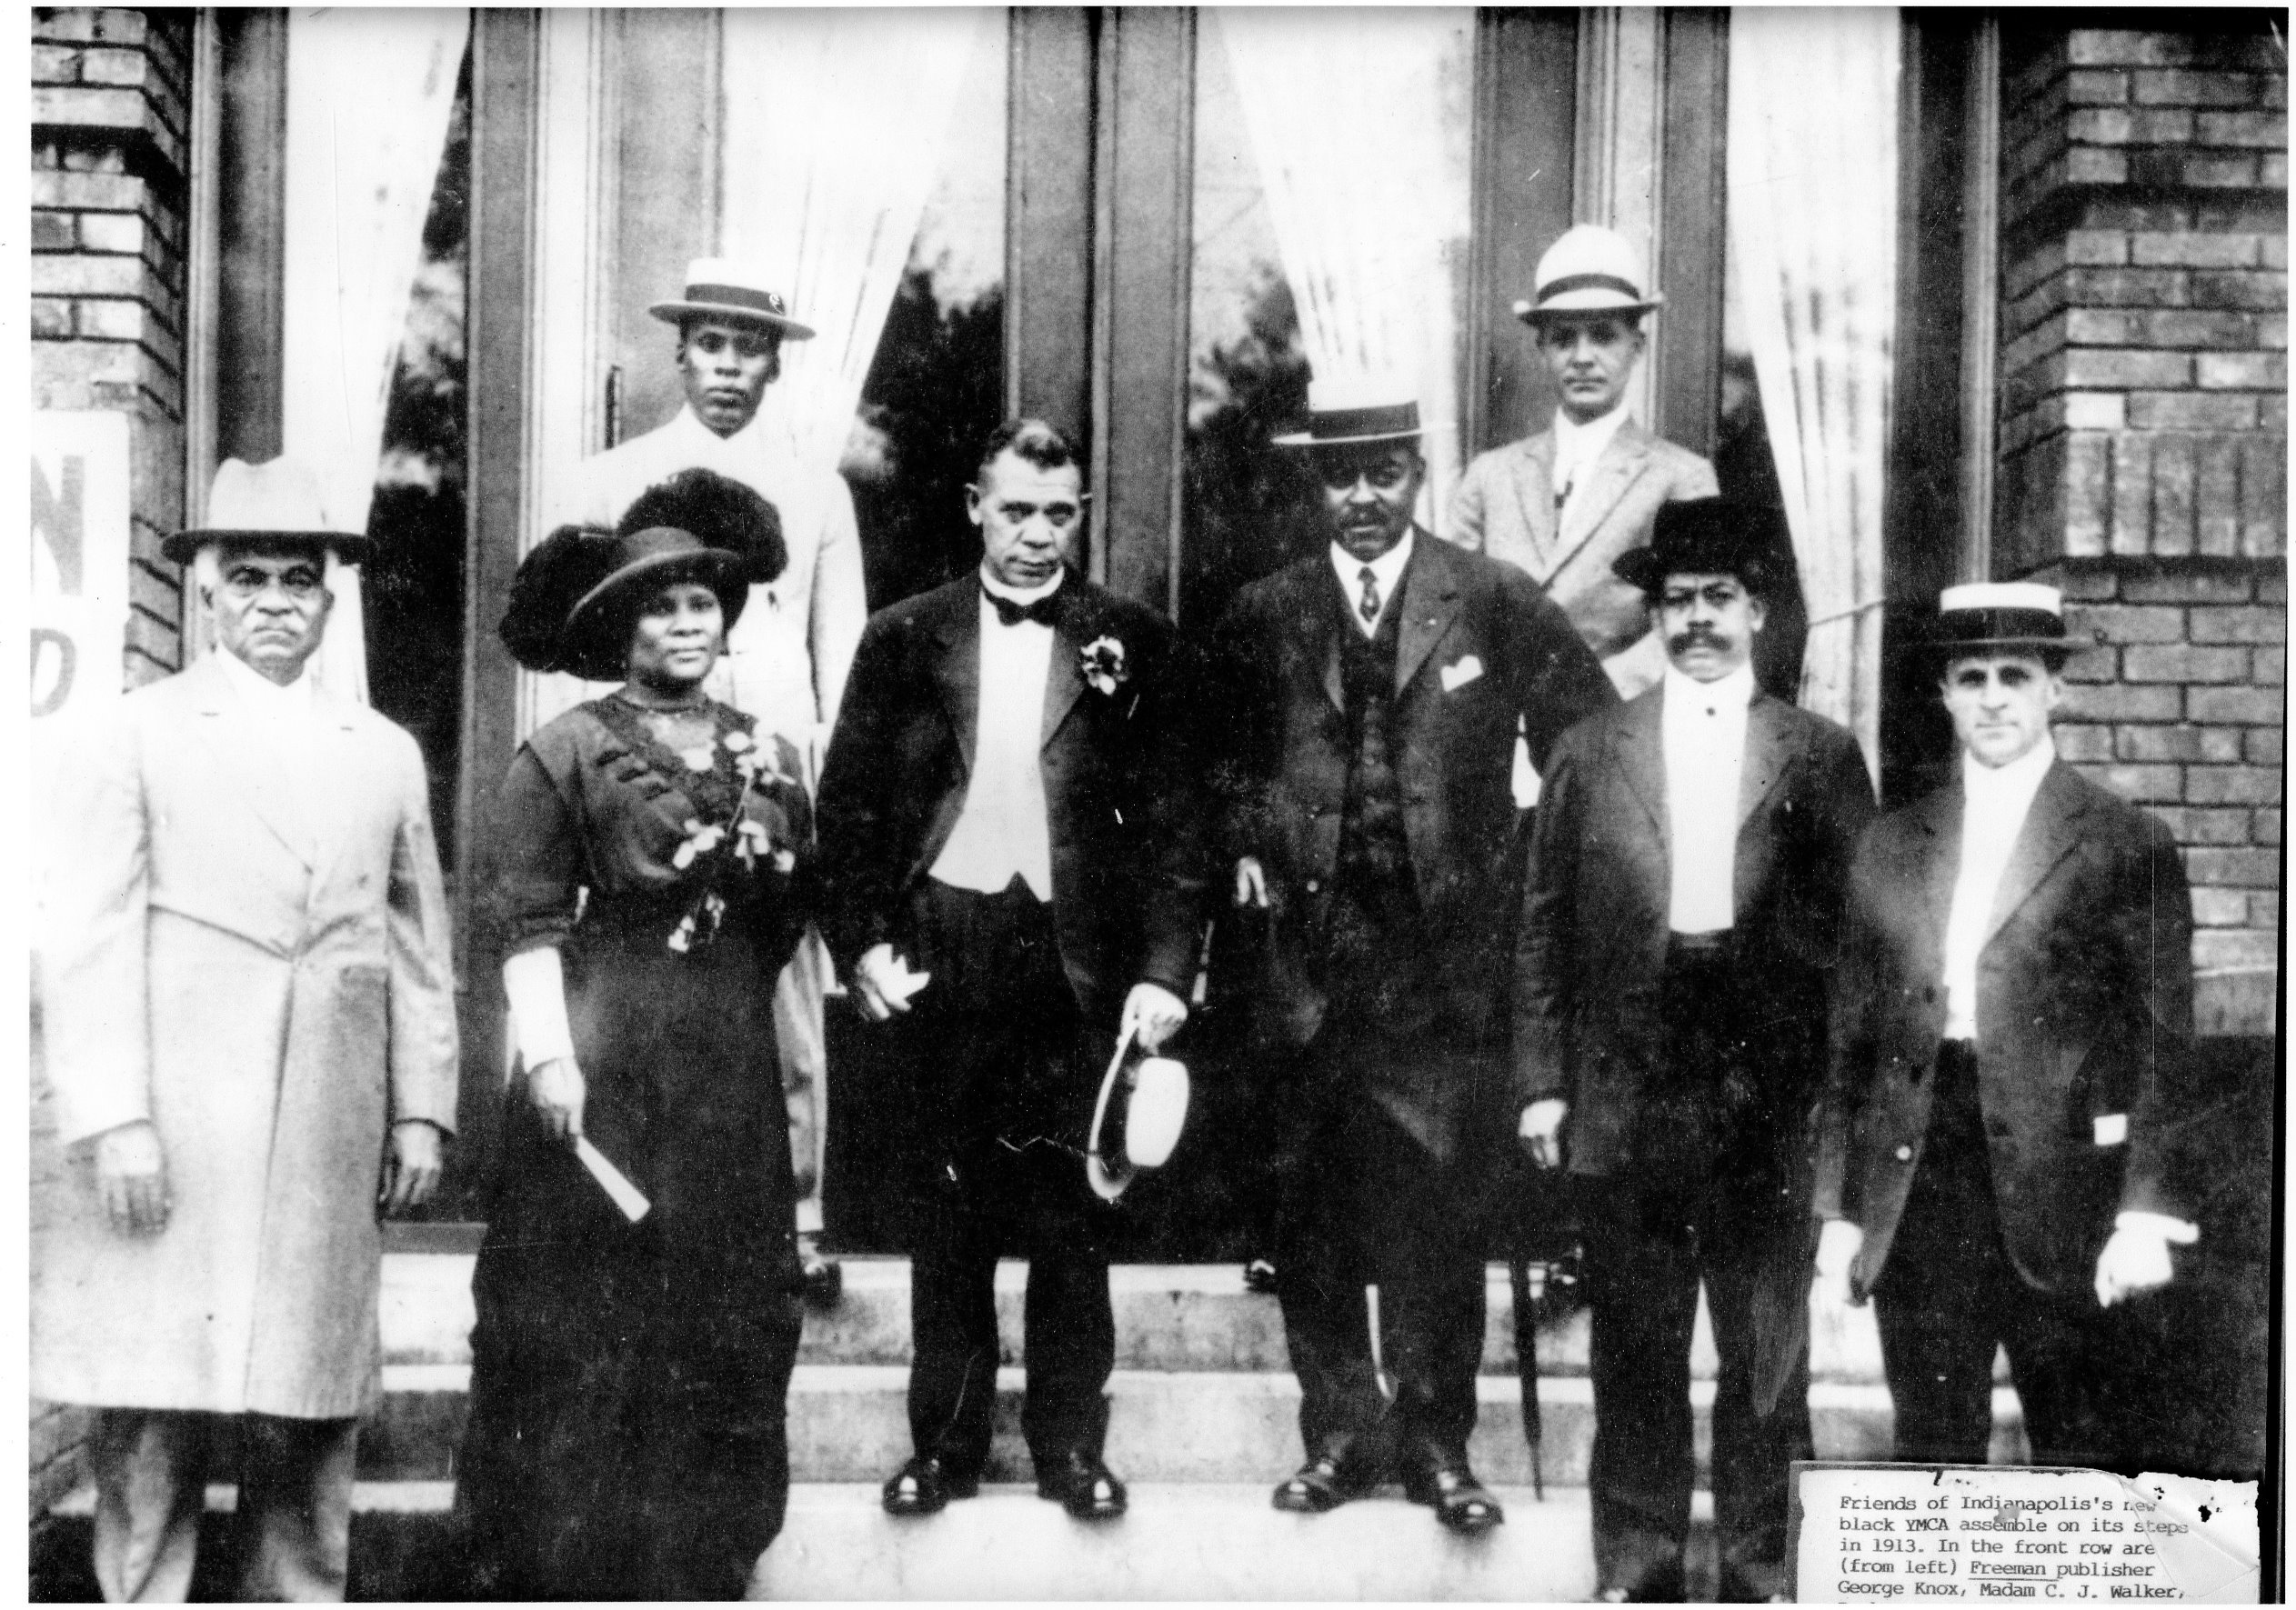

Slide 48
Tuskegee University Archives
We seek not to follow but to lead and, like our first President, Booker T. Washington, to provide our students with the best tools to compete in any situation, during any time, and in any country.

