Slide 1
TCA: Striving for What Is Right
By: Dana R. Chandler, TU Archivist
October 13, 2012
Tuskegee University Archives

Slide 3
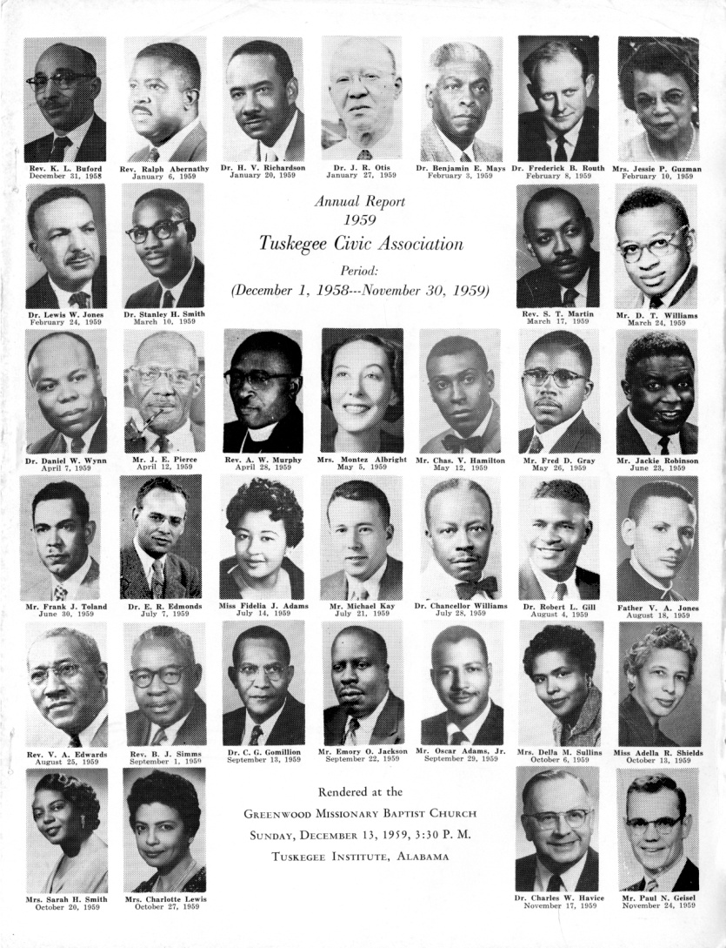
Beginnings
African American group dedicated to civil rights, voter education, and community welfare in Alabama.
Officially formed in 1941
Grew out of a group of men who had been meeting since 1910 as The Men’s Meeting and, later, The Tuskegee Men’s Club
Members (including both men and women) worked to improve the lives of African Americans in Tuskegee and its surrounding area of Macon County.

Slide 4
Charles G. Gomillion
Sociology professor at Tuskegee Institute
First president of TCA
Led association in publishing a voters’ handbook and held a "school for voters" on the Tuskegee campus to educate local African Americans
Under his leadership and help from the National Association for the Advancement of Colored People (NAACP), the association approached the U.S. Department of Justice for help in enforcing blacks’ legal rights, which were denied by local voter registration boards.
Their efforts met with success, as the number of black registered voters in Macon County swelled from under 100 in 1941 to more than 7,000 in 1967.

Slide 5
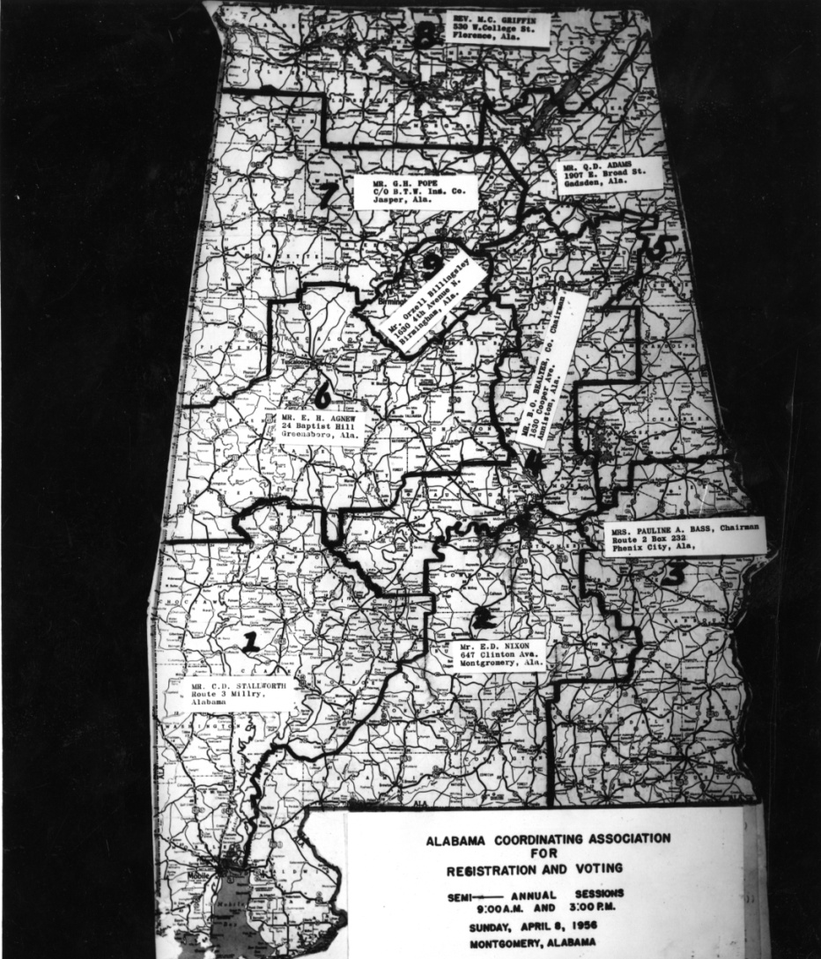
Other Work
The association also fought for school desegregation
1962 initiated a lawsuit, Lee v. Macon County, that demanded the integration of the local school system, which had stubbornly resisted implementing the U.S. Supreme Court’s call for desegregation as put forth in Brown v. Board of Education (1954).
Despite resistance, which included cross burnings and a Ku Klux Klan rally, a federal district court sided with the association in 1966.

Slide 6
1957
Perhaps the organization’s most important achievement was defeating a 1957 statutory redrawing of Tuskegee’s city limits
Classic case of gerrymandering that effectively disenfranchised the area’s growing black vote
Alabama passed Act 140 in 1957, which changed the boundaries of the city of Tuskegee, Alabama
It had previously been a square but the legislature redrew it as a 28 sided figure, excluding all but a handful of potential African-American votes
Led to TCA leading voters for right to vote

Slide 7
Gomillion V. Lightfoot
U.S. Supreme Court ruled that such redistricting had violated the 15th Amendment rights of Tuskegee’s African Americans
Passed on February 3, 1870, the 15th Amendment prohibits each government in the United States from denying a citizen the right to vote based on that citizen's "race, color, or previous condition of servitude" (for example, slavery).
Also, Equal Protection Clause of the Fourteenth Amendment provides that "no state shall ... deny to any person within its jurisdiction the equal protection of the laws."

Slide 8
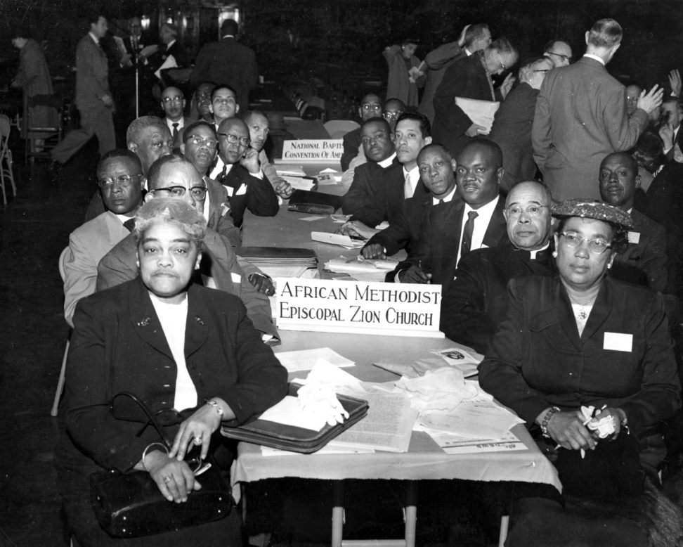
Voter’s Rights Act of 1965
Gomillion v Lightfoot paved way for this act
A landmark piece of national legislation in the United States that outlawed discriminatory voting practices that had been responsible for the widespread disenfranchisement of African Americans in the U.S.

Slide 9
"We have protested and shall continue until these inhumanities are abolished. We Negroes are doggone sick and tired of letting people, throw mud in our faces and stand by and let them rub it in.“ Rev. K. L. Buford

