Slide 1
The Southern Courier 1965-1968
Tuskegee University Archives

Slide 2
Choosing From a Variety of Sources Within the TU Archives
National Committee to Abolish the Poll Tax
Jennings Perry, Editor, Nashville Tennessean

Slide 3
Choosing From a Variety of Sources Within the TU Archives
The Tuskegee University Campus Digest
Sammy Younge: First Black College Student killed in the Civil Rights Movement

Slide 4
Telling the Story of Civil Rights…
Newspaper articles report dry facts
Basic information
Who, what, when and where
Often unemotional
Photographs capture a single moment
Emotion of the moment
Dry facts missing
What’s going on adjacent to the scene
Reporters notes, letters and observations can give a sense of how people felt during an event…the other story

Slide 5
Edward R. Murrow- My Dad’s Favorite
Famous CBS Reporter (1935-60)
Majored in Speech at Washington State University
Flew on Allied bombing raids in Europe during the WWII
Provided additional reports from the planes as they droned over Europe
Skilled at improvising vivid descriptions of what was going on around him, aided the effectiveness of his radio broadcasts^{[1]}

Slide 6
What We Get From Newspaper Archival Collections
Background similar to that which Murrow gave.
Not necessarily voices over a tape, but voices within their written records…

Slide 7
What We Are Not Going to Get…
From blogs, background information is lost
From Internet headlines, not full story
These things will sadly leave us little to fill in the rest of the story.
Why?
No archival material!

Slide 8
The Records of the Southern Courier give us the rest of the story regarding the Civil Rights Movement in Alabama during its most turbulent time

Slide 9
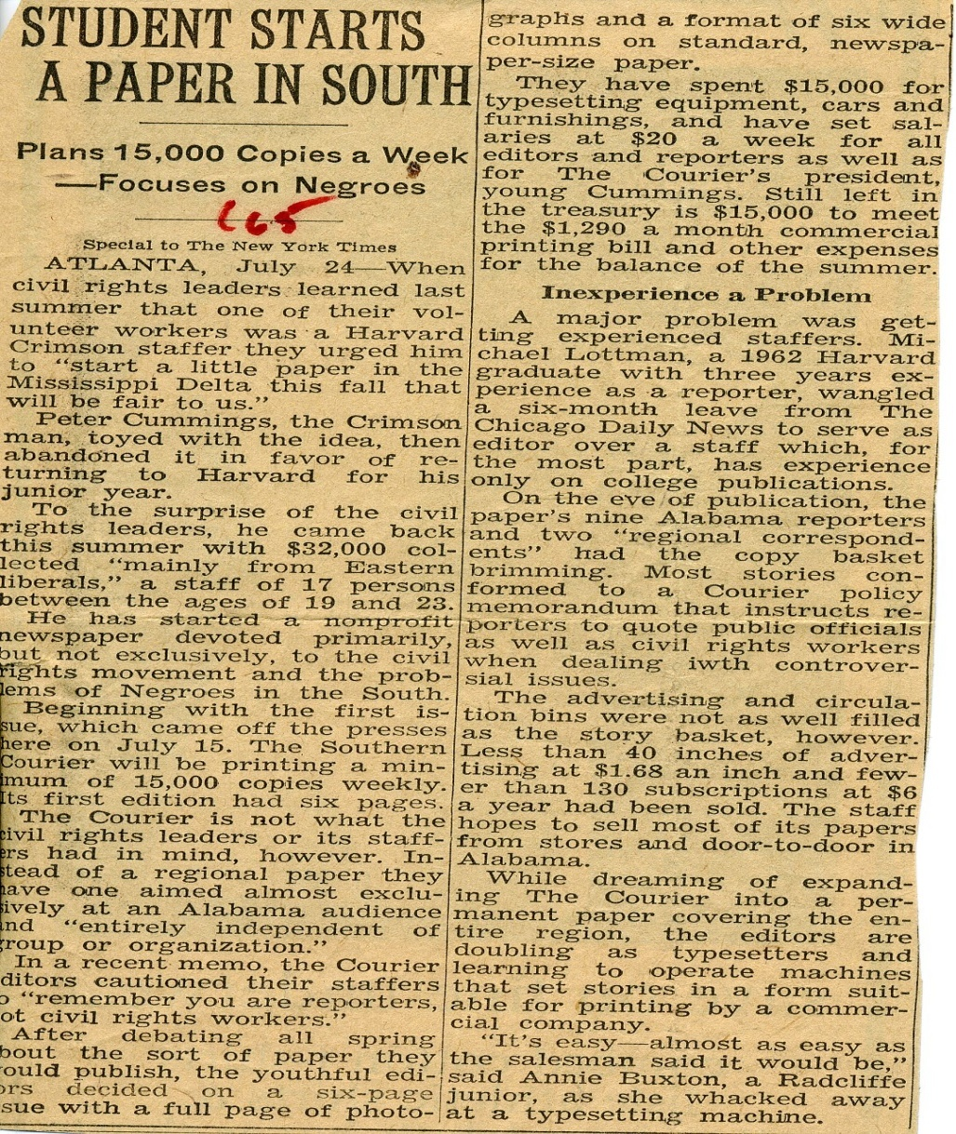
Southern Courier
Based in Montgomery, Alabama
Civil Rights Movement from July 1965 to December 1968
Originally planned as a regional, non-profit, independent paper
Its young staffers (which ranged in age from 19 to 23) narrowed their efforts toward an almost exclusive Alabama audience.

Slide 10
Its Beginning
Started by Peter Cummings of the Harvard Crimson, Harvard University, Boston, Massachusetts
Incorporated July 13, 1965, under the Southern Educational Conference, Inc.

Slide 11
Staffing
Michael Lottman, the paper’s editor:
sought to insure the paper’s integrity
was an active fundraiser
was astern supervisor over the paper’s 17 original staff members and many distributors.
Reporters were expected to:
become part of the communities from which they reported
write articles without bias
be independent from any groups or organizations.

Slide 12
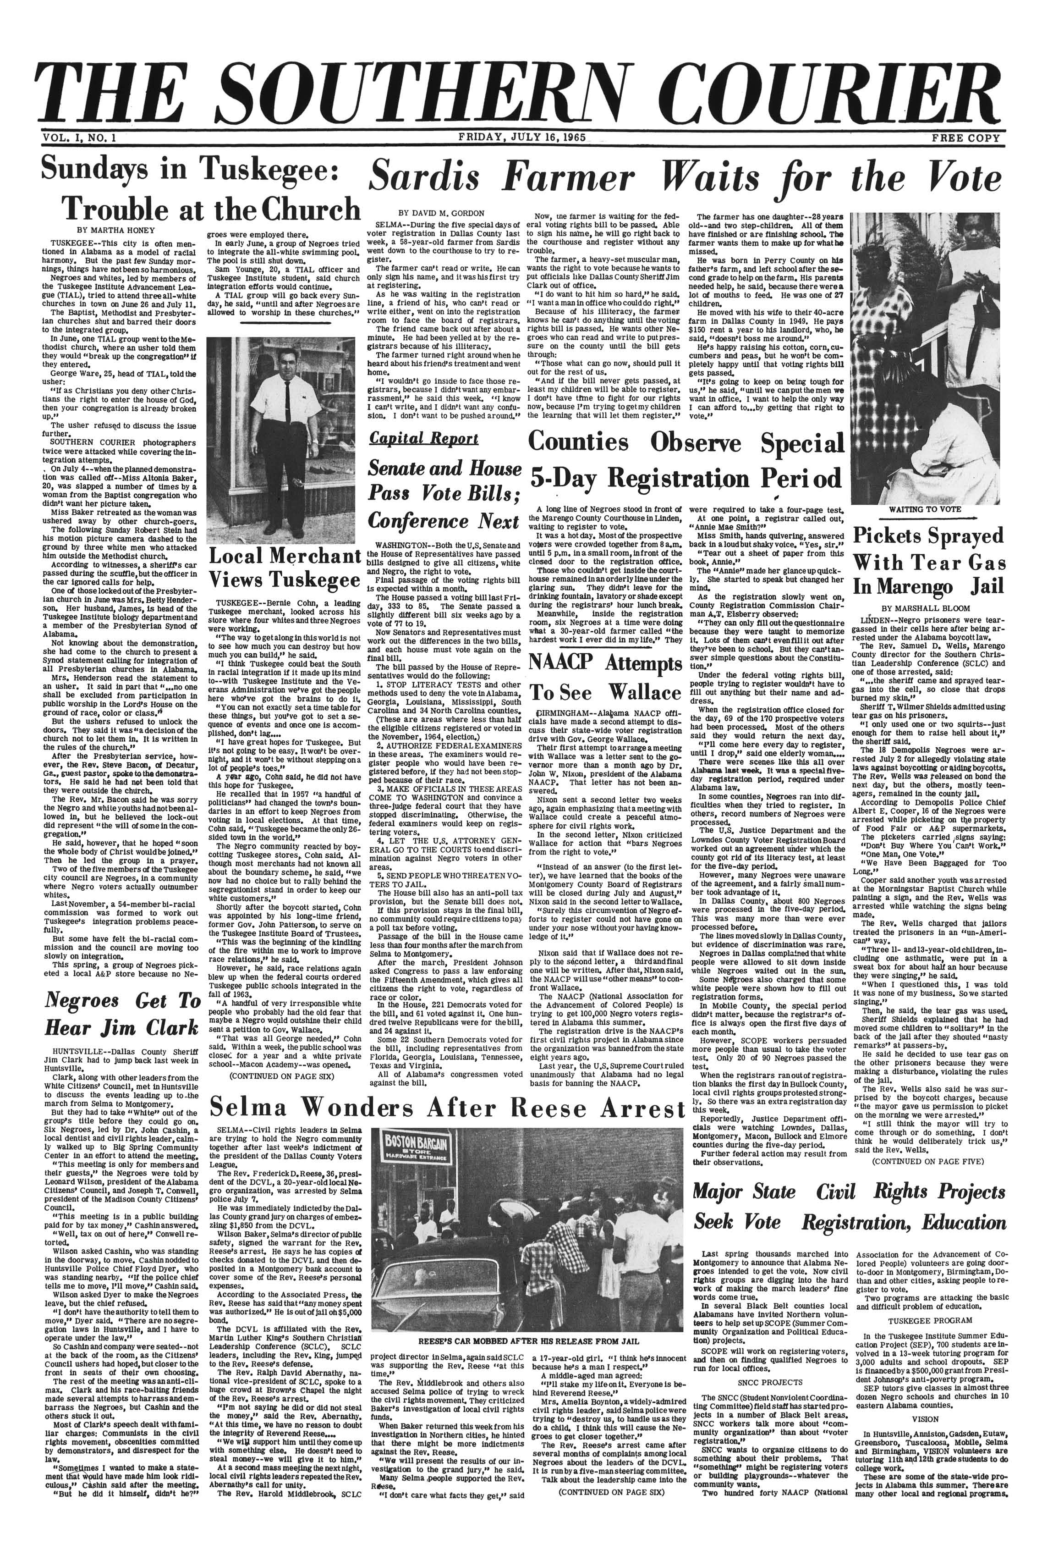
The Paper
Originally consisting of a simple six-page format
Had a fluctuating distribution which began at 15,000 copies
Throughout its entire time, subscriptions and advertising were insufficient in maintaining the paper’s financial stability.
First Issue of The Southern Courier,
Vol. I, no. 1, Friday, July 16, 1965

Slide 13
“…forced to go out and warmly and charmingly steal.”
Used $32,000.00 startup funds received primarily from “Eastern liberals”
Eventually received grants from a variety of corporations and endowments, which aided with operating expenses
Austere measures, during the entire time of publication, meant that staff members relied on “help from home” and often doubled as typesetters and printers.

Slide 14
The Reporters
Although pro-civil rights, they viewed themselves, not as agents of change, but as witnesses to the societal upheaval of a nation’s evolution.
These young men and women (both black and white) often found themselves in precarious situations during marches, meetings and events where violence often occurred.
Nonetheless, they approached their work…
with youthful exuberance
distinct desire for unbiased reporting

Slide 15
“We are tired... and scared”
Many letters pointing out the difficulties and dangers the reporters and delivery people faced
Some had to face “mad dogs”
Some were beaten, sometimes badly
Many times they were ridiculed, cursed and spit upon
Some were threatened with death

Slide 16
Not Everyone Can Respond…
“Each week I am anxiously awaiting…
Please don’t think that people are not proud… because they do not respond.
We want to know about our people…
We want to know what is going on…
With the Courier, we can, for the first time, know…”

Slide 17
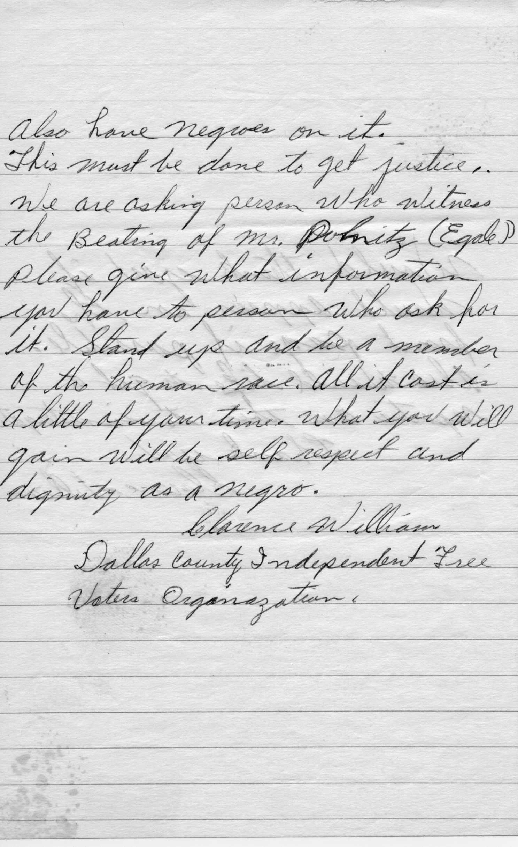
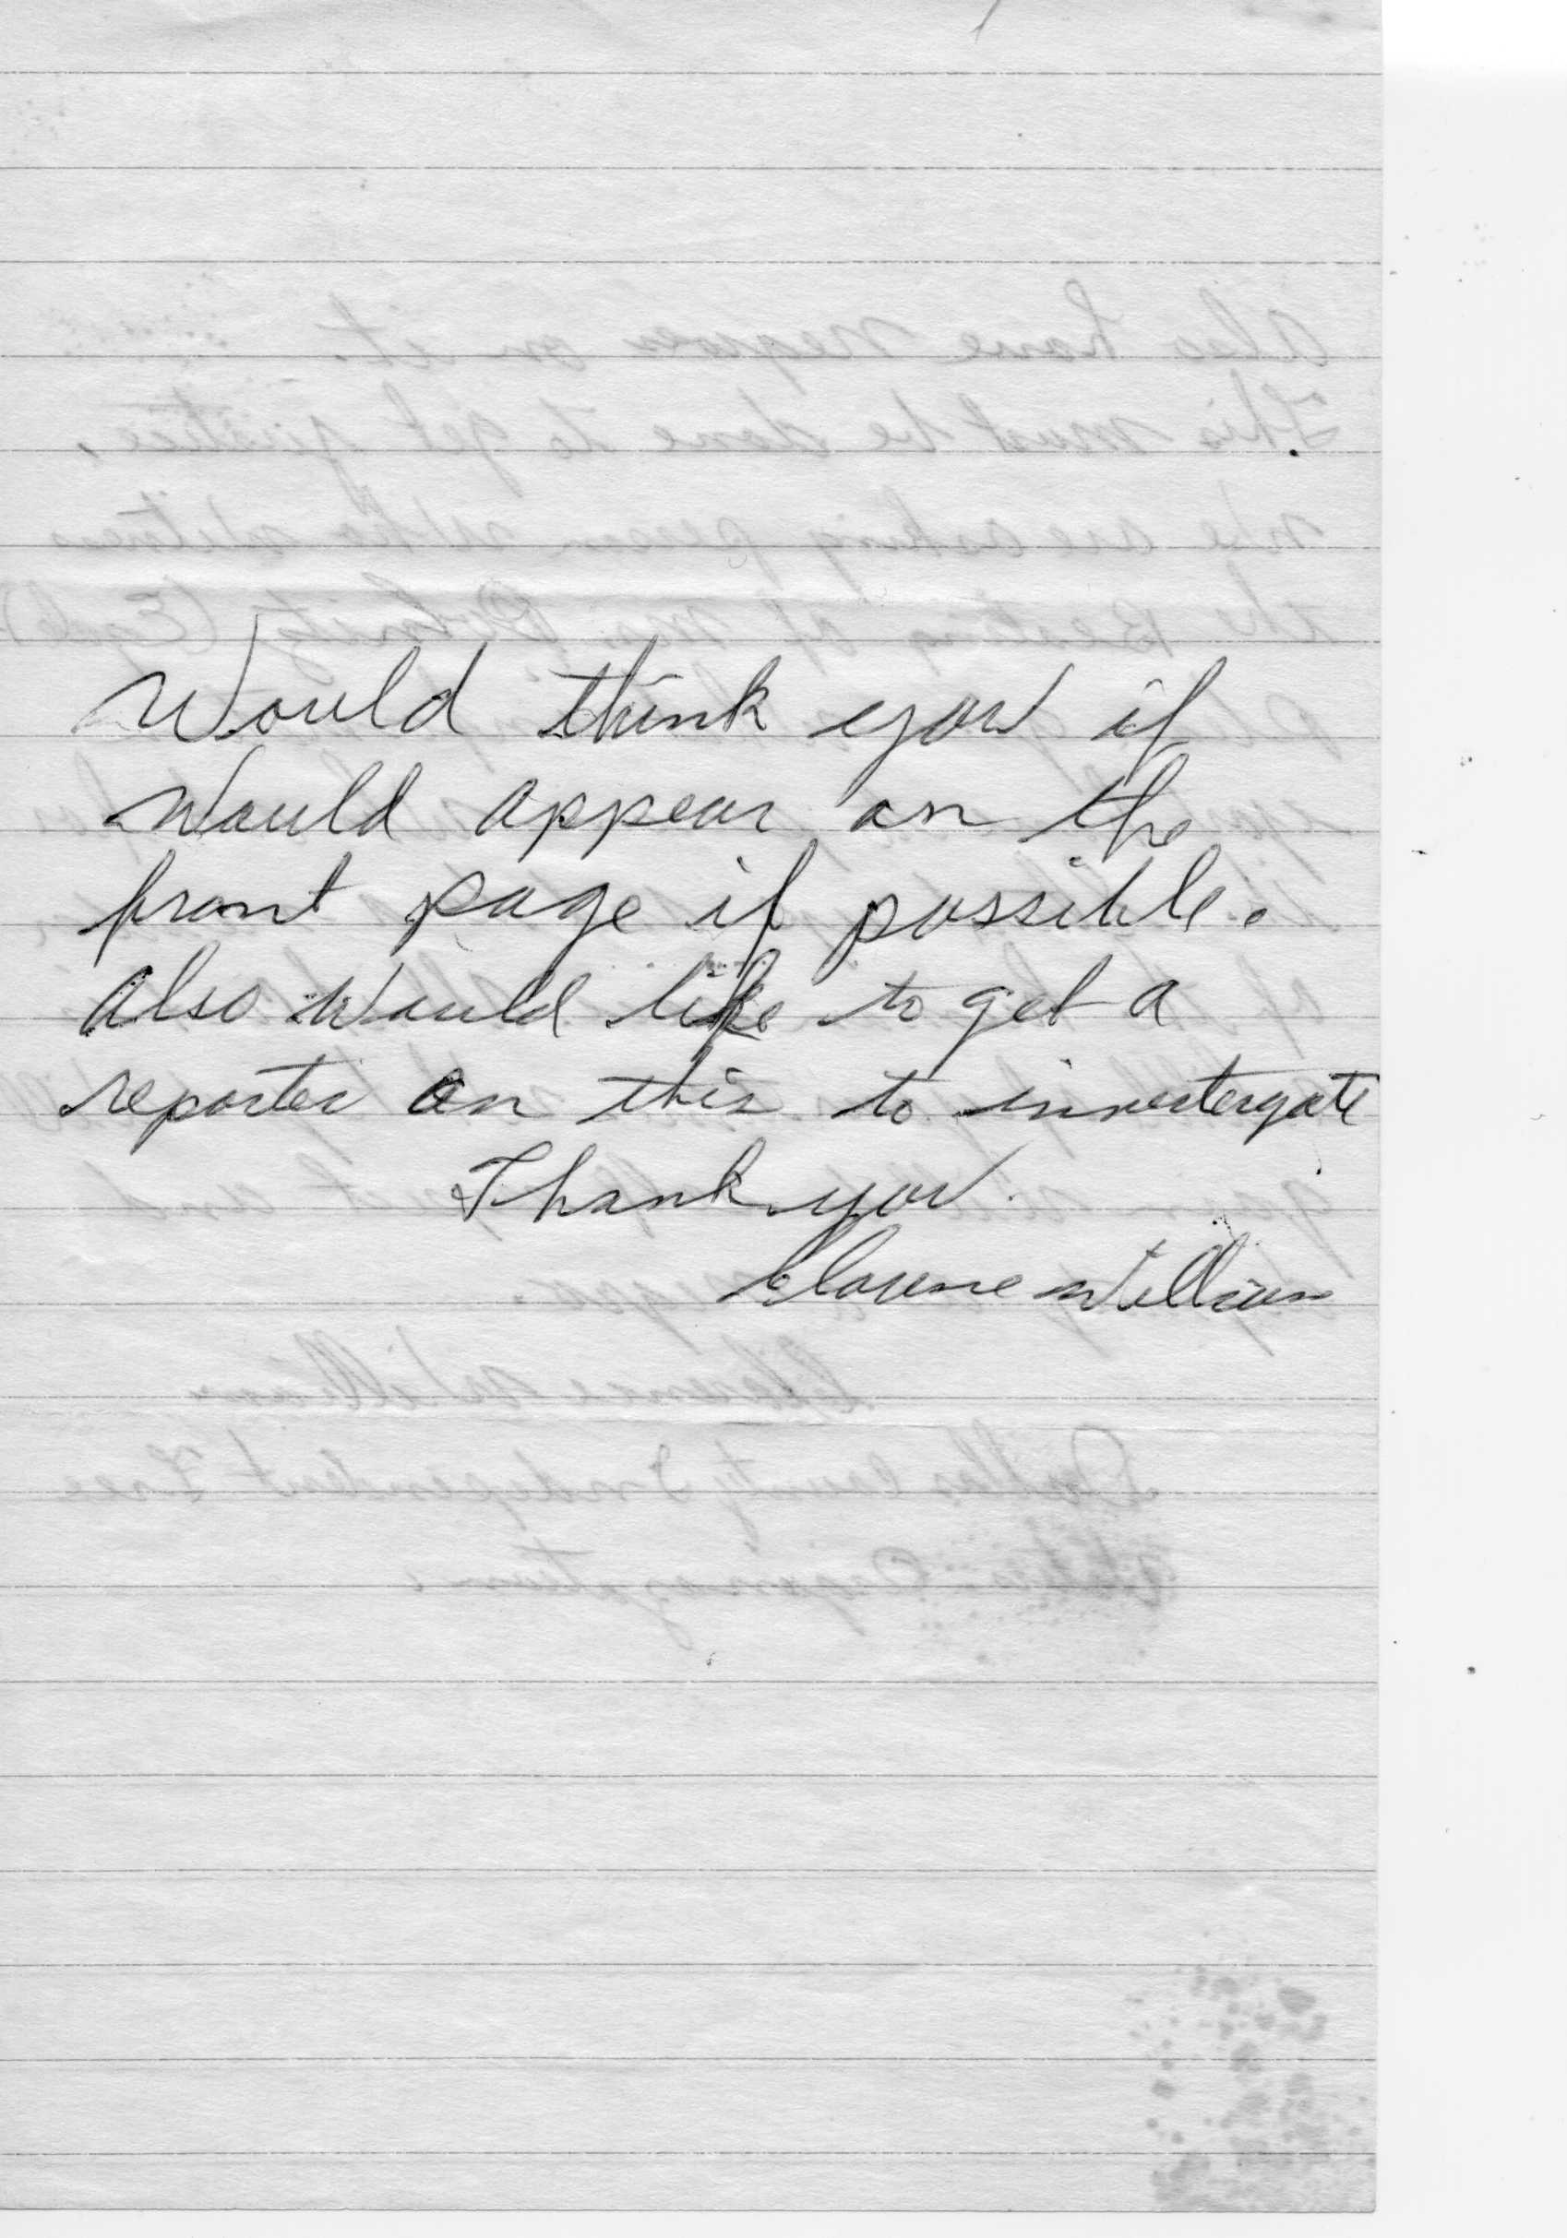
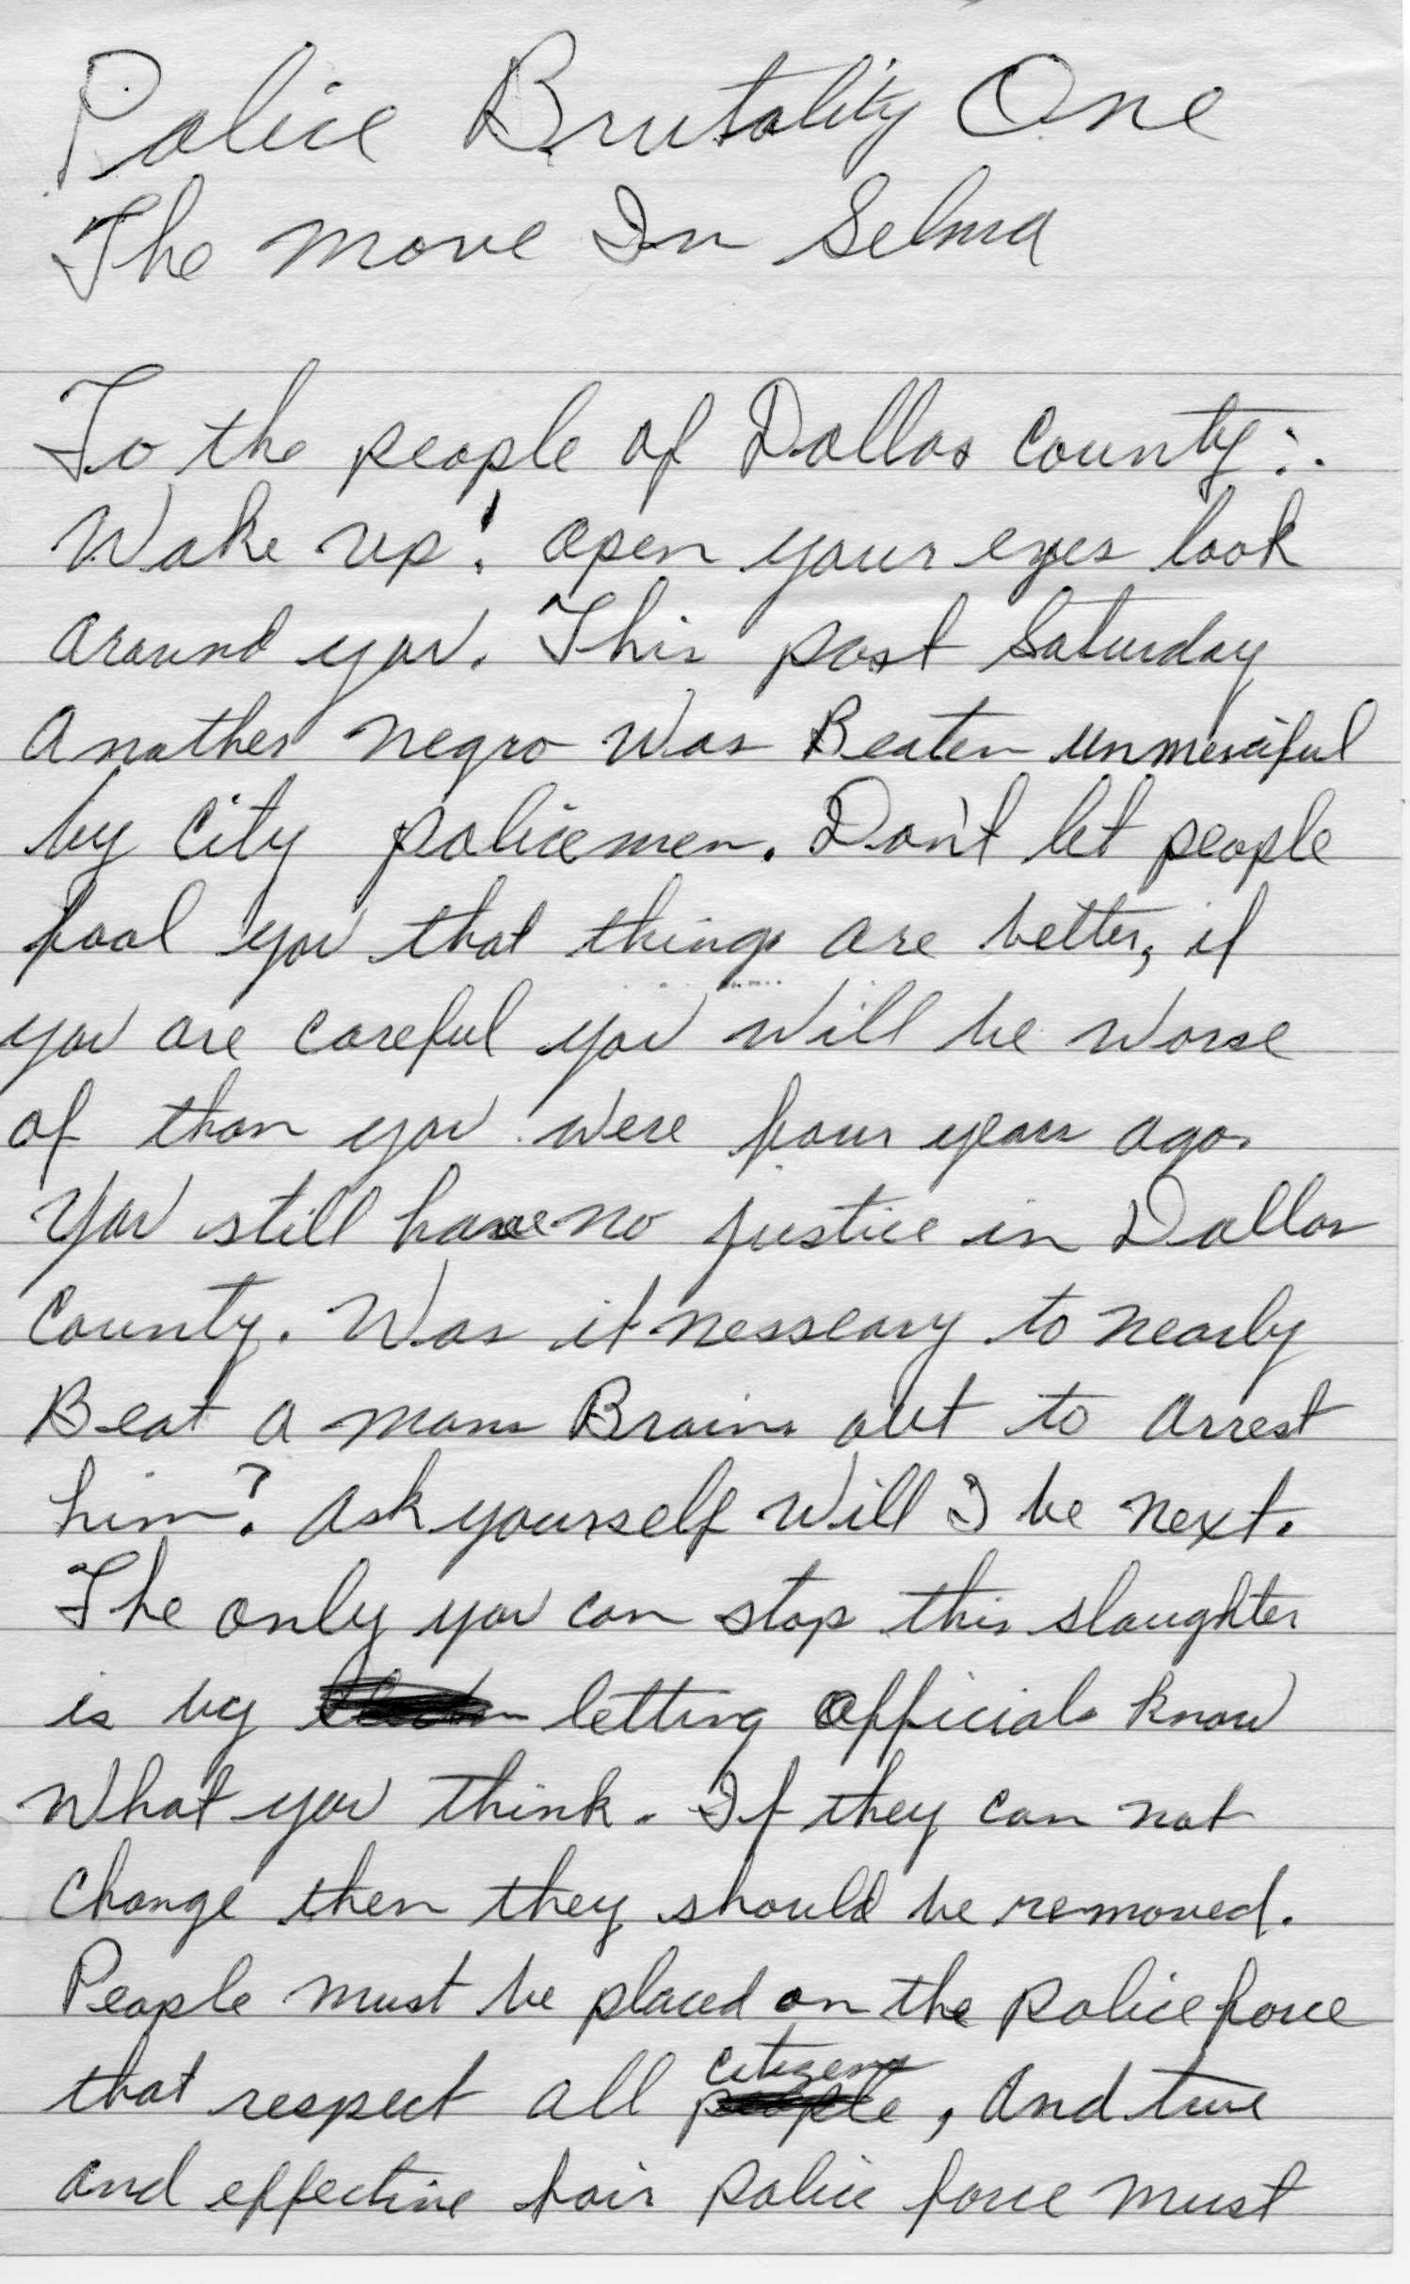
Brutality…
Clarence Williams wrote from the Dallas County Independent Free Voters Organization
Correspondence entitled: “Police Brutality One (sic) The Move In Selma”

Slide 18
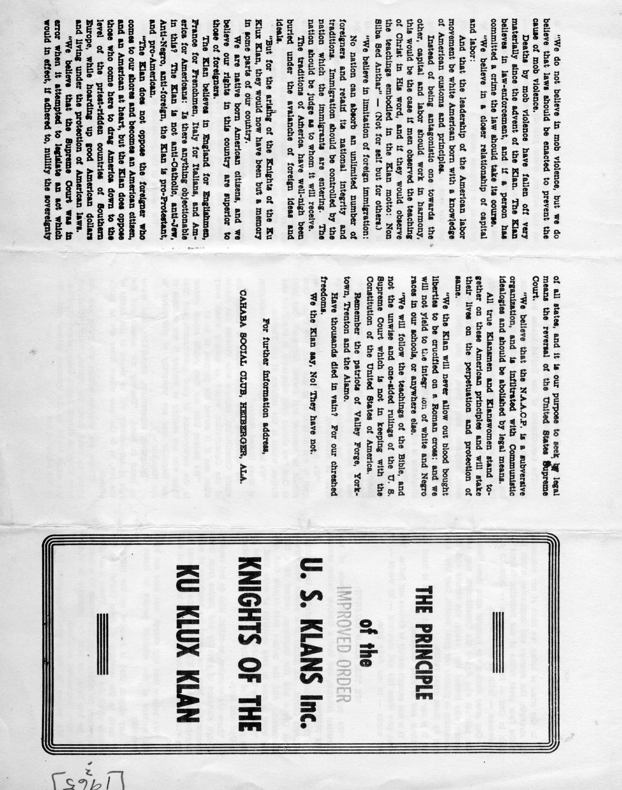
Tried to be Unbiased, Showing Both Sides…
The Principle of the US KLANS Inc.
News Release from the Student Nonviolent Coordinating Committee (SNCC), Selma, Alabama

Slide 19
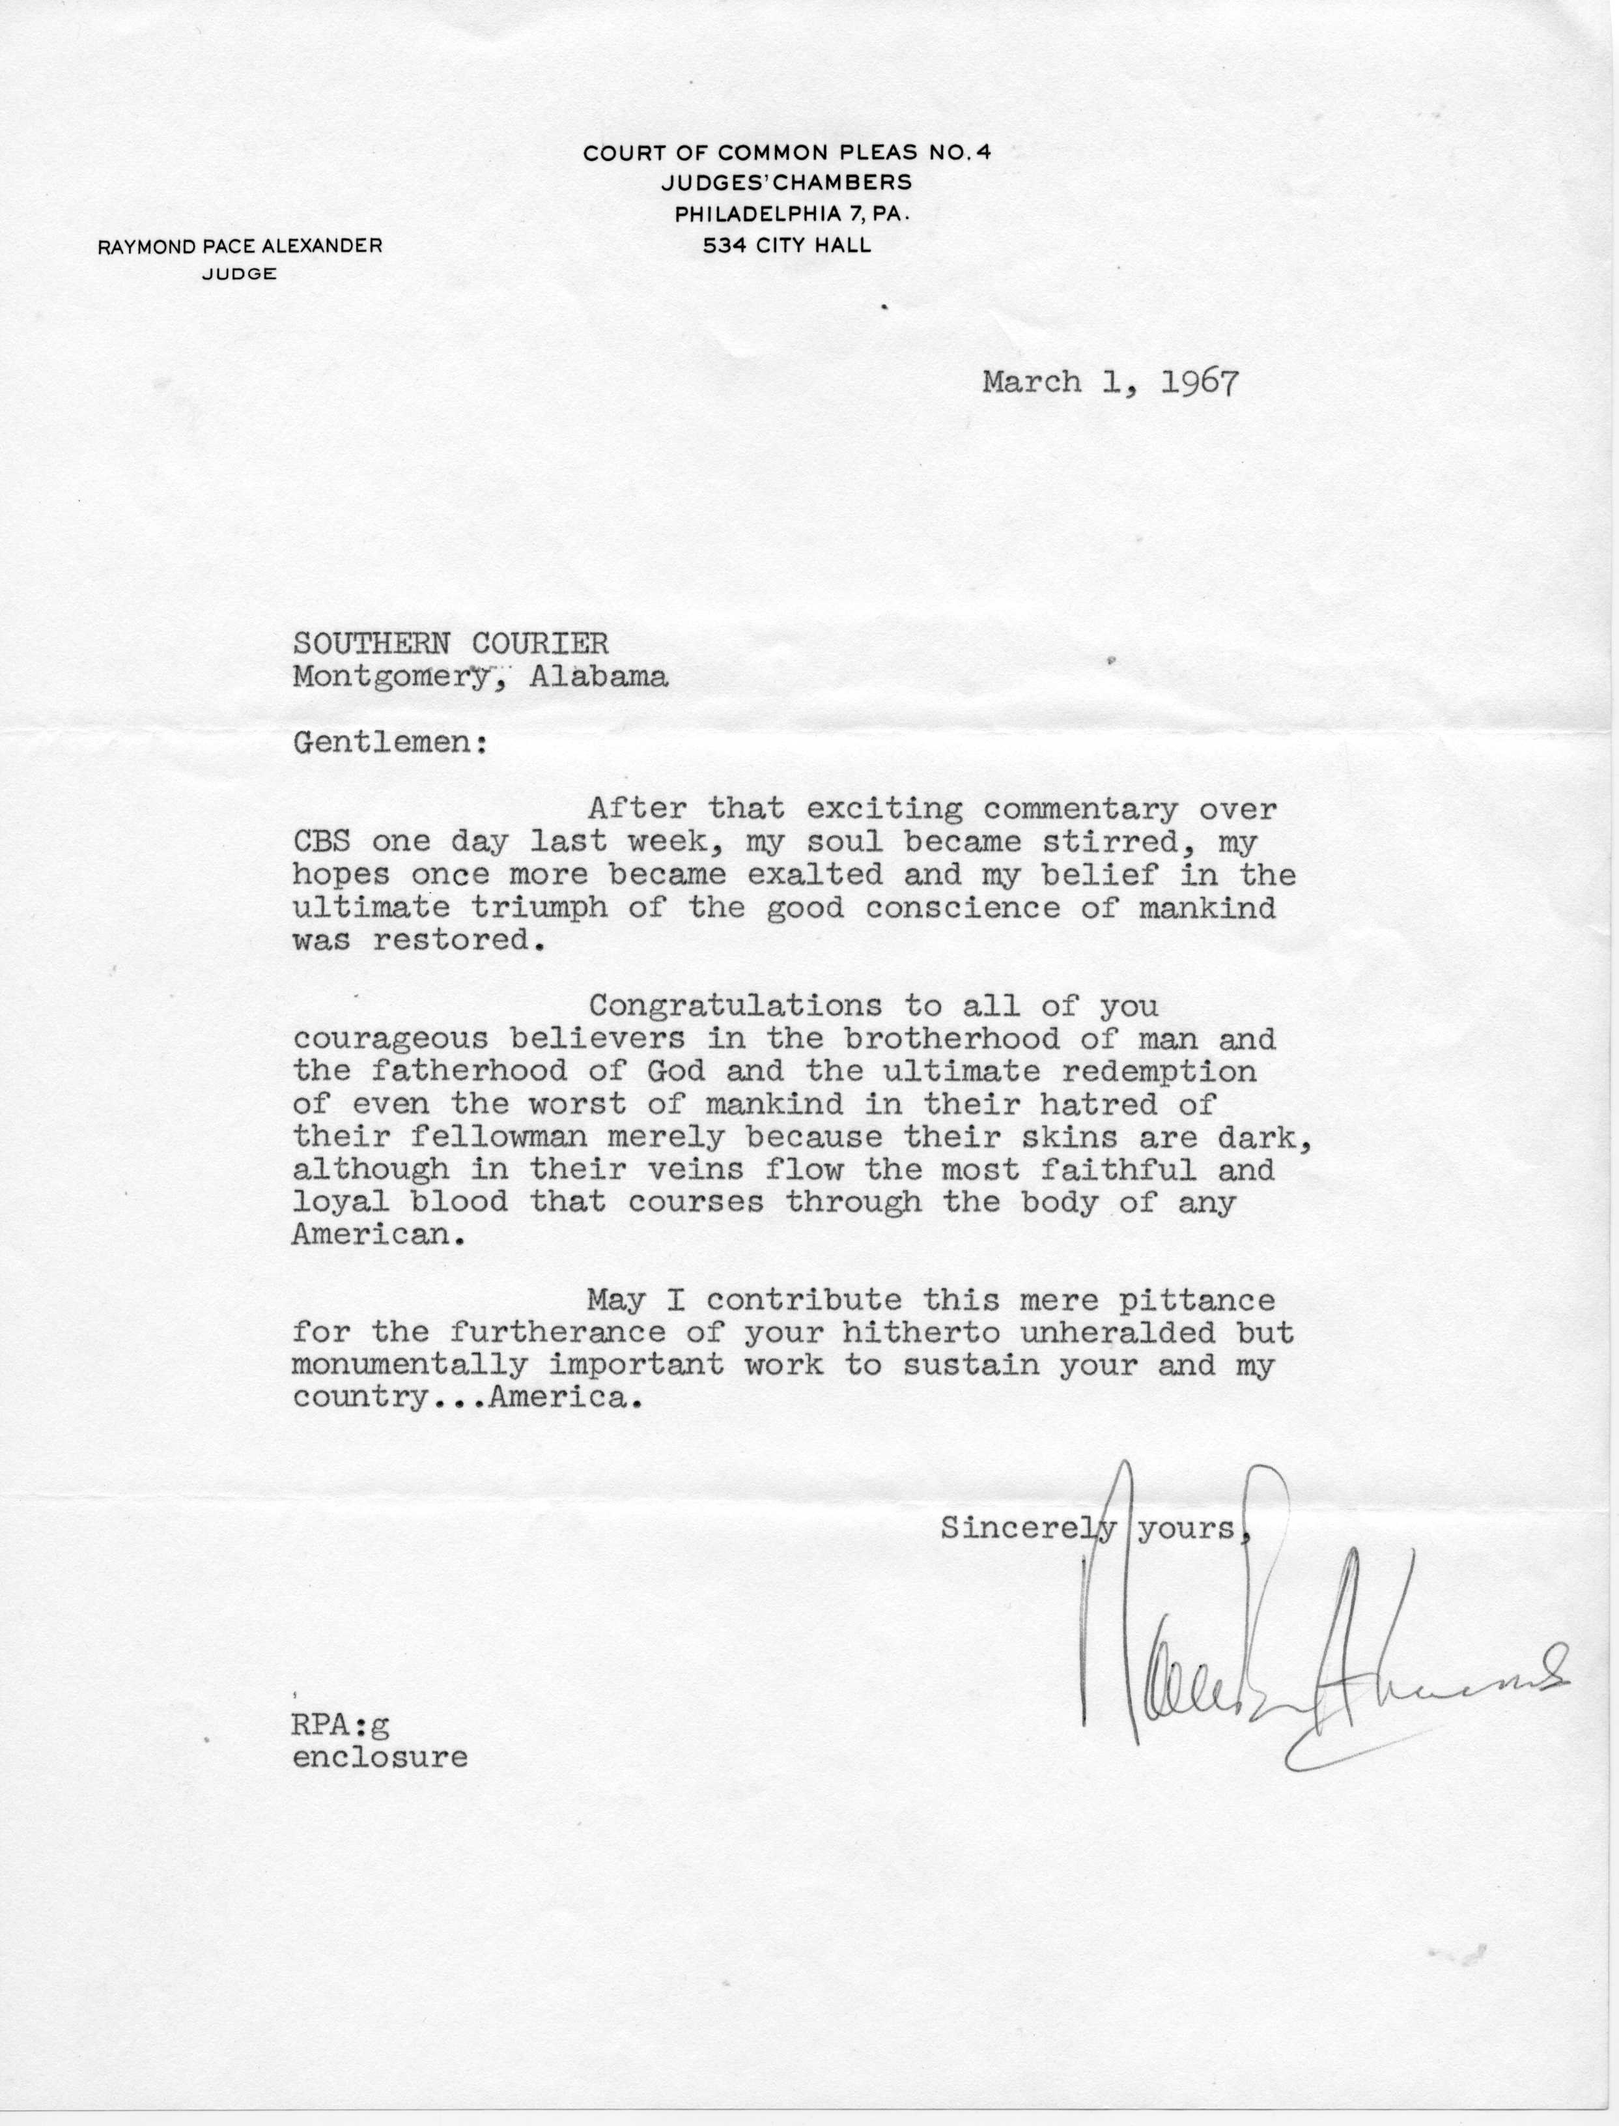
My Soul Became Stirred….
Letter Addressed to the Courier
“…my hopes once more became exalted and my belief in the ultimate triumph of the good conscience of mankind was restored.”

Slide 20
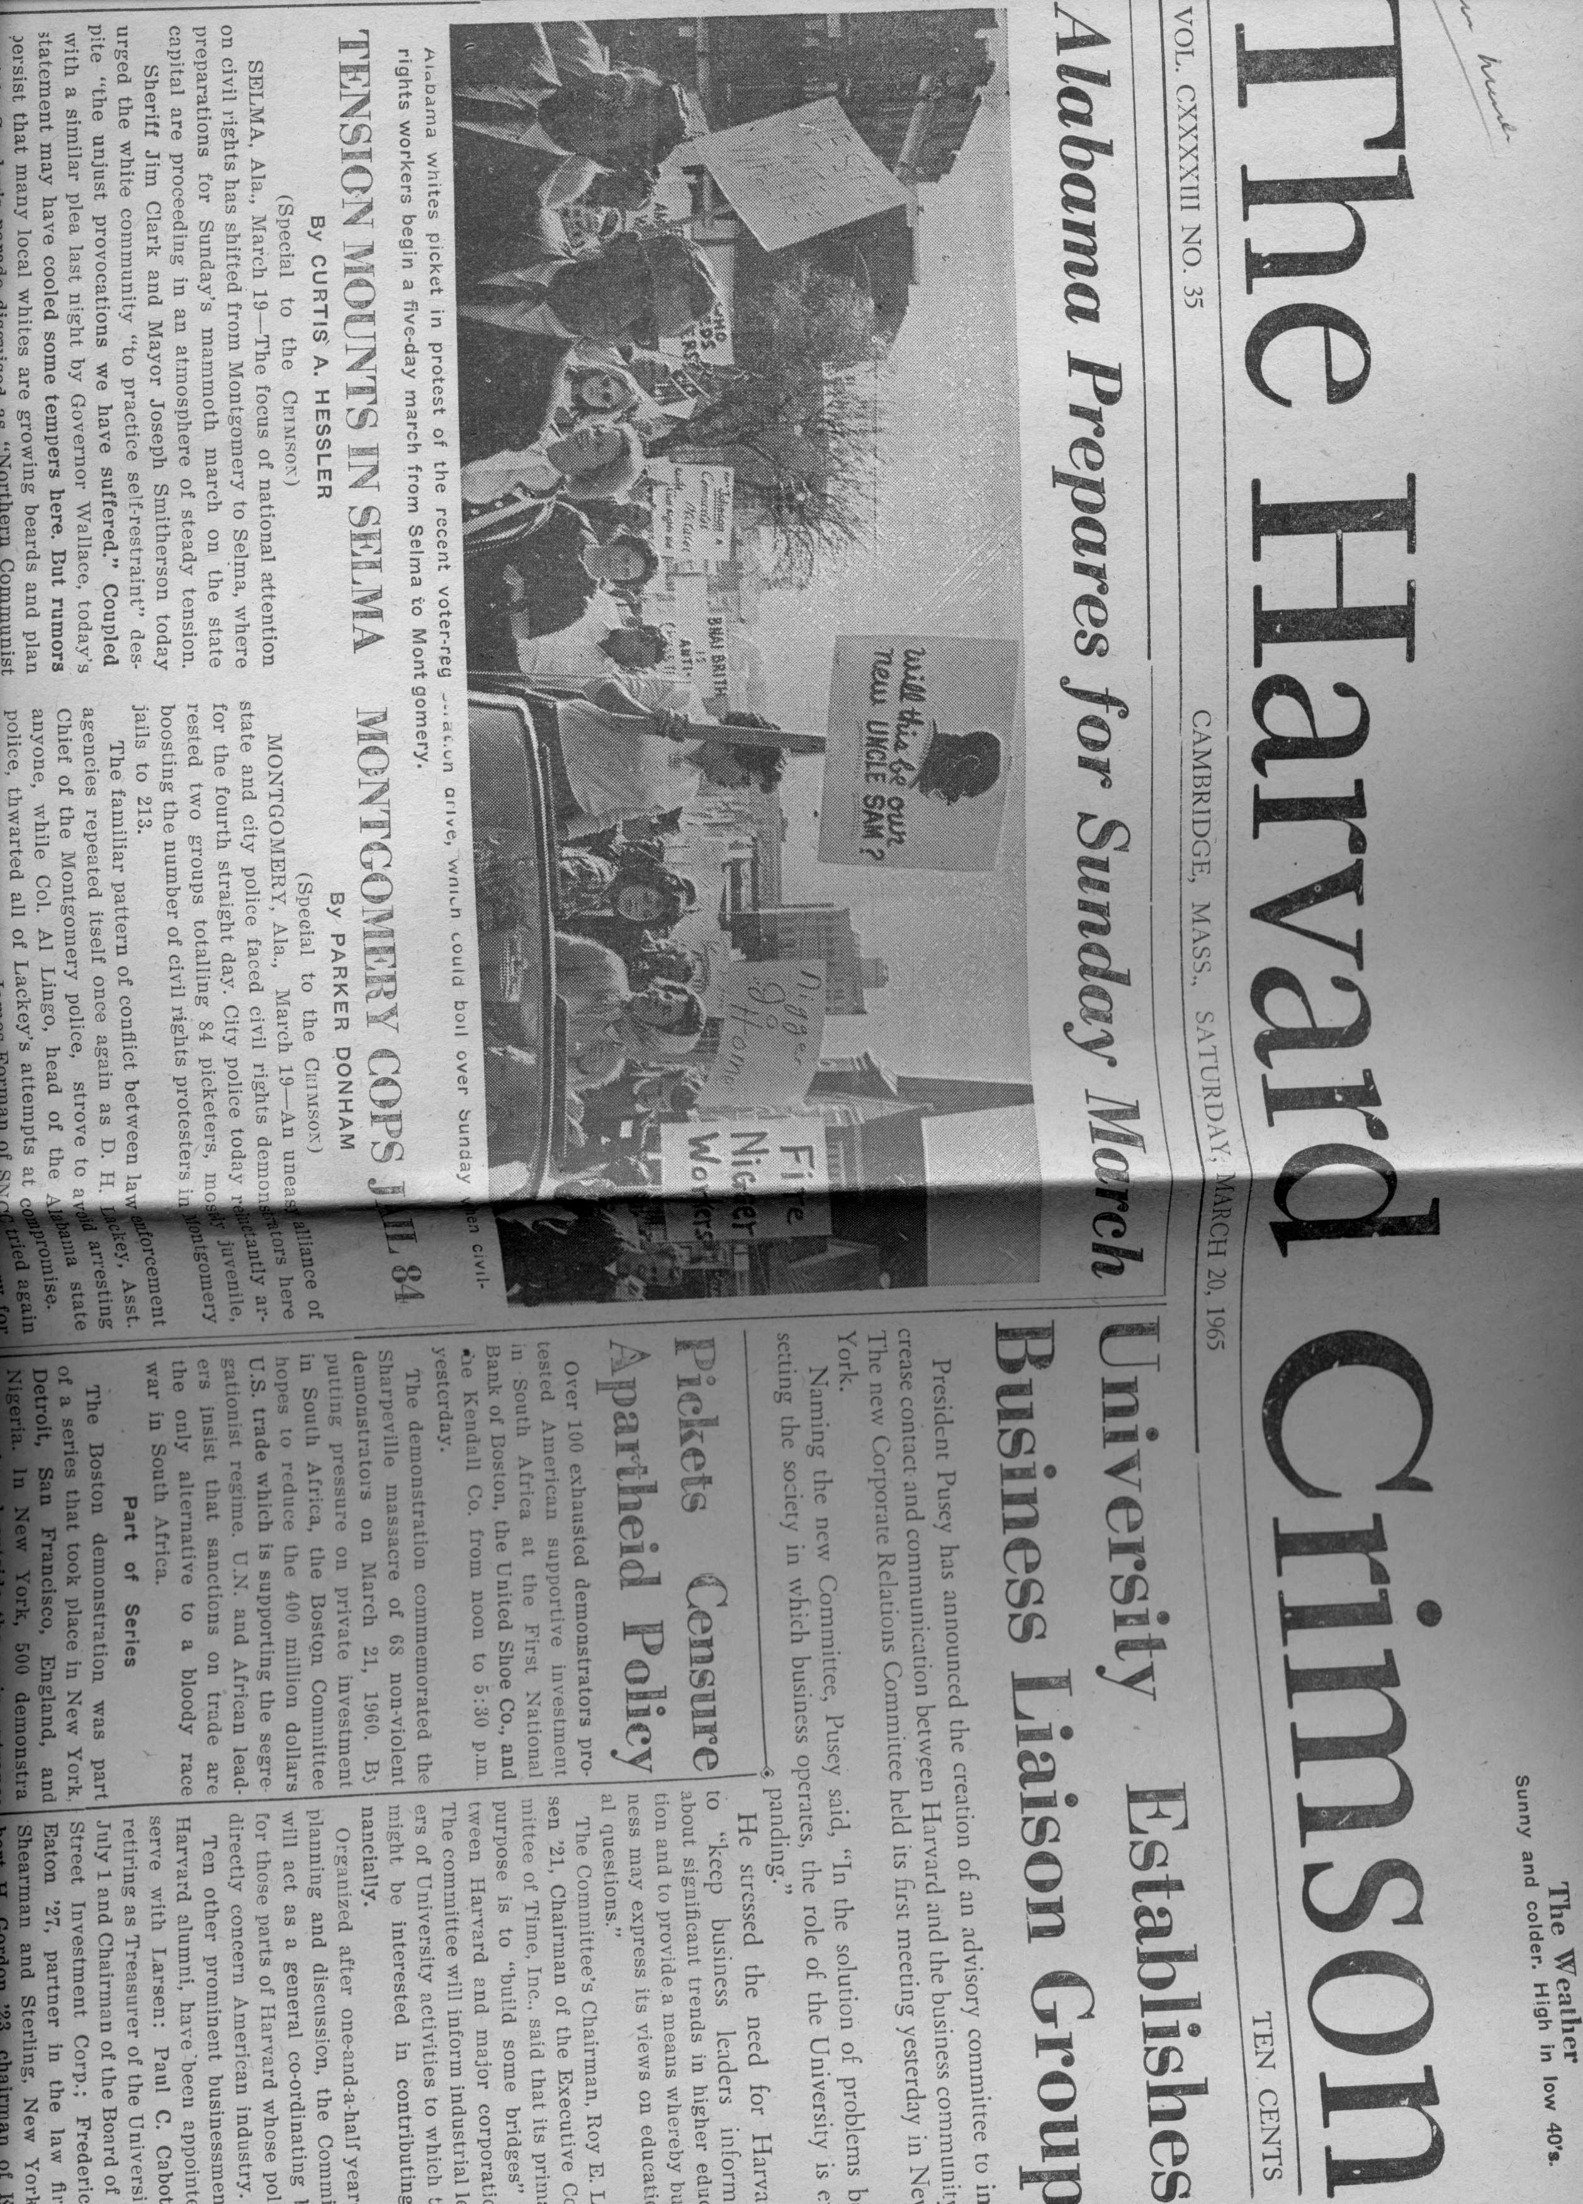
News Traveled Beyond the Confines of the State of Alabama
The events during the Civil Rights era were reported in The Harvard Crimson as well as other newspaper publications, thanks to the reporters of the Southern Courier.

Slide 21
The End
After three tumultuous years, The Southern Courier came to an end in December 1968 due to funding shortfalls
Many of the staff had continued to work, until the last paper was printed, with little or no financial assistance
The paper’s influence led to many localized newsletters, thereby assisting in a grass roots campaign for racial equality

Slide 22
The Courier Affects Alabamians…
“I was stunned…
…minimal effect on Washington
…minimal effect on Alabama Statehouse
One of the best %$#$%# things that ever happened to Alabama and you can be proud that you did something worthwhile…
I wish I could say the same.”

Slide 23
The Collection: Southern Courier
Scope and Content
The collection consists of documents generated or received by The Southern Courier, 1965-1969. The bulk of the records date between 1965 and 1968; with some dated as late as 1969.
They include correspondence, newspaper clippings, articles, pamphlets and other miscellaneous documents.
The records are potentially valuable to those interested in researching a history of sociological thought regarding the lives of rural Southern poor and African Americans, Democratic thought and the history of the Civil Rights Movement.

Slide 24
The Collection: Southern Courier
Arrangement
The documents are artificially arranged in four series as the Records of The Southern Courier. The boxes are organized by subject and in the assumed original order. Contents include receipts, articles, newspaper clippings, posters, correspondence, and official reports. All contents are available for use.
Series I: The Southern Courier’s records of day to day operations. Includes receipts, correspondence, manuals, telegrams, order forms, index cards with addresses and photos/negatives used in the paper. 1965-1969.
Series II: Information, correspondence, articles, etc. regarding race relations in the state of Alabama.
Series III: Information, correspondence, articles, etc. regarding race relations in the state of Mississippi and other Southern states.
Series IV: General information, correspondence, articles, etc. regarding race relations throughout the nation and world.

Slide 25
The Collection: What We Gain From It
Many emotions
Insight into the story behind the stories
Understanding their accomplishments under duress
Elation over their commitment and successes
Disappointment over their treatment
Sadness that the paper ended so quickly

Slide 26
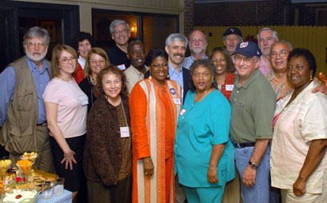
Remembering
2006
The Southern Courier Reunion
Montgomery, Alabama
Courtesy of The Southern Courier, 2006 Jim Peppler, http://www.southerncourier.org/

Slide 27
The Collection: Southern Courier
Links
http://192.203.127.197/archive/
Tuskegee University Archives
http://216.226.178.196/cdm4/peppler.php
The Jim Peppler Southern Courier Photograph Collection at the
Alabama Department of Archives and History
http://www.southerncourier.org/
The Southern Courier

